Slide 1




PBC Toolkit Training for Core Implementation Teams
MOMENTUM Integrated Health Resilience
PBC Roadmap: Unpacking the Diagnostic and Programmatic Tools for Effective Implementation
Adapted and expanded from Breakthrough ACTION’s
Provider Behavior Change Toolkit
April 2024
Notes:
This roadmap was developed to help guide implementing partners on the linkages between the diagnostic (data gathering) and programmatic (planning) phases of the Provider Behavior Change (PBC) Toolkit. It helps unpack the flow of the data gathered into using the data for decision-making and implementing and monitoring the action plan (with specifics on who, how, when, to roll out the actions), which is the outcome of the process.

Slide 2
Core Principles
The keystone of this toolkit is empathy; providers are real people whose behavior is influenced by diverse factors
Placing empathy at the center of this toolkit process enables users to see how providers experience the world around them and generate solutions that are sensitive to their needs, desires, and realities
Providers should be seen as part of the solution
This toolkit allows for reflection of current behavioral and non-behavioral norms and practices among providers and their peers, and to support positive norms and practices, while taking steps to address negative or biases norms and practices using a participatory and inclusive approach

Slide 3
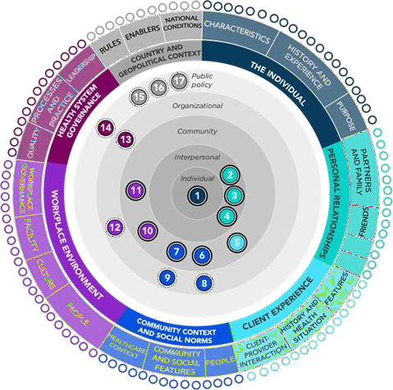
Why a PBC Roadmap?
Allows for unpacking the PBC Toolkit to put concepts into practice more easily
Helps to understand the flow from diagnosis to programming, and the steps necessary for each activity along the way
Note: Most graphics used here are from the BA toolkit

Slide 4
Tools
-Core implementation team
-Focus Behaviors
-Schedules and Logistics
-Training
1. Prepare
-Provider Behavioral Blueprint
-District Health Officer Blueprint
-Client Scenario Tool
-Facility Observational Guide
2. Inquire
-Daily Synthesis Sheet
-Global Synthesis Sheet
3. Synthesize
-Ideation/ Brainstorming Tool
-Action Planning
4. Act
Notes:
These are the overall steps in the toolkit. We’ll roll them out one by one and show how they all fit together to develop an action plan.
We will discuss in detail the preparation phase, including focus behaviors and logistics (you’re in the training!), AFTER we walk through the roadmap. We will do this because it is very important to understand how the diagnostic tools help us move forward into finding solutions and action planning.

Slide 5
Preparation is Key
1. PREPARE
Stakeholder sensitization and buy-in at national and sub-national levels
Identify/prioritize initial behaviors and sub-behaviors
Assemble the Core Implementation Team (CIT) and assign roles
Arrange logistics, train CIT, and choose participants for diagnostic phase
Notes:
Preparation happens before the diagnostic and planning sections. It is key to ensuring that the activity will go smoothly.
When choosing the Core Implementation Team (CIT), ensure that they have enough experience in the subject matter and the time to devote to being a CIT member
Key members of CIT should include those with experience in 1) Qualitative research; 2) Service delivery; 3) Social and Behavior Change; 4) Peer provider (active and engaged facility provider); 5) Gender/Gender-Based Violence; 5) community engagement/leadership.
Team members of the CIT could include service delivery and SBC; implementing partners; and local medical experts or consultants, who serve as trainers and national, regional, and district staff; Researchers or research consultants; Providers; Facility managers; Ministry of Health staff (national or sub-national)
Ensure that the Facility In-Charge agrees with the chosen peer provider(s) so they will not introduce bias into the CIT
Include a community leader, who will represent community voices in line with social accountability approaches of trust and two-way dialogue between providers and clients/community members.
Make sure each member of the CIT knows their specific role, including leading the synthesis process, brainstorming, action planning, liaising with the Ministry of Health, arranging travel and other logistics, procuring supplies, and documenting the process (with pictures, get signed consent!)

Slide 6
Review Materials
1. PREPARE
Review secondary data to identify/prioritize initial behaviors and sub-behaviors
  Examples: Health facility assessments, exit interviews, Knowledge, Attitude, and Practice surveys, etc.
  Criteria for selection *may* include (non-exhaustive):
    Behaviors that offer the greatest room for improvement or have the most significant influence on health outcomes;
    Persistent performance gaps that cannot be attributed simply to lack of commodities, as evidenced by routine data sources;
    Specific behavioral areas suggested during expert consultations or key informant interviews;
    Programmatic priorities of stakeholders; and the scope and expertise of the team.
Notes:
By prioritizing initial behaviors and sub-behaviors, this can be beneficial in guiding the CIT through the diagnostic and planning phases, with key behaviors that are related to that facility.

Slide 7
Go to the Worksheets
1. PREPARE
Notes:
Once you have a sense of providers’ behavioral challenges and opportunities, you can use the Behavior Mapping Worksheet provided in the toolkit as a handout to identify potential key behaviors and related sub-behaviors.
In fragile settings, also consider biased behaviors about GBV survivors and discriminatory practices with GBV survivors of specific age, ethnicity, or gender.
All handouts will be provided during the training and for use with the CITs.

Slide 8
Review Logistics and Training
1. PREPARE
Logistics and Pre-testing/adaptation
Arrange locations where activities will take place with facility in-charge or another designee
Schedule/confirm interviews
Get all supplies (e.g., cards, toolkit printed, consent forms, pens, markers)
Train your CIT team! Train trainers!
Ideally at least 3 days
Role plays, opportunity to reflect and adjust as needed during training
Practice, practice, practice!
Consider adding values clarification exercise for a gender lens
Pre-testing and adaptation will ensure that the tools are technically, culturally, and socially appropriate
Notes:
Providers can be in private room in facility or rented hall.
District/County Health officers can be in district offices, rented hall, or facility.
Clients can be in community meeting space, private space in facility, or rented hall.
Facility = at facility!
Daily/global synthesis can be hotel room, partner offices, or rented hall.
Ideation can be facility or rented hall.
Action planning can be rented hall or facility

Slide 9
Determine the Participants
1. PREPARE
Select participants for qualitative data collection, including participating facilities, providers, clients, and district staff
These are the recommended number and composition of participants for each stage
Develop a schedule for diagnosis/data collection, daily and global syntheses, action planning and ideation, and arrange locations and logistics
Ethical review is recommended if results will be broadly disseminated, published, or presented, especially if vulnerable groups are involved
Notes:
Once facilities have been selected, the CIT selects the specific providers, clients associated with the facility or catchment area, and district staff who will participate in the process.
Ultimately, the number and types of participants will be based on local realities and resources available. These are examples to guide you.
Participating providers should provide FP services (or other services, depending on your program) and be directly responsible for practicing the focus behaviors. Providers may be nurses, doctors, midwives, or social workers. Consider providers’ sex, age, years of experience, and cadre to ensure a mixture of representation.
District officers who are responsible for overseeing or supporting FP services. At least one FP focal person should be included, and other district health team members are also welcome.
Selected clients should have interacted recently with a provider for FP services (or other services, depending on your program). For FP, consider whether clients currently use FP, are interested in using FP, or have discontinued FP.

Slide 10
Unpacking the Flow!

Slide 11
Tools: Recap
-Core implementation team
-Focus Behaviors
-Schedules and Logistics
-Training
1. Prepare
-Provider Behavioral Blueprint
-District Health Officer Blueprint
-Client Scenario Tool
-Facility Observational Guide
2. Inquire
-Daily Synthesis Sheet
-Global Synthesis Sheet
3. Synthesize
-Ideation/ Brainstorming Tool
-Action Planning
4. Act
Notes:
These are the overall steps in the toolkit. We’ll roll them out one by one and show how they all fit together to develop an action plan.
We will discuss in detail the preparation phase, including focus behaviors, logistics (you’re in the training!), AFTER we walk through the roadmap. We will do this because it is very important to understand how the diagnostic tools help us move forward into finding solutions and action planning.

Slide 12

Overall Flow
#5: Solution Prioritization
#6 Action Planning
How Might We?
PLANNING
Ideas on wall
Inspiration Cards
#4: Brainstorming Ideation
How Might We?
X4
Influencing Factor Cards
X4
DIAGNOSIS
X4
#3: Global Synthesis
#2: Daily Synthesis
#1: Data Collection
X1
Notes:
This looks quite complex – but we will unpack the different phases from diagnosis to planning and then revisit to see how it all fits together.
Take note of the DIAGNOSIS vs. PLANNING phases – that is how the flow will be presented.
DIAGNOSIS (DATA COLLECTION) NEEDS TO BE COMPLETELY FINISHED BEFORE PLANNING STARTS!

Slide 13
Overall Flow
How Might We?
#4: Brainstorming Ideation
#5: Solution Prioritization
#6 Action Planning
PLANNING
Inspiration Cards
How Might We?
#2: Daily Synthesis
#3: Global Synthesis
DIAGNOSIS
#1 Data Collection
#2: Daily Synthesis
Influencing Factor Cards
Notes:
Here is a simplified version – now let’s start unpacking!

Slide 14
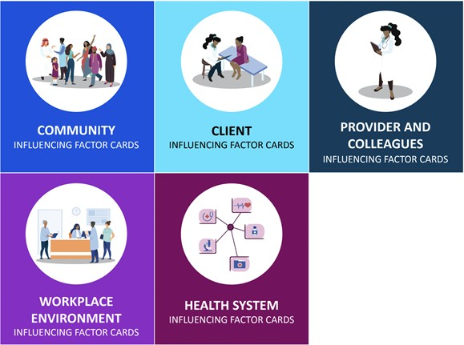
Influencing Factor Cards
2. INQUIRE
Potential provider behavioral
influences from five categories:
  Community
  Client
  Provider and Colleagues
  Workplace Environment
  Health System
Each category has a deck of cards
Each card has the name of an influencing factor with the definition on the back
DIAGNOSIS
Notes:
These need to be printed and assembled for use. Ideally in plastic for protection, but if limited hard cardboard would be good also.

Slide 15



Influencing Factor Cards
2. INQUIRE
Category Header Card TOP OF DECK
Influence Factor Name FRONT OF CARD
Influence Factor Definition BACK OF CARD
DIAGNOSIS

Slide 16
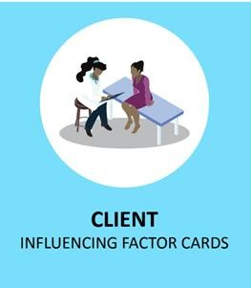
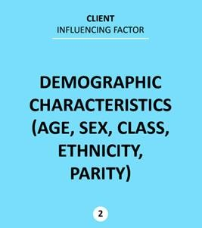
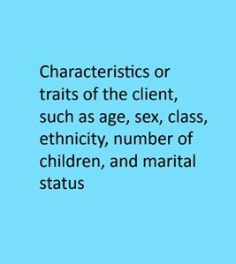
Influencing Factor Cards
2. INQUIRE
Category Header Card TOP OF DECK
Influence Factor Name FRONT OF CARD
Influence Factor Definition BACK OF CARD
DIAGNOSIS

Slide 17


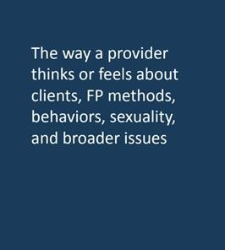
Influencing Factor Cards
2. INQUIRE
Category Header Card TOP OF DECK
Influence Factor Name FRONT OF CARD
Influence Factor Definition BACK OF CARD
DIAGNOSIS

Slide 18


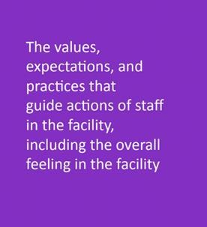
Influencing Factor Cards
2. INQUIRE
Category Header Card TOP OF DECK
Influence Factor Name FRONT OF CARD
Influence Factor Definition BACK OF CARD
DIAGNOSIS

Slide 19
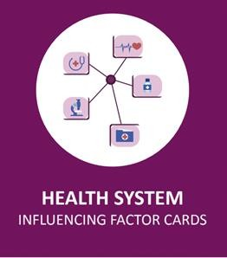

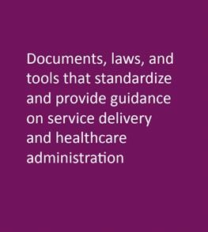
Influencing Factor Cards
2. INQUIRE
Category Header Card TOP OF DECK
Influence Factor Name FRONT OF CARD
Influence Factor Definition BACK OF CARD
DIAGNOSIS

Slide 20
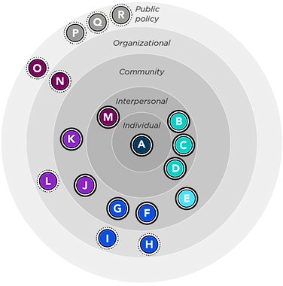
Group Work: How Does the Ecosystem Affect Providers?
Choose target provider behavior, e.g.:
  Postpartum family planning
  Antenatal care
Explore Provider Behavior Ecosystem Map
  Familiarize yourself with the key actors and entities
Notes:
Two groups. Choose provider, and target provider behavior. Split up cards and choose one randomly from each of the five decks. Discuss how each of these factors influences the provider’s decision tree – write out different scenarios, positive and not so positive!

Slide 21
Discussion
What surprised you the least? Why?
What surprised you the most? Why?

Slide 22
Influencing Factor Cards: Adaptations for Fragile Settings
2. INQUIRE
DIAGNOSIS
Notes:
During orientation to the PBC toolkit, these are additional cards that were discussed in Sudan and South Sudan that apply to fragile settings.

Slide 23
Influencing Factor Cards: Adaptations for Fragile Settings
2. INQUIRE
DIAGNOSIS
Notes:
These are additional cards that were discussed in Sudan and South Sudan during orientation to the PBC toolkit that apply to fragile settings.

Slide 24
Discussion
Do all these adaptations apply to your setting?
What are we missing?

Slide 25
Data Collection
2. INQUIRE
Data collection is important because it:
Helps to truly understand what shapes behavior
Includes providers, clients, and other stakeholders for an inclusive approach
Improves empathy, ownership, and buy-in among participants
DIAGNOSIS
Notes:
In fragile settings, consider behaviors that may be more common than in stable environments, e.g., gender bias

Slide 26
Behavioral Blueprints
2. INQUIRE
Participants chooses ONE enabling influencing factor, and ONE preventing influencing actor
Behavioral blueprints are diagrams that help the participants consider the impact of different influencing factors (e.g., community, clients, providers, colleagues, workplace environments, and health systems) on provider behavior.
Participants (1): Key health officers (e.g., from the district health management teams) to understand their support and what they see as influencers of provider behavior, enabling and preventing
Participants (2): Health providers discussing their perspectives on the behaviors of interest and identifying the enabling and preventing factors that influence these behaviors
Influencing Factor Cards are used to facilitate the discussion
DIAGNOSIS
Notes:
Additional influencing factors to consider to add to the deck in fragile settings:
Conflict and insecurity (e.g., attacks and pillage of health centers)
Climate shocks and stressors, like flooding, drought, heatwaves
Economic crises and food insecurity
Staff renumeration and welfare

Slide 27
Observation Guide for Guided Visit
2. INQUIRE
Helps provide an overview of the workplace environment (e.g., interpersonal dynamics, services, Supplies and consumables, facility structure, staff residence) that influences provider behavior
It is helpful to check in with the M&E team to see what data in the Guide have already been collected, for example, through a Health Facility Assessment (HFA), Services Provision Assessment (SPA), or other assessments
Review outstanding questions to be answered and coordinate with the facility in-charge or other designee
Ensure the guide captures elements common to fragile settings and adapt accordingly, e.g., are private rooms available for GBV cases? Is there a referral system in place for GBV cases? Are youth (boys, girls) treated differently? What about ethnic minorities or vulnerable groups?
Taking pictures is very useful! With consent.
DIAGNOSIS
Notes:
The Observation Guide takes a member of the CIT through a facility tour, guided by the facility or department in-charge. A CIT member interviews the in-charge while observing the activities and environment. Areas examined include the layout and client flow, staffing and hours, service provision process, behaviors of interest, and documentation.
Is there a referral system in place for GBV cases? Are youth (boys, girls) treated differently? What about ethnic minorities or vulnerable groups? In fragile settings, in step one, when asking general conditions of the facility, probe for the conditions for the safety of staff and patients under different crises scenarios.

Slide 28
Observation Guide for Guided Visit
2. INQUIRE
Six steps; can be condensed based on the information already available
Remember – adaptation is ok! And encouraged to fit the context and culture!
Especially in fragile settings!
DIAGNOSIS
Notes:
In fragile settings, in step one, when asking general conditions of the facility, probe for the conditions for the safety of staff and patients under different crises scenarios.
In fragile settings, in step five, when asking about the facility’s performance in the region, probe if the situation would be the same under an acute crisis.

Slide 29
Client Visual Scenarios
2. INQUIRE
The Client Visual Scenarios tool lets clients review images that represent service provision, followed by a CIT member talking through how each image compares to 1) their recent service delivery experiences, 2) their perceptions of service experiences or provider behaviors, and 3) their motivations for seeking the health service
Participants: 3-4 clients using health services that meet selection criteria
Scenarios may include health literacy, norms, and misconceptions, and may be developed for the local context based on the behavioral mapping exercise
Local pictures for scenarios are key!
DIAGNOSIS
Notes:
Selected clients should have interacted recently with a provider for FP services. Also, consider whether clients currently use FP, are interested in using FP, or have discontinued FP (or the services that the project is focusing on).
For fragile settings, consider scenarios that focus on gender norms and harmful practices, that impact the clients and health providers’ behaviors.
Also, consider young women looking for FP support during times of recurring stresses, i.e., flooding, or shocks, and infectious disease outbreak (e.g., Ebola) and having to go through different providers and being turned down because of lack of providers/attending other priorities - or provider's fear of being infected.

Slide 30
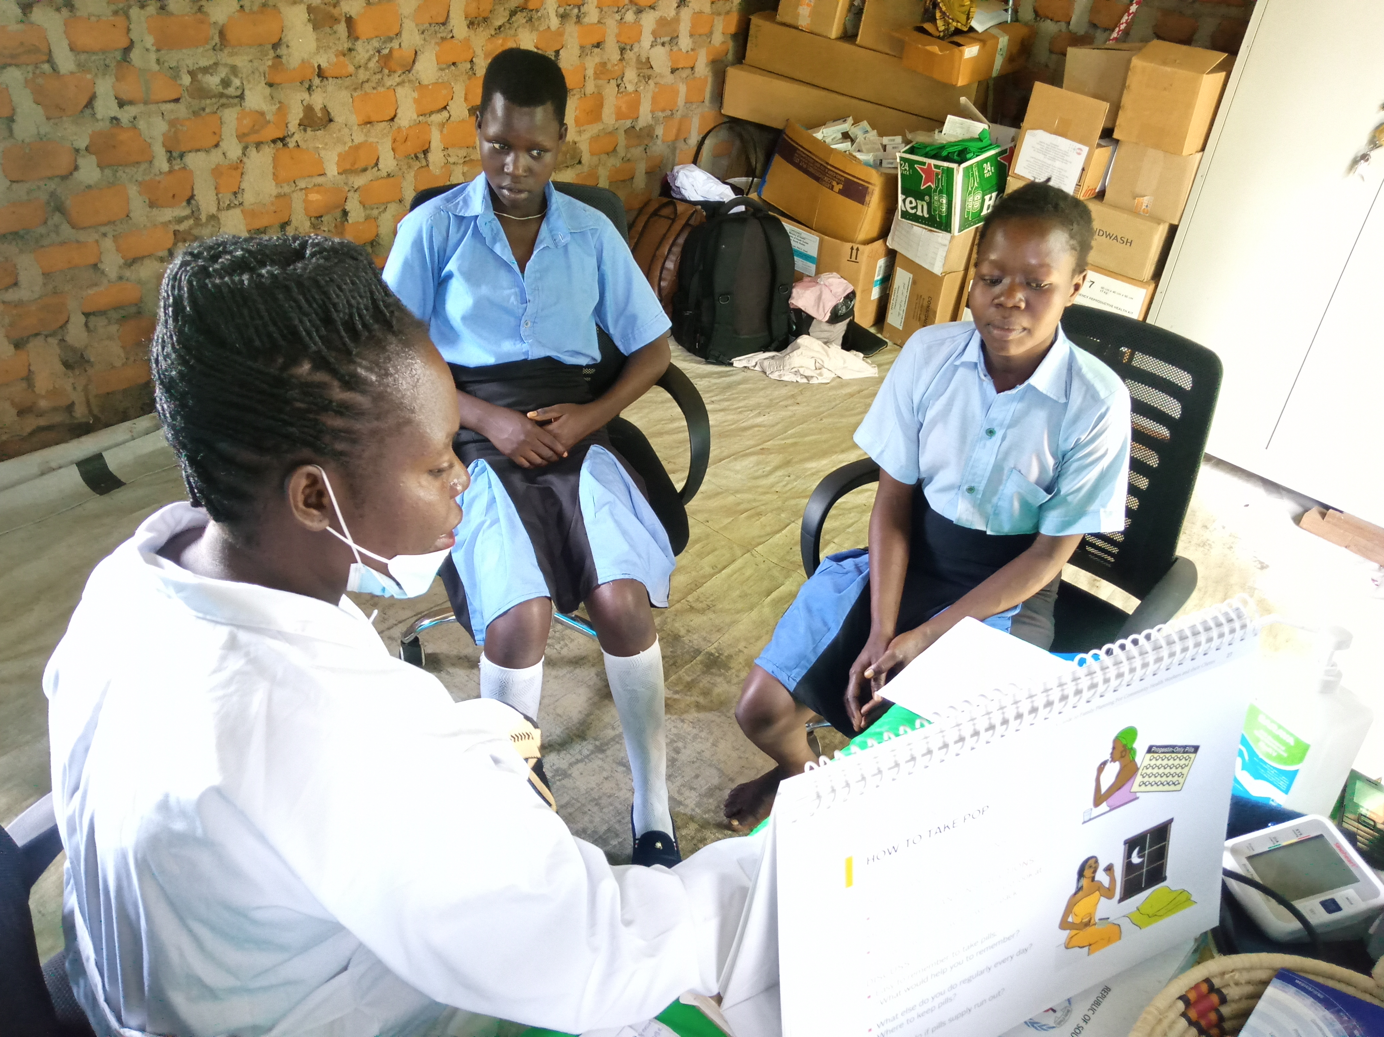
Example of Client Scenario Picture
2. INQUIRE
DIAGNOSIS

Slide 31
Daily Synthesis Tool
3. SYNTHESIZE
Pain points (challenges) and causes | What works well
Challenges, problems, needs identified that negatively influence factors identified? What causes the pain points (challenges)? | Among influencing factors, what IS working? Are there opportunities for further improvement?
  What did the CIT learn about factors influencing provider behavior today?
  Allows for reflection, summaries, vocalization of insights
DIAGNOSIS
  Among the influencing factors affecting the five categories in the system:
Notes:
Now that all the data are collected, designing an effective solution requires everyone to learn what does and does not work before ideation/brainstorming and action planning. The best way to do this is to synthesize learnings to understand the root causes of provider behavior.
The synthesis step visualizes the root causes of providers' behaviors in a multi-level approach, allowing the team to understand what triggers provider behaviors.
This activity allows the team to summarize findings from the diagnostic process daily and start to form key takeaways from the findings.

Slide 32
Daily Synthesis Tool
3. SYNTHESIZE
DIAGNOSIS
Notes:
The Daily Synthesis sheets support daily analysis of diagnostic findings and learnings. First, the tool allows the CIT to reflect on and summarize the factors participants mentioned as influences on provider behavior. Second, a Point of View exercise enables the CIT to articulate initial insights in preparation for the global synthesis.
If available, you can invite the Facility In-Charge to participate in the daily synthesis meeting should she/he wish to do so.
The goal of this daily synthesis sheet is for each team member to reflect on and summarize the learnings from the diagnostic process they conducted during the day.
Note: If you are still conducting diagnostic visits, the next step will consist of completing another Daily Synthesis Sheet afterward. If you have completed your last diagnostic process, the next step will be to complete the Global Synthesis Sheet with the rest of the CIT.

Slide 33
Global Synthesis Tool
3. SYNTHESIZE
Using daily synthesis sheets, prioritize top “three” influencing factors within each of the five categories in the system
DIAGNOSIS
Notes:
The Global Synthesis Sheet is designed to support the final analysis of the findings from the diagnostic process. It allows for final reflection and summarization of the influence factors, pain
points/challenges, and opportunities. It also helps the CIT frame these challenges and opportunities as questions to spark solution generation.
The template is divided into two sections:
Section 1 helps the CIT synthesize the main influencing factors for each category of the system (i.e., Client, Workplace Environment, Providers and Colleagues, Health System, and Community). It also helps synthesize the main pain points/challenges, causes, and successful elements at each level.
Section 2 helps turn each of the system’s main pain points/challenges and opportunities into a “How Might We?” question, which is essential to guide your thinking process for generating potential solutions.

Slide 34
“How might we” question unpacked
3. SYNTHESIZE
How might we… (action)
For… (target group)
In order to… (what is the change)
Improve respectful FP counseling
Youth clients
Increase use of quality FP counseling
How might we improve respectful FP counseling for youth clients in order to increase use of quality FP counseling?
DIAGNOSIS
Notes:
The “How Might We” question will be used during ideation/brainstorming to develop solutions to the questions developed for each category. You will have five questions.
These aspirational questions encourage innovative thinking around a challenge and suggest that solutions are possible.
Use the challenges/pain points for each category to determine the HMW question.

Slide 35
Ideation Part 1
4. ACT
  Uses “How Might We” exercise to determined what’s been done, why they were successful, or why they failed.
PLANNING
Notes:
The Ideation Tool allows the CIT to facilitate a brainstorming process with providers and community members to generate locally appropriate solutions for the prioritized influence factors.
The group reflects on what has already been done in their context, explores other solutions, brainstorms new ideas and prioritizes activities for implementation.
There are three parts to the ideation: 1) Discussing what has worked and not worked related to the “HMW” questions; 2) Brainstorming and “thinking big” using inspiration cards, sticky notes, and walls to produce realistic solutions to the HMW questions; and 3) Narrowing down the “big list” to two questions per category.
This step involves the CIT, providers, health officers, clients, and the Facility-In Charge, allowing for a participatory discussion, and the entire group can see how the diagnostics came together to start generating priority solutions focused on provider behavior in each of the five categories.

Slide 36
Brainstorming/Prioritizing Solutions
4. ACT
Ideas on wall
Samples of inspiration Cards
PLANNING
Notes:
This is the time when we start thinking “big” and gathering solutions to the HMW questions!
The CIT, providers, health officers, clients, and the Facility-In Charge use the ideation part 1 (what worked, what didn’t work) and the inspiration cards, which are solutions that have been tried globally and can serve as examples to use, or to spark additional solutions that the team wants to propose.
The group uses sticky notes to put their individual ideas up on a wall. After all ideas are put on the wall, begin discussing the proposed solutions, and cluster the solutions that are similar.
Once all the solutions are clustered, determine whether each proposed solution can be modified and realistically implemented in the context of the healthcare facility.

Slide 37
Ideation Part 2
4. ACT
What’s the low hanging fruit? Small doable actions?
What will take time and more effort, but needs to be done in the long term?
PLANNING
Notes:
With a shorter list of the solutions that can be modified, work together to reach consensus on which solutions are best fit to answer the HMW question for each category, and use the ideation part 2 to list them new or adapted solutions in the first column.
Together, review the solutions the team brainstormed and placed in the first column. Select one solution for each category that best answer the HMW question and that could be implemented now, with minimal effort. Place those solutions in column 2 (Horizon 1: Do Now, Low Effort).
As a group, select one solution for each category that best answer the HMW question and that could be implemented in the long run because they would require higher effort. Place those solutions in column 3 (Horizon 2: Do Next, High Effort).
After the actions are completed, the team can revisit ideation part 2 for new solutions to try. On to the action planning.

Slide 38
Action Planning
4. ACT
Review solutions from Ideation activity 1 & 2
Prioritize 3-5 actions to start, using Action Plan template
PLANNING
Notes:
This action plan helps the CIT to move forward with the most promising solutions (do now, low effort, do next, high effort) in each of the five categories developed and prioritized during this ideation session. The Action Plan Tool is a strategic template that helps the CIT plan for implementing the final solutions from the brainstorming process. The Facility In-Charge can also be part of this process.
In this step, the CIT creates an action plan for each proposed solution that describes their solution, who it is for, what resources and activities will be required, and how success will be monitored.
It will also include roles and responsibilities, and sources of data collection that link to indicators of success (you can use indicators from Breakthrough ACTION FP indicator bank)
https://breakthroughactionandresearch.org/social-and-behavior-change-indicator-bank-for-family-planning-and-service-delivery/
The team may choose to focus on a couple of solutions for the immediate future rather than creating action plans for every category. This should be determined by the CIT after considering the priorities of all stakeholders.

Slide 39
Overall Flow
#5: Solution Prioritization
#6 Action Planning
How Might We?
PLANNING
Ideas on wall
Inspiration Cards
#4: Brainstorming Ideation
How Might We?
X4
Influencing Factor Cards
X4
DIAGNOSIS
X4
#3: Global Synthesis
#2: Daily Synthesis
#1: Data Collection
X1
Notes:
And that is the process! Now that we have walked through each step, this roadmap should make more sense, from preparation, to collecting the data among clients, providers, health officers, and the facility, to synthesizing the data outputs daily and then merging all together to determine what are the key influencing factors that lead to the “How Might We” question, to be used in brainstorming/ideation.
Thinking big and then narrowing down allows for all possible solutions that may work to be considered before reaching consensus on the priority solutions and moving forward with the action plan.

Slide 40
Overall Flow
CIT, facility manager, clients, health officers, providers choose 1 solution per category
How Might We?
CIT, facility manager, clients, health officers, providers brainstorm what worked/didn’t work
#4: Brainstorming Ideation
#5: Solution Prioritization
#6 Action Planning
PLANNING
CIT finalizes action plan based on steps #1-5, can include the Facility In-Charge
Inspiration Cards
CIT, facility manager, clients, health officers, providers think BIG with post its!
How Might We?
#2: Daily Synthesis
#3: Global Synthesis
CIT summarizes findings from diagnostic process daily
DIAGNOSIS
#1 Data Collection
CIT reviews all data from diagnostic process, prioritizes influencing factors, reframe challenges as design questions (HMW??)
#2: Daily Synthesis
CIT interviews providers, health officers, clients
Influencing Factor Cards
Notes:
Here are examples of who should be involved in each step. It is vital to document the process of pre-testing, adaptation, implementation, and monitoring to understand what worked and what didn’t work and use adaptive management tools for continuous improvement (e.g., pause and reflect, most significant change, etc.).
Documentation also helps improve the process as you may scale up and can help the global community learn best practices and evidence that has shown to change providers’ behaviors through this process.

