Slide 1
Post Partum Haemorrhage
VOICES FROM THEIR EXPERIENCES
Angela Nguku
Founder & Executive Director
White Ribbon Alliance Kenya

Slide 2
The White Ribbon Alliance Kenya
(WRA Kenya)?
A women-led movement for reproductive maternal newborn and adolescent health and rights. Established as a loose network in 2009 and registered as a local organization in 2017, we work to directly influence Sustainable Development Goals (SDG) 3 ( promote good health and wellbeing) and 5 (Gender Equality) and indirectly and ultimately all the other SDGs.
WRA Kenya is a powerful network of advocates working for reproductive, maternal, newborn and adolescent health and rights. We mobilize communities, igniting their power and voice to demand for quality and equitable care and actively participate in decision-making processes that affect their lives and well being
We advocate for what women want by rooting our work in the self-articulated needs of women and girls, in all their diversity

Slide 3
Why do we exist?
On average -17 women and 50 babies die each day die from pregnancy and childbirth complications. This is approximately 6500 and 35000 newborns each year! Most of these deaths are preventable (KDHS 2023)
A baby is stillborn every 16 seconds. This is a silent area in most MNH conversations
The biggest killer of women during childbirth is Post Partum Hemorrhage
Communities have been passive recipients rather than active contributors to the MNH agenda
Data has been skewed on the numbers- Behind the numbers are the lived experiences and realities of women, girls, and the silent newborns
WRA Kenya focuses her efforts on Maternal and Newborn health, because research shows that when women are healthy, children, families, communities and countries thrive

Slide 4
How do we do It?
Through our network of champions and partners at all levels, WRA Kenya helps communities understand that they have the power to hold the system accountable for promises made and money spent. Period.
WRA Kenya’s champion networks are unique partnerships made up of citizens, health workers, policy makers, community-based organizations,, media and other players who best understand their county’s challenges and the most viable solutions.
WRA Kenya believes that community members are the “experts” regarding their own lives and experiences. Their opinions matter as much as any health provider, development agencies, or policymaker.

Slide 5
We have a unique approach. And it works
We’ve figured out how to cultivate meaningful relationships between decision makers, duty bearers and the communities (citizens) , building trust and accountability for long-term, citizen-led change. We call this the ASK-LISTEN-ACT Approach.
Ours is a mutual non antagonistic change model that works because both users and suppliers of care are all aligned in what they all want. The best health care outcomes!

Slide 6
Our approach is both simple and effective!
ASK
LISTEN
ACT
women what they want
to their concerns and ideas for change
with women and galvanize others to do the same

Slide 7
The foundation of our work

Slide 8
Objectives of the WWW campaign
Drive maximum visibility on the status of the poor quality, disrespectful and inequitable care for maternal health in Kenya
Educate and empower individuals about the importance of quality, equity and dignity in women’s and girls’ healthcare
Support women and girls to demand access to high-quality and dignified care
Place women’s and girls’ voice (self-articulated needs) at the centre of health policies, programs and accountability
Ultimately, it would help governments, health professionals, agencies, private providers and civil society organizations better understand what is most important to women and girls when it comes to their healthcare and to push for change within countries and communities.

Slide 9
WWW Focus
What Women Want was focused on the self-identified priorities of women and girls relative to quality maternal and reproductive healthcare.
In asking the open-ended question of “what is your one request for quality reproductive and maternal health services?”, we hoped to hear from women and girls in many different settings, including marginalized populations
A maternal newborn health Revolution

Slide 10
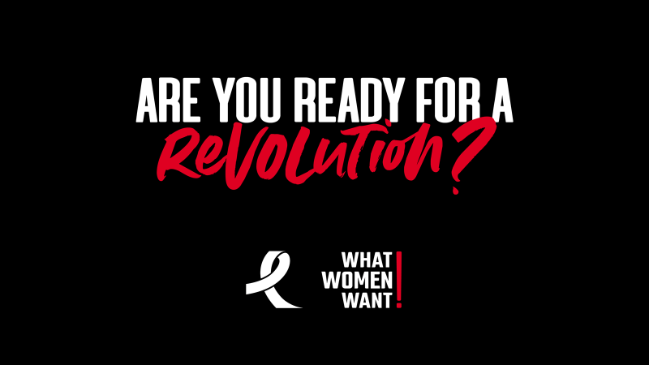

Slide 11
TELL US #WHATWOMENWANT
Notes:
COLOR LOGO WITH PHOTO EXAMPLE – REPLACE PHOTO WITH YOUR OWN BY RIGHT CLICKING ON IMAGE AND CHOOSING “CHANGE PHOTO”

Slide 12
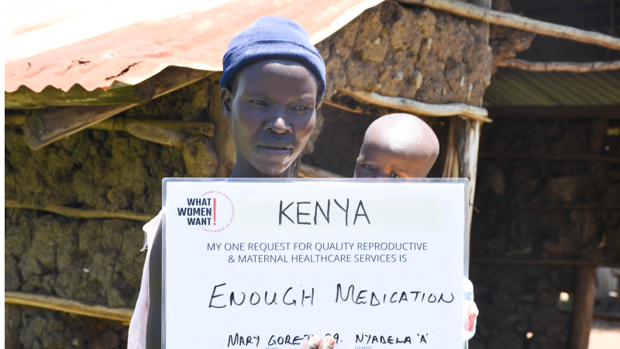

Slide 14
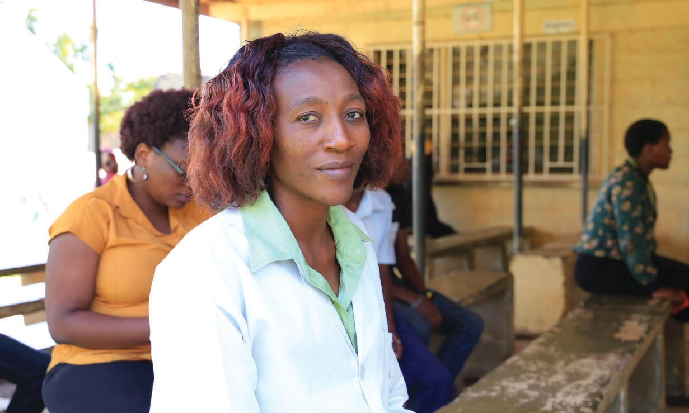
‘’We have lost many mothers to PPH. We lack proper basic equipment, and our pharmacy is not stocked with drugs for cases such as PPH or other complications that kill mothers. A proper equipped maternity ward is the most crucial need for this facility with well trained staff. In the meantime, an efﬁcient referral system will improve our services for us to be able to save mothers. ‘’
Facility Head- Local Health Centre, Nairobi ‘’
Facility Head ,Local Health Centre
Nairobi County

Slide 15
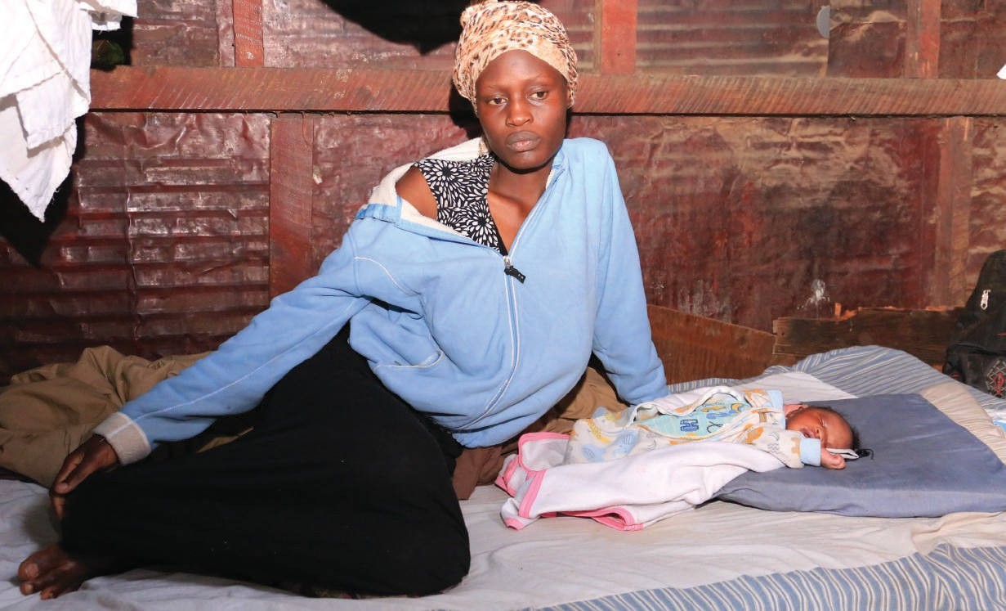
‘’I was not aware of PPH before I delivered this baby. No one told me about it. I had heard of the basics of pregnancy and thought after delivery that is all. I now know better. Every time I look at my baby, I imagine she would have been motherless by now. I wish young mothers can get the right information about pregnancy and childbirth. It is a matter of life and deaths. There is need for intensive awareness on PPH and its implications to young mothers. Knowledge will help save mothers and newborns’’
Evelyne,20-year - old mother,
Nairobi slums

Slide 16
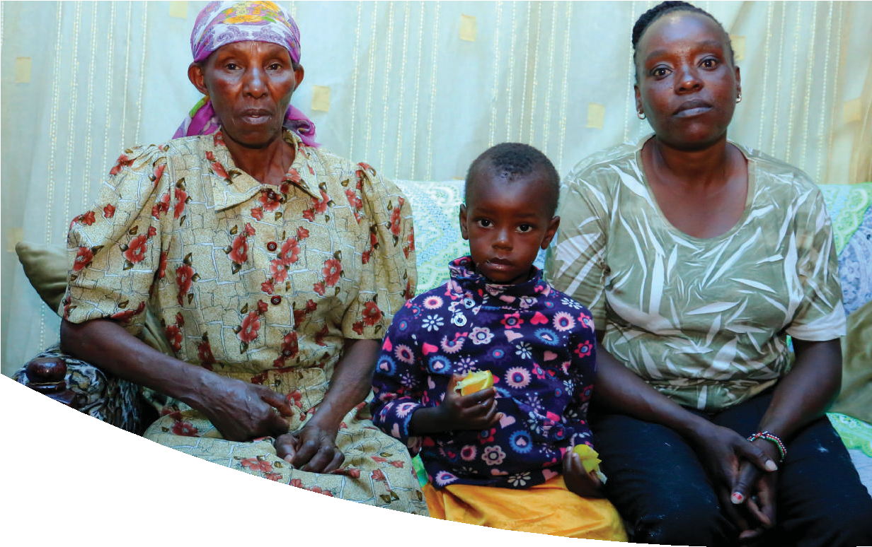
‘’This is my niece Amani and my mother. We are the only mother she knows. Her mother, my sister died from bleeding after delivery. She died in a local health facility. There was no blood bank and the staff told us that the drugs to stop bleeding were out of stock. The facility did not have a stand-by ambulance. It has been 3 years now. Our facilities really need to be ready to save mothers lives’’
Jackline, who lost her sister to PPH - Kiambu County

Slide 17
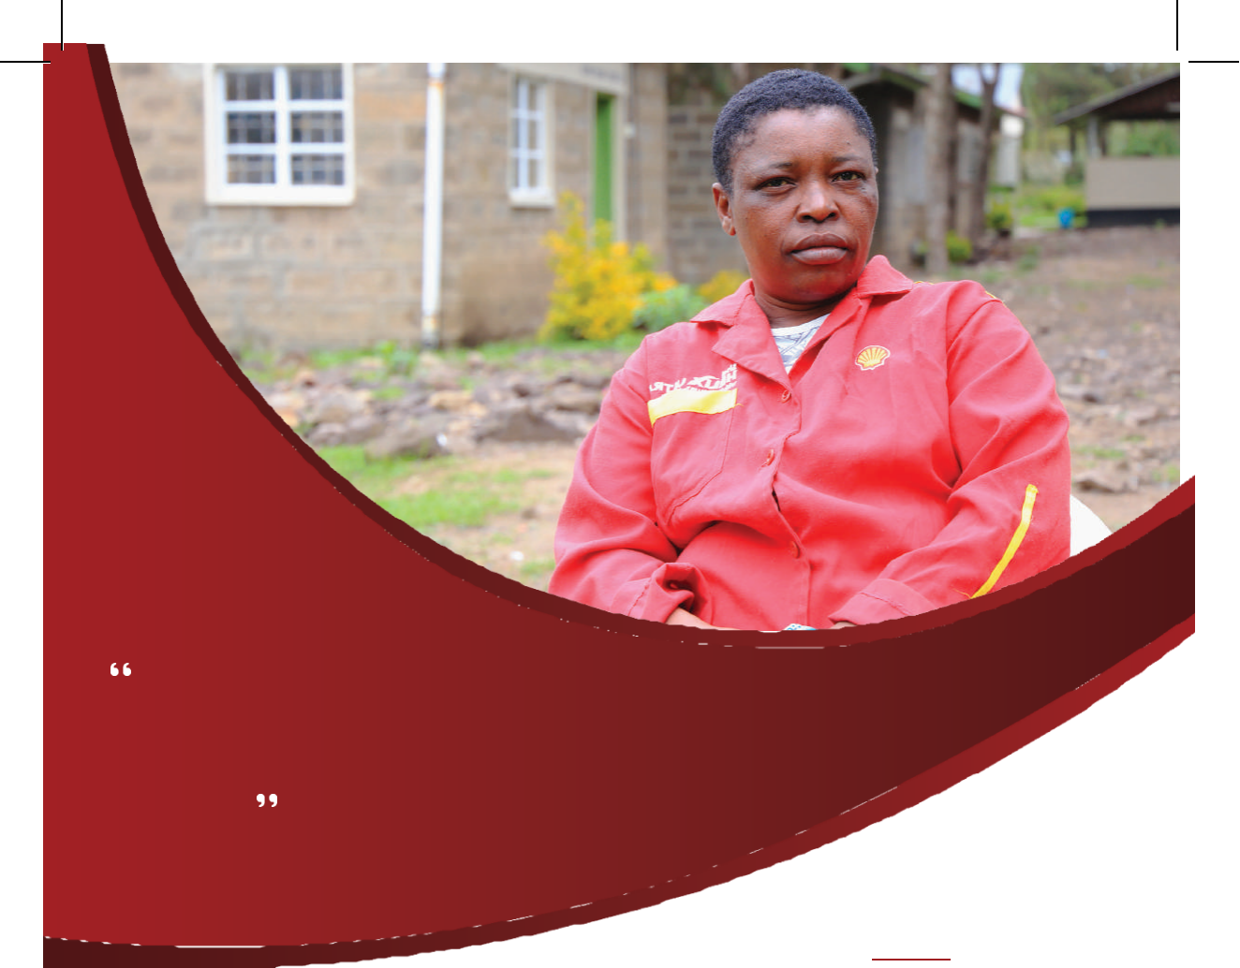
‘’I have witnessed many women in my neighborhood die of bleeding after delivery. I too would have been a statistic. I had a normal pregnancy and attended all my clinics. I delivered well in the local health facility. However, I recall bleeding too much. Thankfully, the staff were keen to note and referred me to the nearby higher facility. However, the ambulance did not have fuel. My husband managed to hire an ambulance, and this got me to the other side where I was attended to. I wish all our facilities had all it takes to save mothers lives but most importantly, I wish all mothers knew about its dangers ‘’
‘
Elizabeth, PPH survivor
Narok County

Slide 18
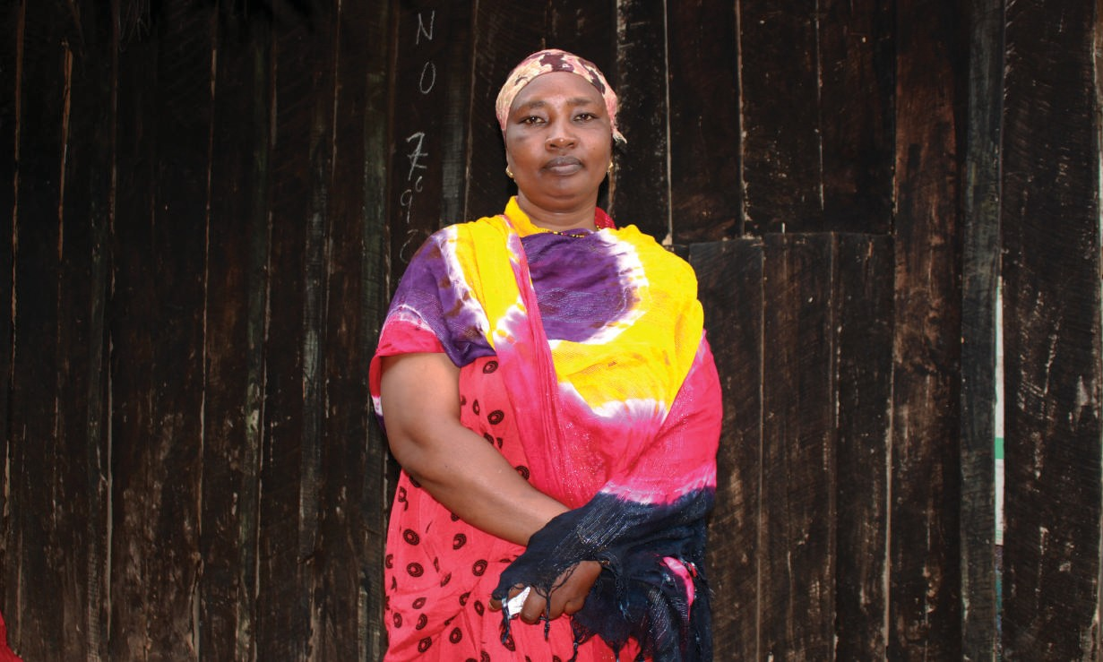
‘’ I am happy I survived to tell my story. I believe it is because i attended my antenatal care religiously and was able to be advised on delivering in a health facility. Being a community health worker helped me too. I delivered normally but I started bleeding almost immediately. The nurses knew me and had to rush to a nearby private facility to get a drug to stop the bleeding. The private facility had what was needed. I can only imagine if they did not have it. I was weak for long but today I am alive. As a CHV, I have seen many mothers die of bleeding. Something urgent must be done to save mothers. Investments in drugs and blood banks is a must’’
Zainab, PPH survivor
Isiolo County

Slide 19
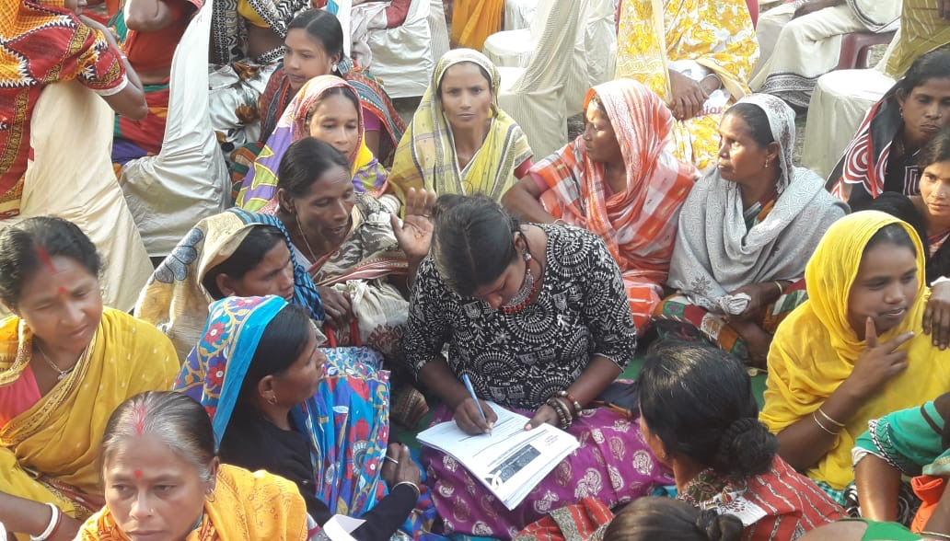
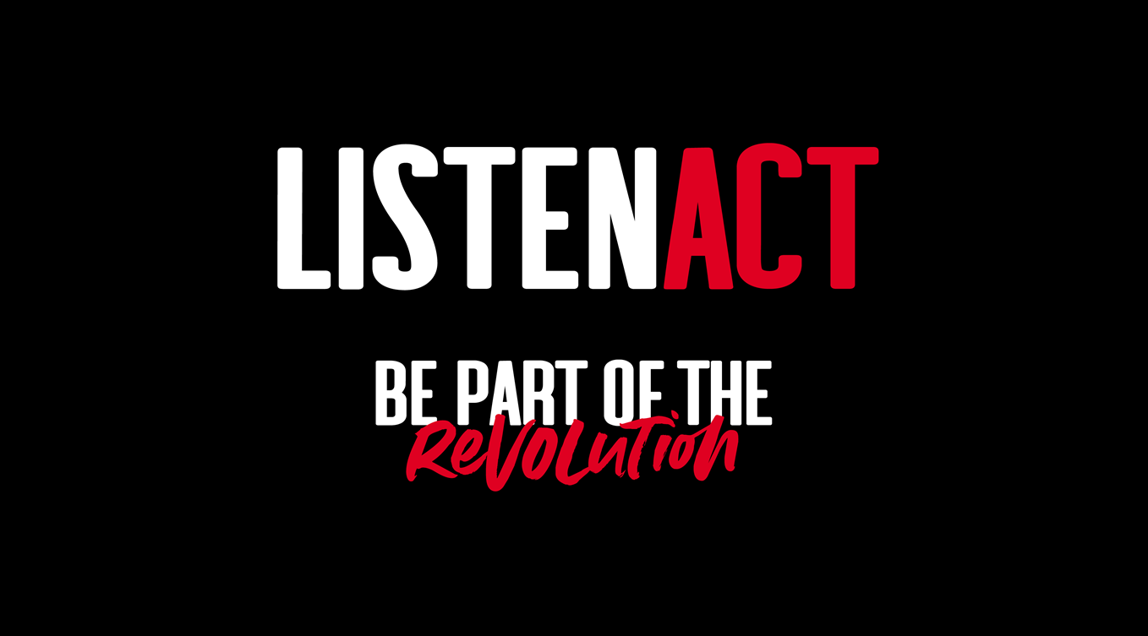
THANK YOU

