Slide 1
A Roadmap and Call-to-Action to Combat Postpartum Haemorrhage from 2023 to 2030
Consensus from the Postpartum Haemorrhage Summit
13 September 2023

Slide 2
Why do we need a PPH Roadmap?
Public health needs
Innovation deficit
Inconsistencies in guidance
Implementation barriers
  PPH leading cause of maternal death globally; disproportionately higher in LMICs
  Several LMICs not on track to meet SDG-3 targets
  Stagnant PPH research horizons
  Only two new PPH medicines over the last 30 years
  Fragmentation and inconsistencies in international and national PPH guidelines
  Lack of updated national policies & low uptake
  Multidimensional implementation bottlenecks beyond adoption of global norms
  Underutilization of advocacy to catalyze global action
  No PPH-focused global agenda or coherent action plans to guide stakeholders

Slide 3
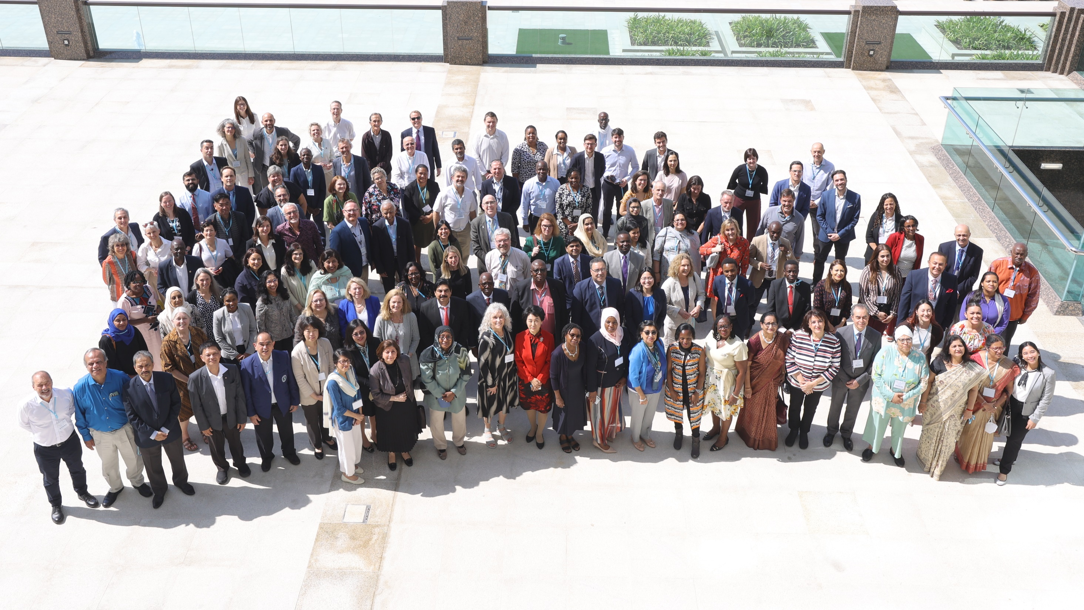

130+ participants
50+ participating countries
Reflective of PPH diversity
Diverse backgrounds
Ministries of Health
Academic Researchers
Industry and Private Sector
Professional Associations
International donors
Non-Governmental Organizations
UN Agencies and Partnerships

Slide 4
The Roadmap

Slide 5

How did we get here? Four strategic areas to catalyse action
Research
Norms/Standards
Implementation
Advocacy
  What are the key gaps in current knowledge about preventing, detecting, and managing PPH?
  What kind of research could catalyse innovation?
  What new guidelines are needed to fill gaps?
  Where do guidelines need to be harmonised to eliminate conflicts?
  Where is implementation breaking down or getting stuck?
  What is needed to get evidence-based interventions to women who need them most?
  How can advocacy be leveraged to advance the PPH agenda?
  What types of advocacy could galvanize action on ending deaths due to PPH?

Slide 6
Roadmap to accelerate progress on Postpartum Haemorrhage
PPH
Summit
Q2 2023
Q3 2023
Q4 2023
H1 2024
H2 2024
2025
2026
2027
2028
2029
2030
Objective
Strategic areas
Research
  All priority questions of the research agenda have been answered
Norms &
Standards
  Global guidelines reflect latest evidence available, and are cascaded into national guidelines, with clear clinical protocols
IMNHC – launch of the RoadMap, including research, normative, implementation, and advocacy agendas
  Priority implementation
  bottlenecks and hurdles, incl. context-specific ones, have been removed
Implementation
Advocacy
Successful engagement of all target audiences
Milestones non contingent on new funding
Milestones contingent on funding
Interdependencies

Slide 7
Roadmap to accelerate progress on Postpartum Haemorrhage
PPH
Summit
Q2 2023
Q3 2023
Q4 2023
H1 2024
H2 2024
2025
2026
2027
2028
2029
2030
Objective
Strategic areas
Research
  All priority questions of the research agenda have been answered
Norms &
Standards
  Global guidelines reflect latest evidence available, and are cascaded into national guidelines, with clear clinical protocols
IMNHC – launch of the RoadMap, including research, normative, implementation, and advocacy agendas
  Priority implementation
  bottlenecks and hurdles, incl. context-specific ones, have been removed
Implementation
PPH guideline adaptation and adoption to support dissemination and implementation in-country
Support authorization of full scope of practice for midwifery and other cadres; capacity building, professional development
Advocacy
Successful engagement of all target audiences
Milestones non contingent on new funding
Milestones contingent on funding
Interdependencies

Slide 8
Roadmap to accelerate progress on Postpartum Haemorrhage
PPH
Summit
Q2 2023
Q3 2023
Q4 2023
H1 2024
H2 2024
2025
2026
2027
2028
2029
2030
Objective
Strategic areas
Research
  All priority questions of the research agenda have been answered
Calls for proposals to conduct top priority research
Norms &
Standards
  Global guidelines reflect latest evidence available, and are cascaded into national guidelines, with clear clinical protocols
Publication of WHO recommendations actioning new, impactful evidence
IMNHC – launch of the RoadMap, including research, normative, implementation, and advocacy agendas
  Priority implementation
  bottlenecks and hurdles, incl. context-specific ones, have been removed
Implementation
PPH guideline adaptation and adoption to support dissemination and implementation in-country
Support authorization of full scope of practice for midwifery and other cadres; capacity building, professional development
Launch PPH Framework
Advocacy
Successful engagement of all target audiences
Advocacy efforts to raise awareness and advocate for women to be at the centre of the political agenda
Global branding strategy and advocacy framework
Milestones non contingent on new funding
Milestones contingent on funding
Interdependencies

Slide 9
Roadmap to accelerate progress on Postpartum Haemorrhage
PPH
Summit
Q2 2023
Q3 2023
Q4 2023
H1 2024
H2 2024
2025
2026
2027
2028
2029
2030
Objective
Strategic areas
Research
  All priority questions of the research agenda have been answered
Calls for proposals to conduct top priority research
Norms &
Standards
  Global guidelines reflect latest evidence available, and are cascaded into national guidelines, with clear clinical protocols
Publication of WHO recommendations actioning new, impactful evidence
Publication and updating of consolidated guidelines and derivative tools
IMNHC – launch of the RoadMap, including research, normative, implementation, and advocacy agendas
  Priority implementation
  bottlenecks and hurdles, incl. context-specific ones, have been removed
Implementation
PPH guideline adaptation and adoption to support dissemination and implementation in-country
Support authorization of full scope of practice for midwifery and other cadres; capacity building, professional development
Launch PPH Framework
Launch common
measurement platform
Advocacy
Successful engagement of all target audiences
Advocacy efforts to raise awareness and advocate for women to be at the centre of the political agenda
Global branding strategy and advocacy framework
1st Global PPH day
Milestones non contingent on new funding
Milestones contingent on funding
Interdependencies

Slide 10
Roadmap to accelerate progress on Postpartum Haemorrhage
PPH
Summit
Q2 2023
Q3 2023
Q4 2023
H1 2024
H2 2024
2025
2026
2027
2028
2029
2030
Objective
Strategic areas
Research
  All priority questions of the research agenda have been answered
Calls for proposals to conduct top priority research
Publication & dissemination of results completed for the first batch of funded research for integration into global guidelines
Norms &
Standards
  Global guidelines reflect latest evidence available, and are cascaded into national guidelines, with clear clinical protocols
Publication of WHO recommendations actioning new, impactful evidence
Publication and updating of consolidated guidelines and derivative tools
IMNHC – launch of the RoadMap, including research, normative, implementation, and advocacy agendas
  Priority implementation
  bottlenecks and hurdles, incl. context-specific ones, have been removed
Implementation
PPH guideline adaptation and adoption to support dissemination and implementation in-country
Support authorization of full scope of practice for midwifery and other cadres; capacity building, professional development
New procurement initiative
Launch PPH Framework
Launch common
measurement platform
Advocacy
Successful engagement of all target audiences
Advocacy efforts to raise awareness and advocate for women to be at the centre of the political agenda
Global branding strategy and advocacy framework
1st Global PPH day
Regional and local advocacy framework
Milestones non contingent on new funding
Milestones contingent on funding
Interdependencies

Slide 11
Roadmap to accelerate progress on Postpartum Haemorrhage
PPH
Summit
Q2 2023
Q3 2023
Q4 2023
H1 2024
H2 2024
2025
2026
2027
2028
2029
2030
Objective
Strategic areas
Research
  All priority questions of the research agenda have been answered
Calls for proposals to conduct top priority research
Publication & dissemination of results completed for the first batch of funded research for integration into global guidelines
Review of pending/new research gaps
Norms &
Standards
  Global guidelines reflect latest evidence available, and are cascaded into national guidelines, with clear clinical protocols
Publication of WHO recommendations actioning new, impactful evidence
Publication and updating of consolidated guidelines and derivative tools
IMNHC – launch of the RoadMap, including research, normative, implementation, and advocacy agendas
  Priority implementation
  bottlenecks and hurdles, incl. context-specific ones, have been removed
Implementation
PPH guideline adaptation and adoption to support dissemination and implementation in-country
Support authorization of full scope of practice for midwifery and other cadres; capacity building, professional development
New procurement initiative
Launch PPH Framework
Launch common
measurement platform
Advocacy
Successful engagement of all target audiences
Advocacy efforts to raise awareness and advocate for women to be at the centre of the political agenda
Global branding strategy and advocacy framework
1st Global PPH day
Regional and local advocacy framework
Update of frameworks
Milestones non contingent on new funding
Milestones contingent on funding
Interdependencies

Slide 12

Global branding strategy and advocacy framework
Regional and
local advocacy frameworks
Update of advocacy frameworks
Soft launch of the PPH Roadmap
Call for proposals to conduct top priority research
1st
Global PPH Day
Publication of results of first batch of priority funded research
Review of pending/ new research gaps
Q2 2023
Q3 2023
Q4 2023
H1 2024
H2 2024
2025
2026
2027
2028
2029
2030
WHO official publication of the Roadmap
End of scoping exercise of longer-term solutions
New procurement initiative
LEGEND
Research
Launch common
measurement platform
Norms
Implementation
Advocacy
Publication of WHO recommendations actioning new, impactful evidence
PUBLICATION AND UPDATING OF CONSOLIDATED GUIDELINES AND DERIVATIVE TOOLS

Slide 13
Since the soft launch of the Roadmap at IMNHC, several partners have made important commitments
FIGO and ICM have committed to working with WHO to develop a joint, consolidated PPH guideline
USAID has committed to fund the development of the WHO-FIGO-ICM joint, consolidated PPH guideline
Jhpiego and Laerdal Global Health have committed to developing training, job aids, and other implementation support materials to drive in-country implementation of the WHO-FIGO-ICM joint, consolidated PPH guideline
RHSC and Monash have committed to supporting efforts to enhance procurement of and access to quality PPH commodities
USAID has committed to using its supply chain work to strengthen access to PPH commodities and to working with policymakers to include TXA in EMLs
AOFOG has committed to facilitating country access to low-cost heat-stable carbetocin in Asia and Oceania
RHSC and PPH CoP have committed to supporting advocacy efforts and working with policymakers

Slide 14
In addition, WHO has already begun to make progress against its commitments
Meeting with partners to solidify commitments against the Roadmap and determine roles and responsibilities
Scoping existing funded research currently underway related to the 15 top priority research questions
Developing Target Policy Profiles to indicate how research evidence responding to each of the priority research questions can be translated into global guidance
Identifying the potential scope of the WHO-FIGO-ICM joint, consolidated PPH guideline and underpinning evidence bases for potential recommendations, in preparation for meeting of the WHO Technical Advisory Group for Maternal and Perinatal Health Guidelines before end of 2023

Slide 15


Communications and Dissemination Strategy
Soft launch at IMNHC in May 2023
Official publication by WHO and public release at FIGO World Congress in October 2023
Launch of online accountability platform
Additional dissemination through WHO Regional Offices and at upcoming conferences and events

Slide 16
Global Call-to-Action targeting 9 categories of stakeholders
Women and women’s groups
Ministries
of Health
Donors
Implementors (incl. NGOs and CSOs)
Industry & innovators
International
community
Research community
Professional associations
Guideline developers

Slide 17


Thank you!
The development of the Roadmap was funded MSD for Mothers and the Bill & Melinda Gates Foundation

