Slide 1
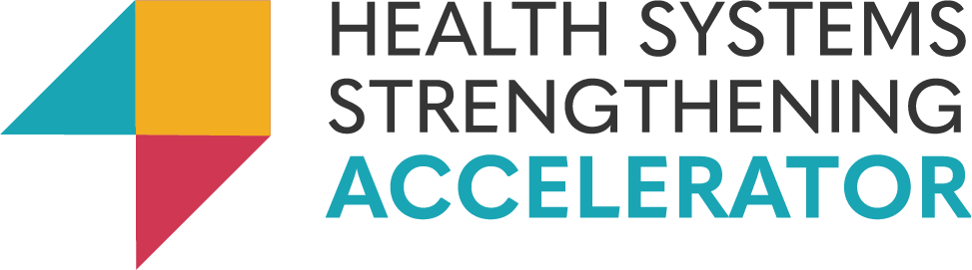




Mitigating Maternal Mortality from PPH:
Strengthening National Safe Blood Systems in Liberia, Malawi, and Rwanda
The USAID Health Systems Strengthening Accelerator Program
June 2022 – June 2024

Slide 2
Agenda
Introducing the HSS Accelerator Safe Blood program and use of the USAID Safe Blood Starter Kit tool
Overviewing the national safe blood systems in Liberia, Malawi, and Rwanda
Reviewing the agendas of “HSS for Safe Blood” in each country (work of the HSS Accelerator)
Highlighting key areas of focus to ensure the blood system services maternal health needs (and where the maternal health community can support national blood systems)

Slide 3
The HSS Accelerator is a global initiative over 2018-2024 to provide technical assistance for strengthening health systems
Funded by USAID and BMGF, the Accelerator:
Is primed by Results for Development (R4D) and includes ICF International and Health Strategy & Delivery Foundation
Technical assistance aims to shift behaviors to a “systems approach,” and “strengthen” countries’ own ability, resources, and capacity to accelerate progress toward self-reliant health systems and reduce their dependence on donor assistance over time
Accelerator technical assistance encompasses…
  Support capacities and policies prioritized by the government
  Change management in a given stakeholder space
  Leverage local, regional, and where needed, global expertise to help enhance stakeholder capacity and development of tools and resources
  Implement with and through local partners
Facilitating processes for stakeholder collaboration and engagement
Coaching and capacity building
  Co-create policies, strategies and tools by translating existing evidence into locally feasible solutions
  Operations and implementation research
  Other analytical support to improve system design
Translating global knowledge and evidence
Evidence generation, learning, and adapting

Slide 4
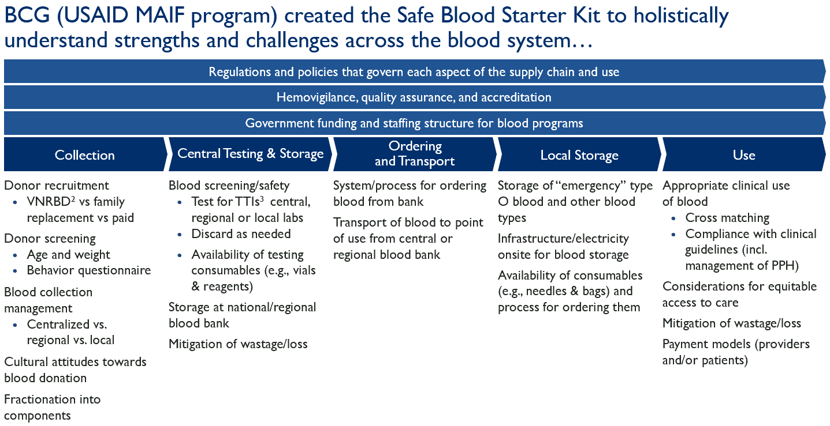
The Accelerator has partnered with the USAID MCHN Office to strengthen national blood systems and help mitigate maternal mortality from PPH
PPH is the major driver of maternal mortality; timely, safe, and effective safe blood transfusion can make the difference between life and death when an obstetric emergency needs to be escalated beyond local/primary and midwife/nurse-led care:
The HSS Accelerator is tasked by the USAID Office of Maternal and Child Health & Nutrition to provide system strengthening technical assistance in Liberia, Malawi, and Rwanda to help improve access to blood transfusions;
The Accelerator partnered with the Boston Consulting Group to review country blood systems and develop TA scopes of work
R4D and BCG started with a review of landscape and issues in the national safe blood systems of Liberia, Malawi, and Rwanda, using the USAID Safe Blood Starter Kit tool:
Co-developed a detailed view of challenges and barriers, identifying the highest priority problems with stakeholders;
Co-created priority solutions to serve as basis for technical assistance scopes of work

Slide 5
The Accelerator co-facilitated application of the USAID’s SBSK in 3 countries in 2022 to assess their blood systems, and identified unique contexts and challenges in each
Liberia
Malawi
Rwanda
Two parallel blood systems,
Central system through National Blood Safety Program (NBSP) dependent on volunteer nonpaid donors; faces severe resource constraints, and as a result collects less than 5% of national blood demand and only reaches 6/13 counties
Decentralized hospital-based blood banks dependent on family and paid donations; provides +95% of national blood demand, but quality concerns
The Malawi Blood Transfusion Services (MBTS) collects and provides safe blood to health facilities as a semi-autonomous trust affiliated with the MOH
Meets an estimated 85% of national blood demand
“Donor-to-door” mandate: collects and processes blood and blood products for facilities, but does not oversee facility-level management and use, leading to quality challenges.
Relies on ‘cost recovery’ and Global Fund support to fund operations and procure supplies, leading to persistent arrears and funding gaps.
Blood Transfusion Division (BTD) is mandated to provide safe, effective and adequate blood through a central system.
BTD comprises - 5 Regional Centers for Blood Transfusion (RCBT) and 1 Bio-Banking Unit (BBU).
BTD collected blood from 5 fixed and 662 mobile collection sites countrywide and serves 88 transfusing public and private health facilities.
SBSK findings
Regulations and policy
Regulations and policy
Regulations and policy
Hemovigilance and quality assurance
Hemovigilance and quality assurance
Hemovigilance and quality assurance
Funding and staffing
Funding and staffing
Funding and staffing
Blood value chain
Blood value chain
Blood value chain

Slide 6






Over Jun ‘23- Jun ‘24, the Accelerator Safe Blood Activity is implementing technical assistance programs with the national blood transfusion services in all three countries to help address priority challenges
Technical working groups and similar forums
E.g., a Steering Committee in Malawi and Technical Working Groups in Liberia and Rwanda for stakeholder convening, coordination, and cooperation
Quantification of blood needs and supplies
E.g., quantification of blood products, supplies, and consumables in Liberia and Malawi to aid blood collection efforts and resource planning
Stewardship & governance of safe blood system and operations
E.g., development of a national safe blood policy & strategy in Liberia and of a comprehensive national hemovigilance strategy and in/pre-service training materials in Rwanda
Resource mobilization strategy and support
E.g., in Liberia and Malawi, developing a resource mobilization strategy and supporting “realistic” (proper or adequate) public sector budgeting for the blood service
Routine and reliable data collection
E.g., in Liberia and Malawi, development and piloting of clinical and supply chain indicators through national health and logistics information systems
Cross-country learning on blood system improvement
E.g., learning from each other and together to develop staff and leadership capacity as well as tools and knowledge products

Slide 7
Maternal health-focused health system stewards, technical and funding partners, implementers, advocates, and providers can also support blood system strengthening efforts in countries
While national systems for blood collection, processing, and supply are intended to be centralized, MCH programs as “key customers“ of the blood system and can strengthen it by:
Supporting advocacy and engagement to adequately resource the national blood system as a critical component of urgent and emergent clinical care: health sector budgets should provide and align funding for blood service operations and supplies.
Blood services dependence on donors for key equipment and consumables (from blood bags and testing reagents to lab items): MCH programs with well-established national supply chains can support integration of blood service supplies into national procurement and LMIS systems with capacity building & advocacy.
Lack of routine collection of blood management and use data: MCH programs can help to capture more rigorous data on blood transfusions and outcomes to improve the evidence base.
Training of HCWs on blood transfusion guidelines and protocols: national blood services typically do not exercise influence on clinical processes and quality assurance; MCH and other programs can help fill the gap with trainings and production and dissemination of job aids
Awareness raising and reducing stigma on blood donations: MCH programs can help leverage the community health workforce, health promotion departments, and SBC interventions/partners to improve perceptions
Notes:
Other key customers include programs like HIV, malaria, oncology, surgery and trauma, etc.

Slide 8



Thank You
For questions or comments, please contact:
Adeel Ishtiaq, Program Director
aishtiaq@r4d.org
Yewedalem Tesfaye, Associate Director
ytesfaye@r4d.org
Samantha Durdock, Senior Program Officer
sdurdock@r4d.org
This presentation is made possible by the generous support of the American people through the United States Agency for International Development (USAID) under the terms of the Cooperative Agreement No. 7200-AA-18CA-00037 managed by Results for Development (R4D) The contents are the responsibility of R4D, and do not necessarily reflect the views of USAID or the United States Government.
www.r4d.org/accelerateHSS
@AccelerateHSS
AccelerateHSS@r4d.org

