Slide 1
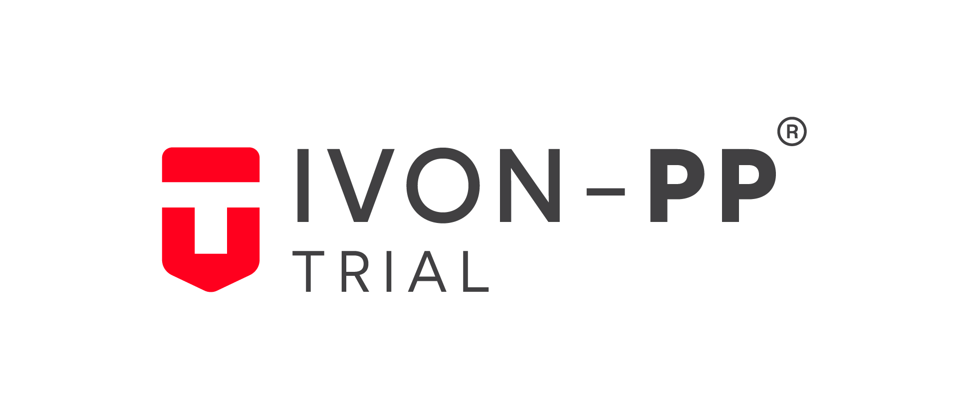
Intravenous ferric carboxymaltose versus oral ferrous sulphate for the treatment of moderate to severe postpartum anemia in Nigerian women (IVON-PP)
An open label randomized controlled trial
Adaramoye Victoria Olawunmi, MB;BS. FWACS.
Obstetrician Gynaecologist; Clinical research fellow
Lagos University Teaching Hospital

Slide 2

Anaemia and postpartum
Childbirth, every mother’s dream, and a fulfilment for every woman across all cultures (1)
Anaemia, defined by hemoglobin levels of <110 g/L at 1 week postpartum(2)
Postpartum anaemia affects 50 – 80% of women in
LMICs(2)

Slide 3

Why this study?
Iron deficiency is the commonest micronutrient disorder causing anaemia(3)
Maternal complications such as infection, fatigue, and depression and increase the risk of maternal death(4)
Oral iron is often used to treat it;
blood transfusion when severe(5)

Slide 4
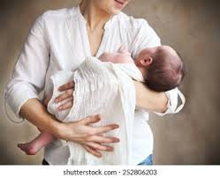
Why this study?
Adherence to oral iron is reportedly poor(6)
Despite awareness, use of intravenous iron for anemia treatment in obstetric units is not widespread in Nigeria(7)
To determine if intravenous iron (FCM) administered as single dose, is more effective and safer than oral iron

Slide 5
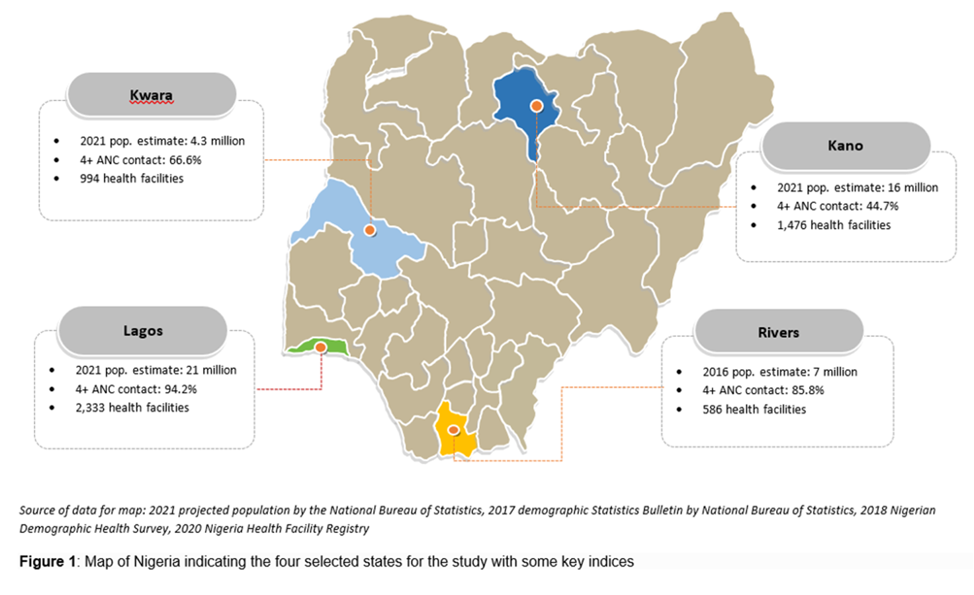
The RCT

Slide 6
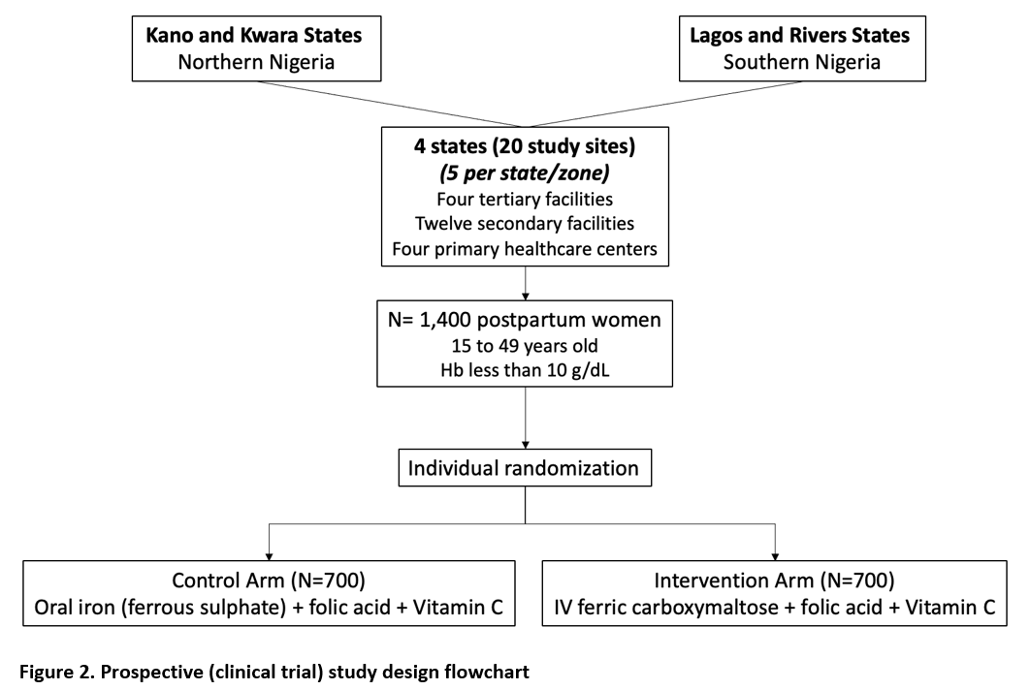
The RCT: The journey so far…

Slide 7
The RCT: The journey so far…

Slide 8
Where we are presently…
On week 39 of the trial.
Data collection is ongoing
- recruitment
- follow-up visits

Slide 9


Slide 10

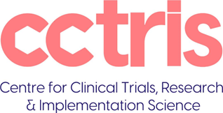
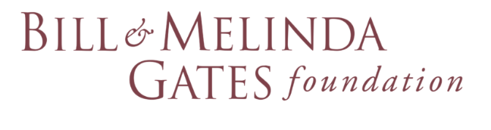




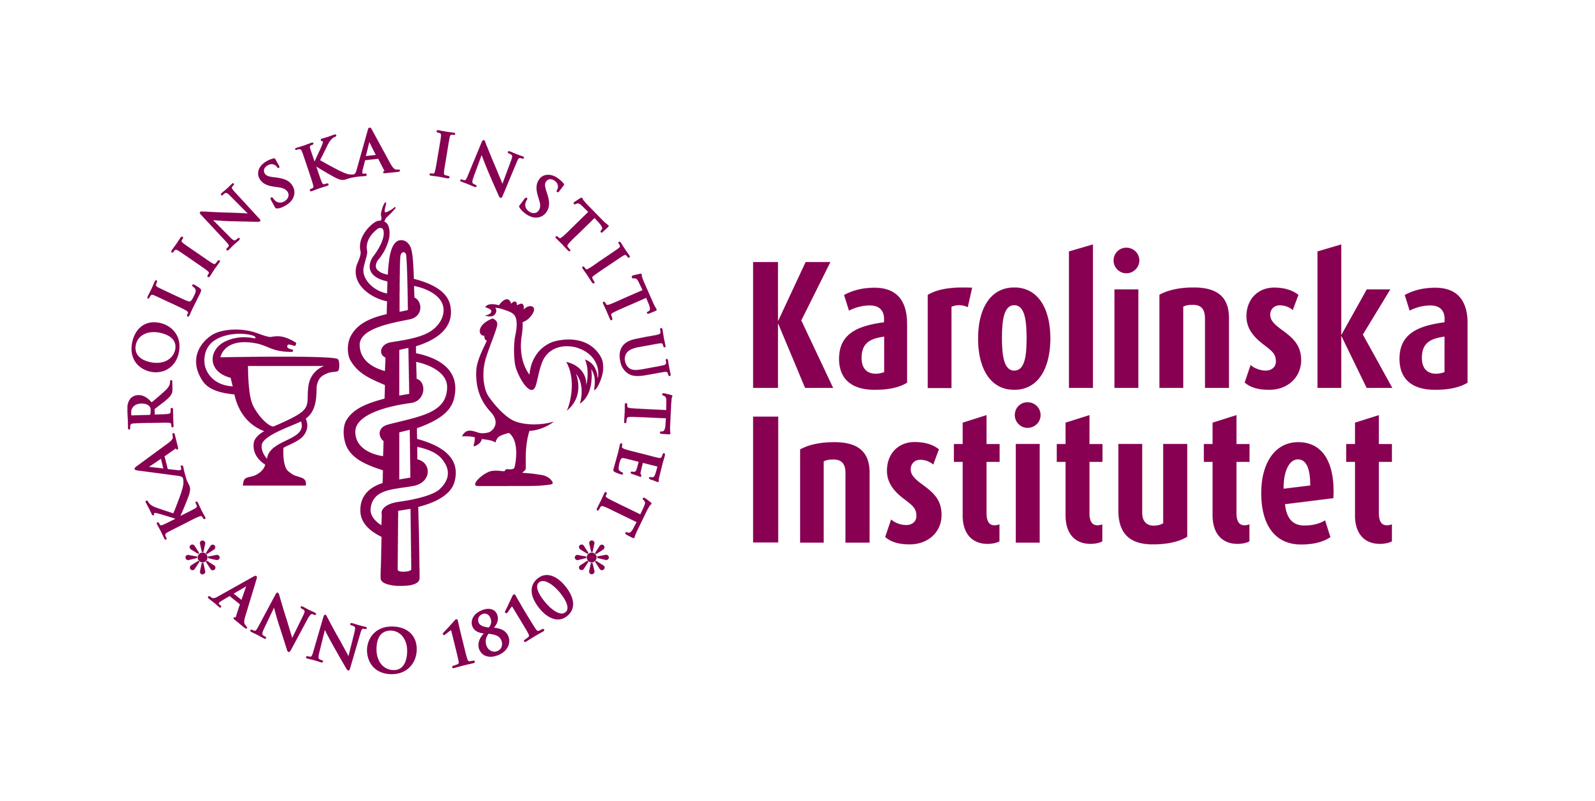


Partnership and Collaborations
We work with diverse professionals and groups to bring our research vision to reality.

Slide 11
References
1. World Health Organization. Postpartum care of the mother and newborn : a practical guide : report of a technical working group. Geneva: World Health Organization; 1998. https://apps.who.int/iris/handle/10665/66439
2. Milman N. Postpartum anemia I: Definition, prevalence, causes, and consequences. Annals of hematology. 2011;90:1247-53
3. Api O, Breyman C, Çetiner M, Demir C, Ecder T. Diagnosis and treatment of iron deficiency anemia during pregnancy and the postpartum period: Iron deficiency anemia working group consensus report. Turkish journal of obstetrics and gynecology. 2015;12(3):173-81
4. Azami M, Badfar G, Khalighi Z, Qasemi P, Shohani M, Soleymani A, et al. The association between anemia and postpartum depression: A systematic review and meta-analysis. Caspian J Intern Med. 2019;10(2):115-24.
5. Balarajan Y, Ramakrishnan U, Ozaltin E, Shankar AH, Subramanian SV. Anaemia in low-income and middle income countries. Lancet. 2011;378(9809):2123-35
6. Froessler B, Cocchiaro C, Saadat-Gilani K, Hodyl N, Dekker G. Intravenous iron sucrose versus oral iron ferrous sulfate for antenatal and postpartum iron deficiency anemia: a randomized trial. J Matern Fetal Neonatal Med. 2013;26(7):654-9.
7. Afolabi BB, Babah OA, Akinajo OR, Adaramoye VO, Adeyemo TA, Balogun M, Banke-Thomas A, Quao RA, Olorunfemi G, Abioye AI, Galadanci HS, Sam-Agudu NA. Intravenous versus oral iron for iron deficiency anaemia in pregnant Nigerian women (IVON): study protocol for a randomised hybrid effectiveness-implementation trial. Trials. 2022 Sep 8;23(1):763. doi: 10.1186/s13063-022-06690-2. PMID: 36076211; PMCID: PMC9454388.

Slide 12


