Slide 1
Anaemia and Infections
Jolly Beyeza-Kashesya
FIGO CHILDBIRTH AND PPH COMMITTEE
Vice Chairperson

Slide 3

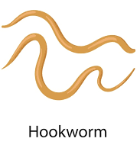
Blood Loss_Parasites
Hookworm
  Ancylostoma duodenale
  Nector americanus
Trichuris Trichura
Schistosoma Haematobium
  Bladder

Slide 4
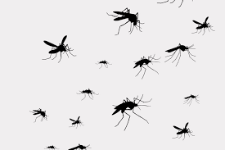
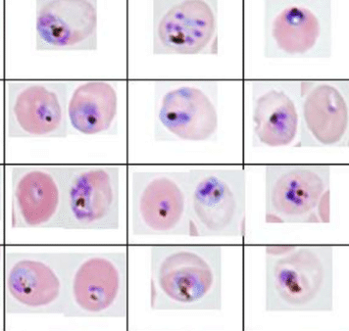
Increased Destruction of Red Blood Cells
Parasites
Plasmodium species
Bacteria
E. Coli
Clostridium perfringens
Mycobacteria pneumonia
Viruses
Infectious Mononucleosis (EBV)
Hepatitis A Virus

Slide 5
Impaired Production
Parasites
Leishmania
Diphyllobothrium Latum
  Impaired absorption of Vit. B12
  Megaloblastic anaemia
Bacteria
TB
Helicobacter Pylori
  Vit B12 absorption
Viruses
HIV
Human Parvovirus
Cytomegalovirus
Epstein-Barr-virus
Human Herpes virus
Varicella Zoster Virus

Slide 6
Infection and Anaemia
Infection or disease causes inflammation
Changes in the Immune system
  Anaemia of inflammation.
    Low serum iron and normal/high ferritin levels
  Your body may not store and use iron normally.
  Decreases bioavailability of iron to host tissues
Parasitic diseases
  Both extracorporeal iron loss and anemia of inflammation

Slide 7
Anaemia in Acute Infections
Destruction of red blood cells by the parasite.
  E.g. in Malaria
Inhibition of medullary erythropoiesis
  Parvovirosis (Parvoviruses)

Slide 8
Anaemia in chronic Infections
Chronic infections (e.g., tuberculosis, lung abscess, and endocarditis)
HIV infection
Hook worm infestation
Autoimmune diseases or diseases with inflammation
  Rheumatoid arthritis, lupus, ulcerative colitis, Crohn's disease

Slide 9
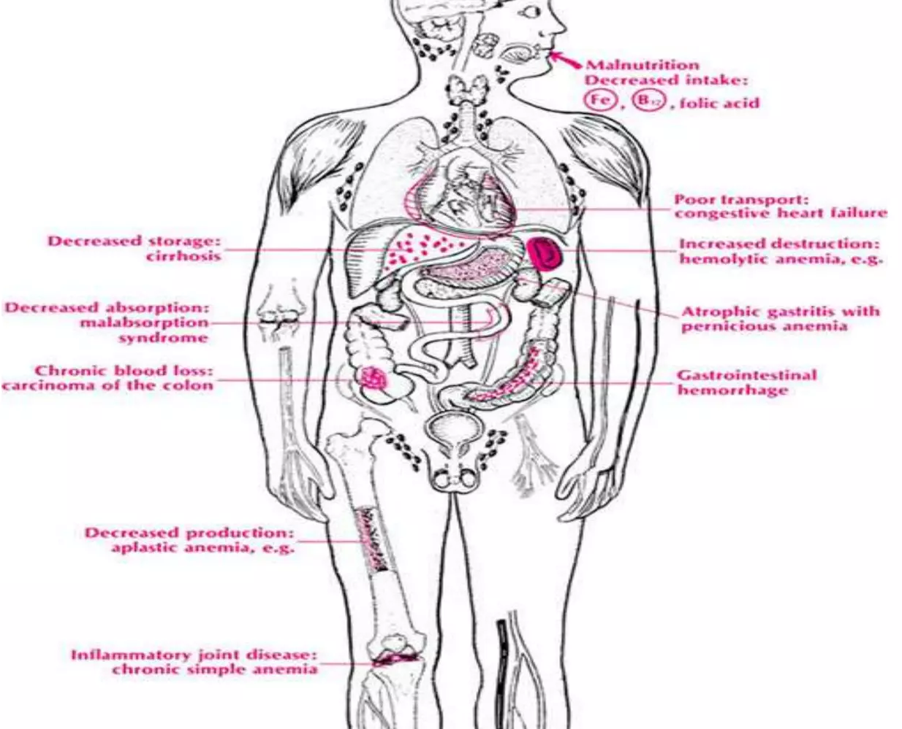
Anaemia in TB
Nutritional deficiency, malabsorption
Low dietary intake is one of the causes resulting in IDA.
Loss of appetite, a classic symptom of TB, may be the reason for reduced dietary intake.
Anti-tuberculosis therapy
vitamin D deficiency was associated with an increased risk of developing active TB
Isonicotinic acid hydrazide (isoniazid, INH), an antituberculosis agent, can cause sideroblastic anaemia as a side-effect
Development of immune haemolytic anaemia (IHA) during intermittent rifampicin administration

Slide 10
Anaemia in HIV infection
Insufficient erythropoietin levels
serum immunoreactive erythropoietin in HIV infected patients across the spectrum of disease stages revealed that levels of the hormone failed to rise commensurately with increasing anaemia.
Nutritional deficiency, malabsorption
ART:
Nucleoside Reverse Transcriptase Inhibitors (NRTIs) such as zidovudine (AZT) and lamivudine (3TC)
  cause hematologic toxicity, including anemia
Tenofovir (TDF)

