Slide 1
Long-term Consequences of PPH
João Paulo Souza, MD, PhD, Professor of Social Medicine (USP)
Director of BIREME/PAHO, Latin American and Caribbean Center for Health Sciences Information

Slide 2
Conflict of Interest and Bias
No commercial conflict of interest
Published previous research on PPH and particularly on severe maternal morbidity and maternal near miss
ICU background which may bias my perspective towards severe cases
I did not use any Large Language Models in this presentation
I currently work at the Pan American Health Organization, but the views expressed do not necessarily represent the decisions, policy, or views of PAHO or WHO

Slide 3
Source of information
Literature search
Few cohort studies on the long-term consequences of PPH
Information is fragmented
Some information is derived from gynecological studies, maternal near-miss studies and general critical care studies

Slide 10
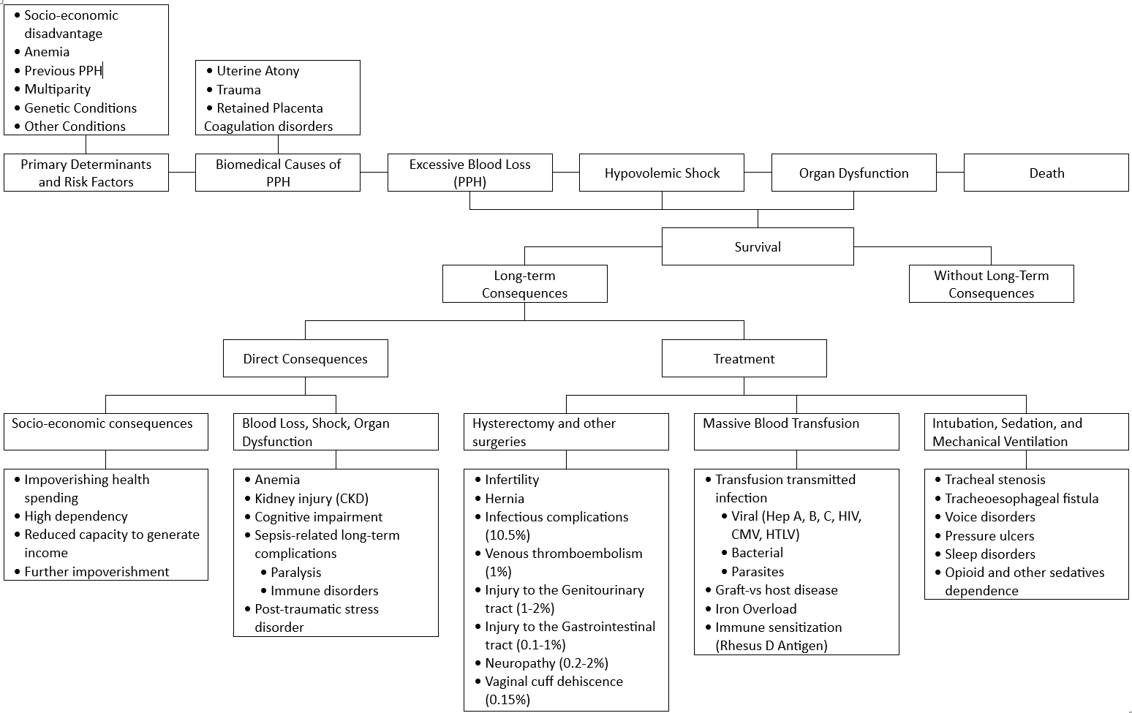
Long-term Consequences of PPH

Slide 11
Final considerations
Survivors of PPH may present long-term complications and sequelae with a variable degree of severity
Some of the long-term complications may affect the quality of life and increase the risk of additional complications and mortality
Long-term cohort studies of survivors of PPH and other maternal near-misses are needed

Slide 12
References
1: Kellum JA, Romagnani P, Ashuntantang G, Ronco C, Zarbock A, Anders HJ. Acute
kidney injury. Nat Rev Dis Primers. 2021 Jul 15;7(1):52. doi:
10.1038/s41572-021-00284-z. PMID: 34267223.
2: Cecatti JG, Souza JP, Parpinelli MA, Haddad SM, Camargo RS, Pacagnella RC,
Silveira C, Zanardi DT, Costa ML, Pinto e Silva JL, Passini R Jr, Surita FG,
Sousa MH, Calderon IM, Say L, Pattinson RC; Brazilian Network for Surveillance
of Severe Maternal Morbidity. Brazilian network for the surveillance of maternal
potentially life threatening morbidity and maternal near-miss and a
multidimensional evaluation of their long term consequences. Reprod Health. 2009
Sep 24;6:15. doi: 10.1186/1742-4755-6-15. PMID: 19778437; PMCID: PMC2760504.
3: Pacagnella RC, Cecatti JG, Camargo RP, Silveira C, Zanardi DT, Souza JP,
Parpinelli MA, Haddad SM. Rationale for a long-term evaluation of the
consequences of potentially life-threatening maternal conditions and maternal
"near-miss" incidents using a multidimensional approach. J Obstet Gynaecol Can.
2010 Aug;32(8):730-8. doi: 10.1016/s1701-2163(16)34612-6. PMID: 21050503.
4: Pacagnella RC, Borovac-Pinheiro A, Silveira C, Siani Morais S, Argenton JLP,
Souza JP, Weeks AD, Cecatti JG. The golden hour for postpartum hemorrhage:
Results from a prospective cohort study. Int J Gynaecol Obstet. 2022
Mar;156(3):450-458. doi: 10.1002/ijgo.13823. Epub 2021 Jul 22. PMID: 34254311.
5: Camargo RS, Pacagnella RC, Cecatti JG, Parpinelli MA, Souza JP, Sousa MH.
Subsequent reproductive outcome in women who have experienced a potentially
life-threatening condition or a maternal near-miss during pregnancy. Clinics
(Sao Paulo). 2011;66(8):1367-72. doi: 10.1590/s1807-59322011000800010. PMID:
21915485; PMCID: PMC3161213.
6: Al-Sharafi BA, Askar F, Qais AA. Management of a patient with Sheehan's
syndrome and diabetes insipidus complicated by recurrent hyponatremia.
Endocrinol Diabetes Metab Case Rep. 2021 Sep 1;2021:21-0078. doi:
10.1530/EDM-21-0078. Epub ahead of print. PMID: 34515663; PMCID: PMC8495719.
7: Zaat TR, van Steijn ME, de Haan-Jebbink JM, Olff M, Stramrood CAI, van Pampus
MG. Posttraumatic stress disorder related to postpartum haemorrhage: A
systematic review. Eur J Obstet Gynecol Reprod Biol. 2018 Jun;225:214-220. doi:
10.1016/j.ejogrb.2018.04.012. Epub 2018 May 2. PMID: 29747143.
8: Papanikolaou J, Makris D, Tsolaki V, Spathoulas K, Zakynthinos E. Post-partum
hemorrhage complicated by reverse-Takotsubo cardiogenic shock; a novel
therapeutic approach. Am J Emerg Med. 2017 Jun;35(6):935.e1-935.e3. doi:
10.1016/j.ajem.2016.12.034. Epub 2016 Dec 19. PMID: 28012808.
9: Soro MP, Denys A, de Rham M, Baud D. Short & long term adverse outcomes after
arterial embolisation for the treatment of postpartum haemorrhage: a systematic
review. Eur Radiol. 2017 Feb;27(2):749-762. doi: 10.1007/s00330-016-4395-2. Epub
2016 May 26. PMID: 27229338.
10: Aggarwal RS, Mishra VV, Jasani AF, Gumber M. Acute renal failure in
pregnancy: our experience. Saudi J Kidney Dis Transpl. 2014 Mar;25(2):450-5.
doi: 10.4103/1319-2442.128621. PMID: 24626025.
11: Héquet D, Ricbourg A, Sebbag D, Rossignol M, Lubrano S, Barranger E.
Placenta accreta : dépistage, prise en charge et complications [Placenta
accreta: screening, management and complications]. Gynecol Obstet Fertil. 2013
Jan;41(1):31-7. French. doi: 10.1016/j.gyobfe.2012.11.001. Epub 2013 Jan 3.
PMID: 23291052.
12: Wagner KS, Ronsmans C, Thomas SL, Calvert C, Adler A, Ganaba R, Goufodji S,
Filippi V. Women who experience obstetric haemorrhage are at higher risk of
anaemia, in both rich and poor countries. Trop Med Int Health. 2012
Jan;17(1):9-22. doi: 10.1111/j.1365-3156.2011.02883.x. Epub 2011 Sep 29. PMID:
21955293.
13: Motomura K, Ganchimeg T, Nagata C, Ota E, Vogel JP, Betran AP, Torloni MR,
Jayaratne K, Jwa SC, Mittal S, Dy Recidoro Z, Matsumoto K, Fujieda M, Nafiou I,
Yunis K, Qureshi Z, Souza JP, Mori R. Incidence and outcomes of uterine rupture
among women with prior caesarean section: WHO Multicountry Survey on Maternal
and Newborn Health. Sci Rep. 2017 Mar 10;7:44093. doi: 10.1038/srep44093. PMID:
28281576; PMCID: PMC5345021.
14: Vogel JP, Souza JP, Mori R, Morisaki N, Lumbiganon P, Laopaiboon M, Ortiz-
Panozo E, Hernandez B, Pérez-Cuevas R, Roy M, Mittal S, Cecatti JG, Tunçalp Ö,
Gülmezoglu AM; WHO Multicountry Survey on Maternal and Newborn Health Research
Network. Maternal complications and perinatal mortality: findings of the World
Health Organization Multicountry Survey on Maternal and Newborn Health. BJOG.
2014 Mar;121 Suppl 1:76-88. doi: 10.1111/1471-0528.12633. Erratum in: BJOG. 2015
Feb;122(3):451. PMID: 24641538.
15: Sheldon WR, Blum J, Vogel JP, Souza JP, Gülmezoglu AM, Winikoff B; WHO
Multicountry Survey on Maternal and Newborn Health Research Network. Postpartum
haemorrhage management, risks, and maternal outcomes: findings from the World
Health Organization Multicountry Survey on Maternal and Newborn Health. BJOG.
2014 Mar;121 Suppl 1:5-13. doi: 10.1111/1471-0528.12636. PMID: 24641530.
16: Souza JP, Gülmezoglu AM, Vogel J, Carroli G, Lumbiganon P, Qureshi Z, Costa
MJ, Fawole B, Mugerwa Y, Nafiou I, Neves I, Wolomby-Molondo JJ, Bang HT, Cheang
K, Chuyun K, Jayaratne K, Jayathilaka CA, Mazhar SB, Mori R, Mustafa ML, Pathak
LR, Perera D, Rathavy T, Recidoro Z, Roy M, Ruyan P, Shrestha N, Taneepanichsku
S, Tien NV, Ganchimeg T, Wehbe M, Yadamsuren B, Yan W, Yunis K, Bataglia V,
Cecatti JG, Hernandez-Prado B, Nardin JM, Narváez A, Ortiz-Panozo E, Pérez-
Cuevas R, Valladares E, Zavaleta N, Armson A, Crowther C, Hogue C, Lindmark G,
Mittal S, Pattinson R, Stanton ME, Campodonico L, Cuesta C, Giordano D, Intarut
N, Laopaiboon M, Bahl R, Martines J, Mathai M, Merialdi M, Say L. Moving beyond
essential interventions for reduction of maternal mortality (the WHO
Multicountry Survey on Maternal and Newborn Health): a cross-sectional study.
Lancet. 2013 May 18;381(9879):1747-55. doi: 10.1016/S0140-6736(13)60686-8. PMID:
23683641.
17: Souza JP, Bellissimo-Rodrigues F, Santos LLD. Maternal Mortality: An Eco-
Social Phenomenon that Calls for Systemic Action. Rev Bras Ginecol Obstet. 2020
Apr;42(4):169-173. doi: 10.1055/s-0040-1710041. Epub 2020 Apr 24. PMID:
32330957; PMCID: PMC10316832.

