Slide 1

The Social Determinants of Post-Partum Haemorrhage
Prof Salome Maswime
Head of Global Surgery
Obstetrician and Gynaecologist

Slide 2
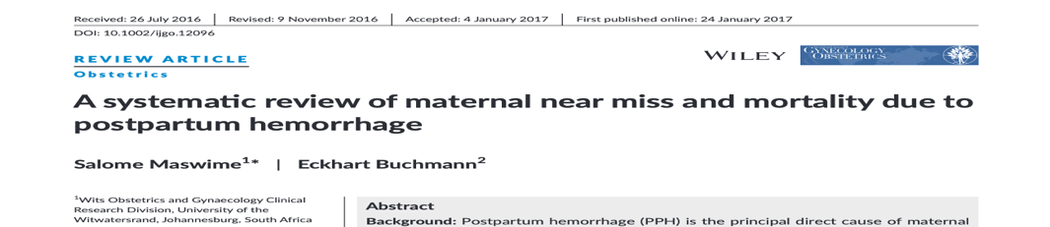
Women in low-income countries and lower middle-income countries have an increased likelihood of severe PPH and of dying from PPH-related consequences.
The mortality index for PPH was 6.6% (range 0.0%–40.7%). The mortality index was highest in low-income countries and lower middle-income countries.
IJGO 2016.Maswime

Slide 3
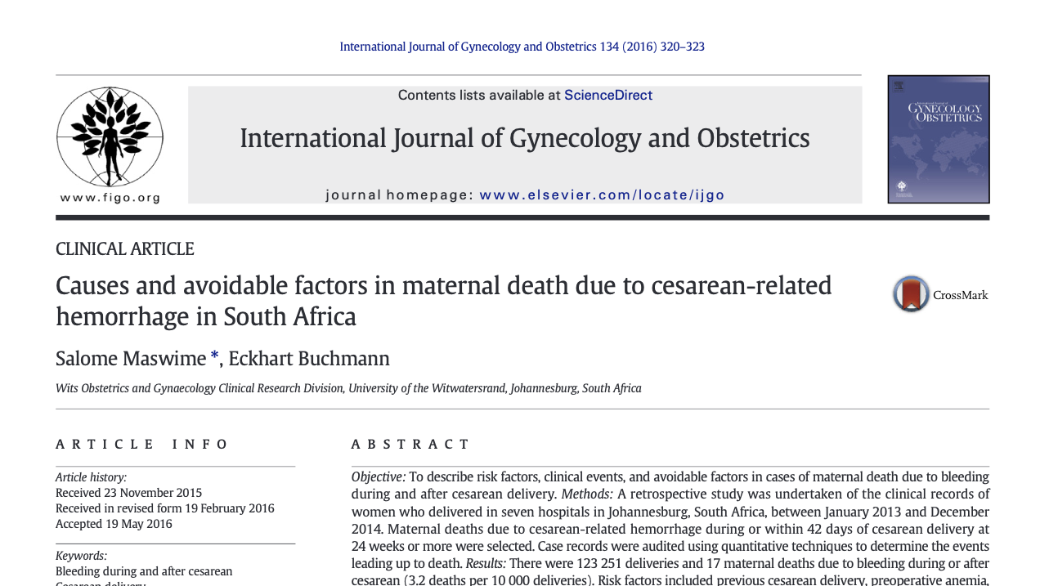

Slide 4
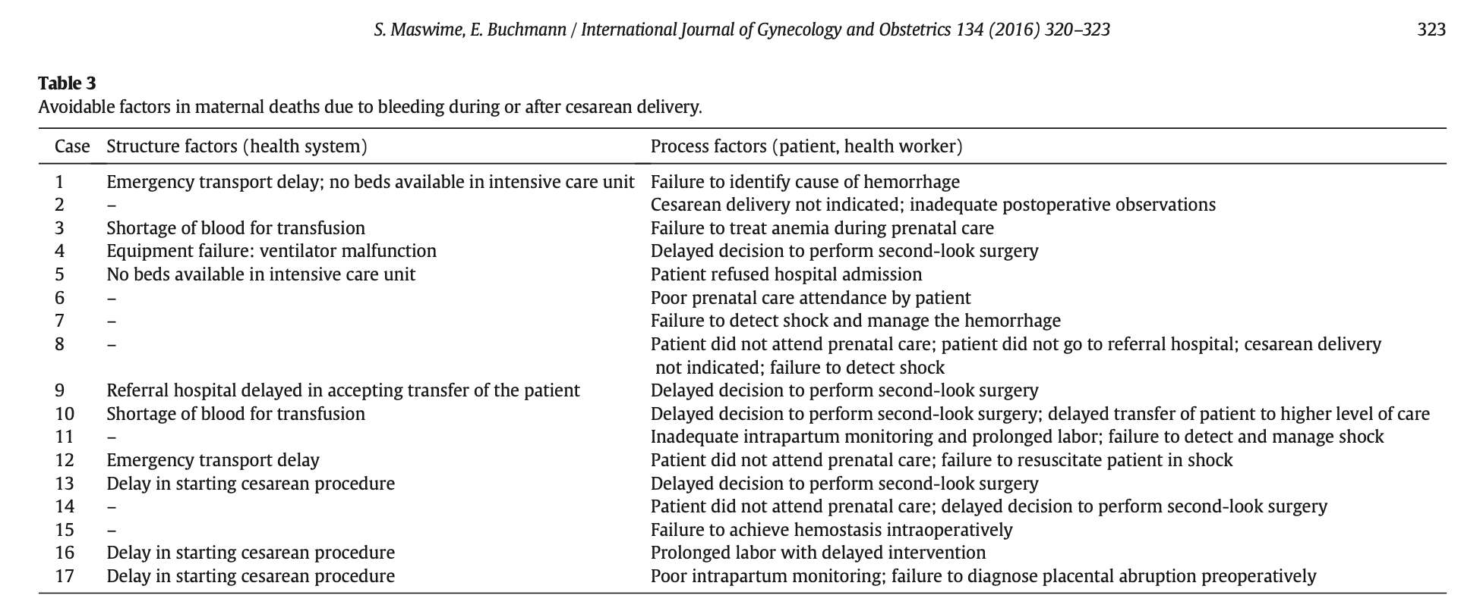

Slide 5
Maternal death audit
Avoidable factors | Number (%)
Delay transporting patient to higher level of care | 2 (12%)
Delay starting caesarean section | 3 (18)
Shortage of blood | 2 (12%)
No ICU available | 2 (12%)
Failure to detect shock and treat | 6 (35%)
Delayed decision to perform second-look surgery | 5 (29%)
Did not attend ANC | 3 (18%)
IJGO 2016.Maswime;134
Notes:
Multifactorial

Slide 6
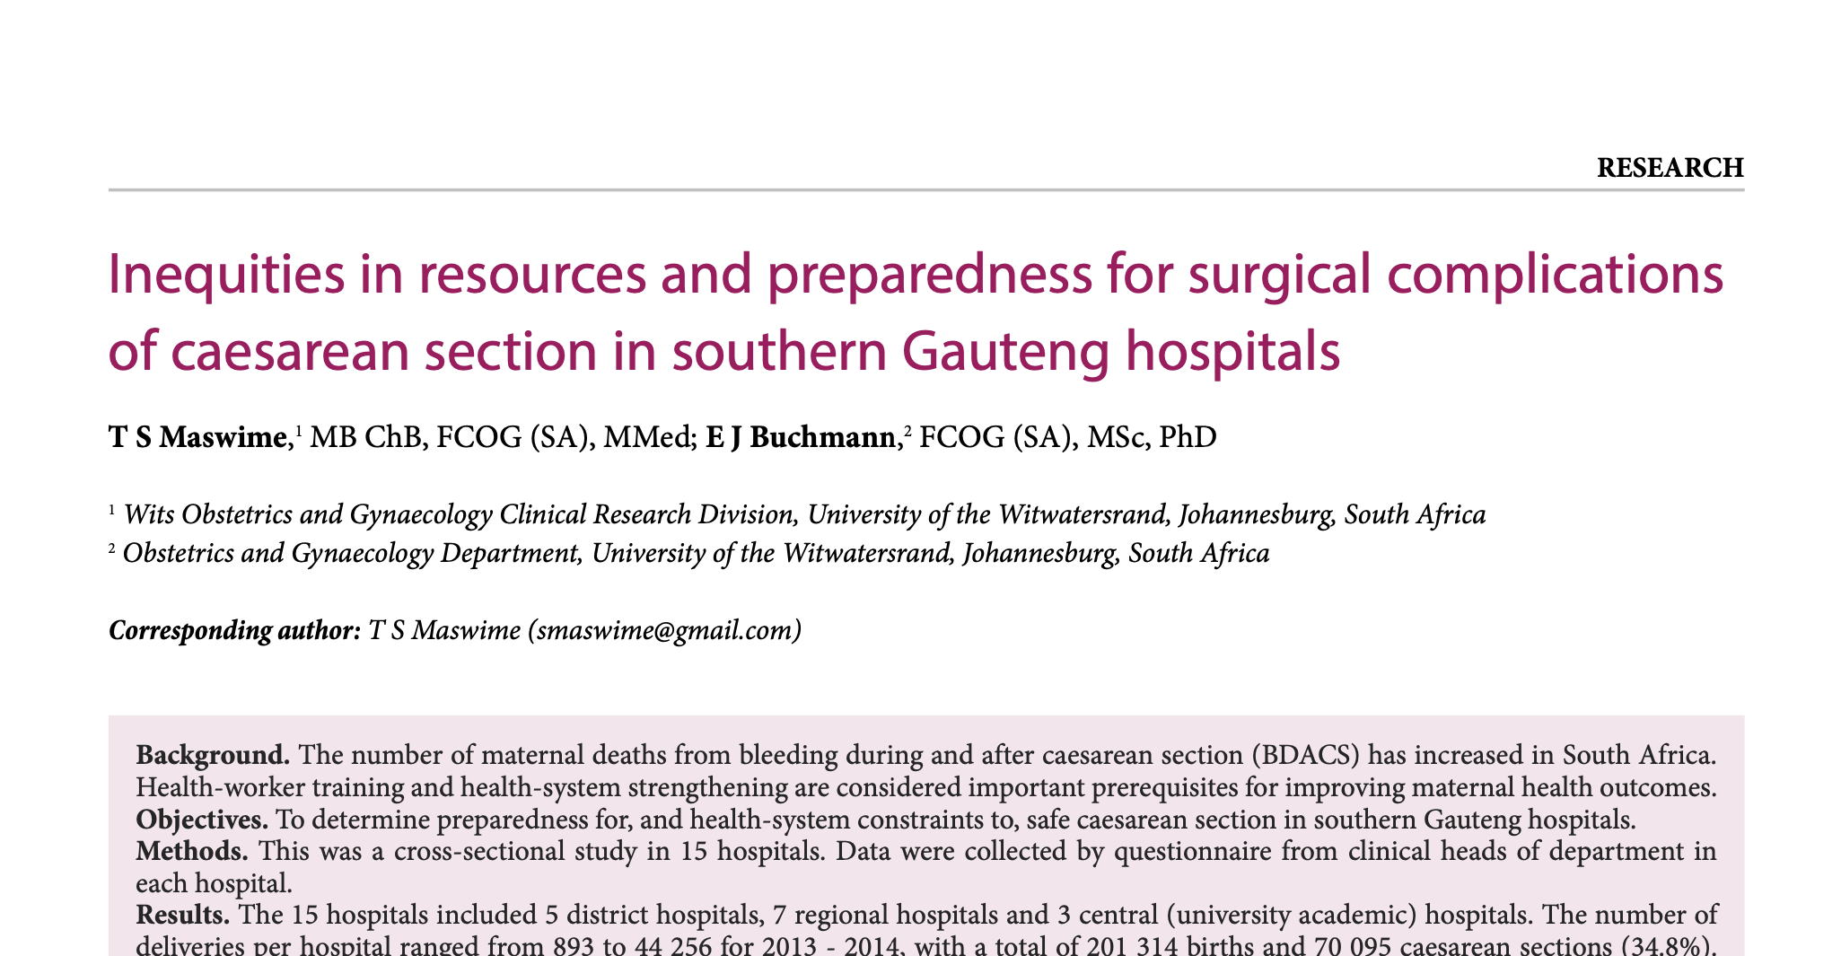
Sajog 2016. Maswime; 22(1)

Slide 7
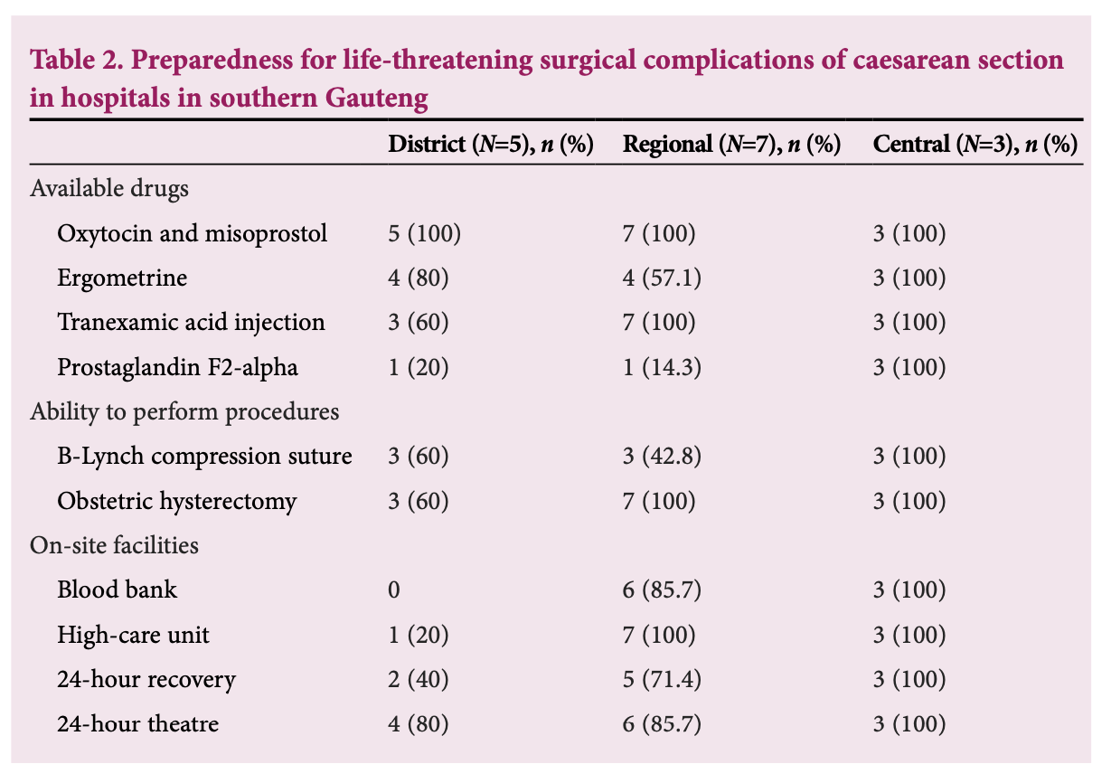
Health system preparedness
Sajog 2016. Maswime; 22(1)

Slide 8
Health systems audit
Regional and district hospitals had the highest number of maternal deaths (p=0.008), yet drugs, resources and staff were skewed in favour of academic hospitals
staff shortages
uneven staff distribution
lack of facilities and infrastructure
shortage of essential drugs used to arrest haemorrhage
shortage of skilled staff to perform life-saving procedures
Sajog 2016. Maswime; 22(1)

Slide 9

APORG, Biccard et al
7 day prospective, international cohort study
Countries
247 hospitals
11 422 patients
Patients were mainly young with a low risk profile
Most common surgery caesarean section: 33%
Postoperative complications: 18.2%
Mortality: 2.1%
Infection was the most common complication
Lancet 2018;Biccard;391(10130)

Slide 10
The African Surgical Outcomes Study
Surgery | Relative risk in Africa
Adult (elective) surgical mortality | 2x
Maternal (caesarean section) mortality | 50x
Lancet 2018.Biccard;391(10130)
Lancet Global Health 2019:Bishop;7(4)

Slide 11
ASOS Sub-study
Algeria 23 (0.6%), Benin136 (3.6%), Burundi 83 (2.2%), Cameroon 40 (1.1%), Congo 1 (0.0%), DRC 117 (3.1%), Ethiopia 25 (0.7%), Gambia 25 (0.7%), Ghana 74 (2.0%), Kenya 163 (4.3%), Libya 313 (8.3%), Madagascar32 (0.8%), Mali 100 (2.6%), Mauritius 58 (1.5%), Namibia 120 (3.2%), Niger 8 (0.2%), Nigeria 150 (4.0%), South Africa 1560 (41.1%), Tanzania 41 (1.1%), Uganda 357 (9.4%), Zambia 14 (0.4%), Zimbabwe 352 (9.3%)
3792 obstetric patients included in the analysis
11463 patients entered into database
41 patients removed
Too young (18)/Duplicates (23)
Lancet Global Health 2019:Bishop;7(4)

Slide 12
Results
3792 patients , 183 hospitals , 22 African countries between
Postoperative complications following caesarean section were reported in 480/3747 (13%)
34 women had an adverse events (9/1000)
The caesarean section mortality rate was 542/100 000
Neonatal mortality was 44/1000 births
Lancet Global Health 2019:Bishop;7(4)

Slide 13
Pre-operative Risk factors
1 in 8 women had pre-eclampsia/eclampsia
1 in 17 women had a major pre-operative bleeding risk
Postoperative complications
1 in 8 women developed a post-operative complications
The most common severe complications were bleeding, infection, and anaesthetic complications
Neonatal outcomes
340 neonates required CPR
140 neonates had a 5 minute Apgar score of <5
Lancet Global Health 2019:Bishop;7(4)

Slide 14

Women in Africa are dying from preventable complications of surgery
Lack of access to care
Delayed access
Shortage of specialists
Shortage of equipment
Shortage of resources
Lack of multi-disciplinary care
Poor infrastructure
Poor pre-operative care
Poor post-operative care
Poor rehabilitation

Slide 15
Determinants of health
Social
Economic
Political
Geographic
Biological

Slide 16
Policy Engagement
Medicine is an art and a science, but the delivery of healthcare services is political.
Policies influence access to health education programs, emergency services, decrease barriers to better health, and increase opportunities that influence health behaviors.
Social and economic policies that target housing, education, safety, employment, and public transportation, increase access to health services.
Agenda setting, budget and resource allocation for population wide programs, influence priorities and access to healthcare.

Slide 17

“Women are not dying because of diseases we cannot treat, they are dying because societies have yet to make the decision that their lives are worth saving.”
Professor Mahmoud Fathalla
Notes:
Mahmoud fathalla – past president of figo

Slide 18
Drivers of poor surgical outcome
Access
Safety
Quality

Slide 19

Access: Measure of the availability of services (Physical)
Safety: The measure of how the services are delivered
(Behavior)
Quality: The measure of whether the services met the expectation
(Outcome)

Slide 20
Access to Care
Geographic accessibility
Availability
of services
Financial accessibility
Acceptability

Slide 21

Delayed Access to care
1. Delay in seeking appropriate medical care
2. Delay in reaching an appropriate health facility
3. Delay in receiving appropriate care

Slide 22
Delayed Access to Care
Decision to incision interval (DII)
30 minutes according to the American College of Obstetricians and Gynaecologists
Prolonged DII is associated with maternal haemorrhage, maternal deaths, neonatal deaths and reduced Apgar scores
With a DII of 120 minutes there are increased rates of intra-uterine deaths, and neonatal asphyxia

Slide 23
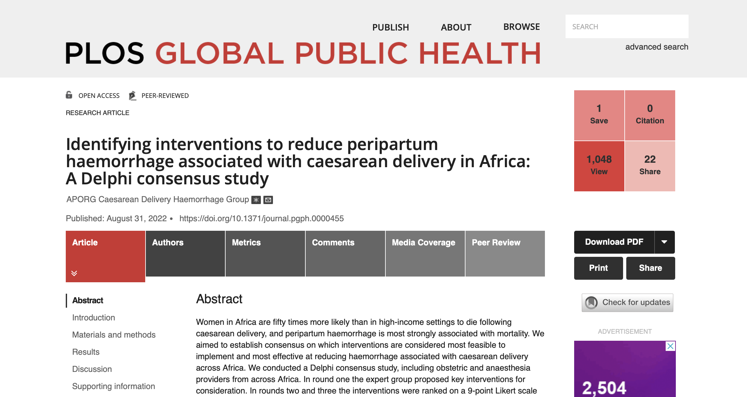

Slide 24
Methods
We aimed to establish consensus on which interventions are considered most feasible to implement and most effective at reducing haemorrhage associated with caesarean delivery across Africa
We conducted a Delphi consensus study, including obstetric and anaesthesia providers from across Africa.
Four phases
Twenty-eight interventions were considered both highly effective and feasible in Africa.
Interventions covered a range of fields, categorised into direct- or indirect interventions.
Plos Global Health 2022. Taylor;2(8)

Slide 25
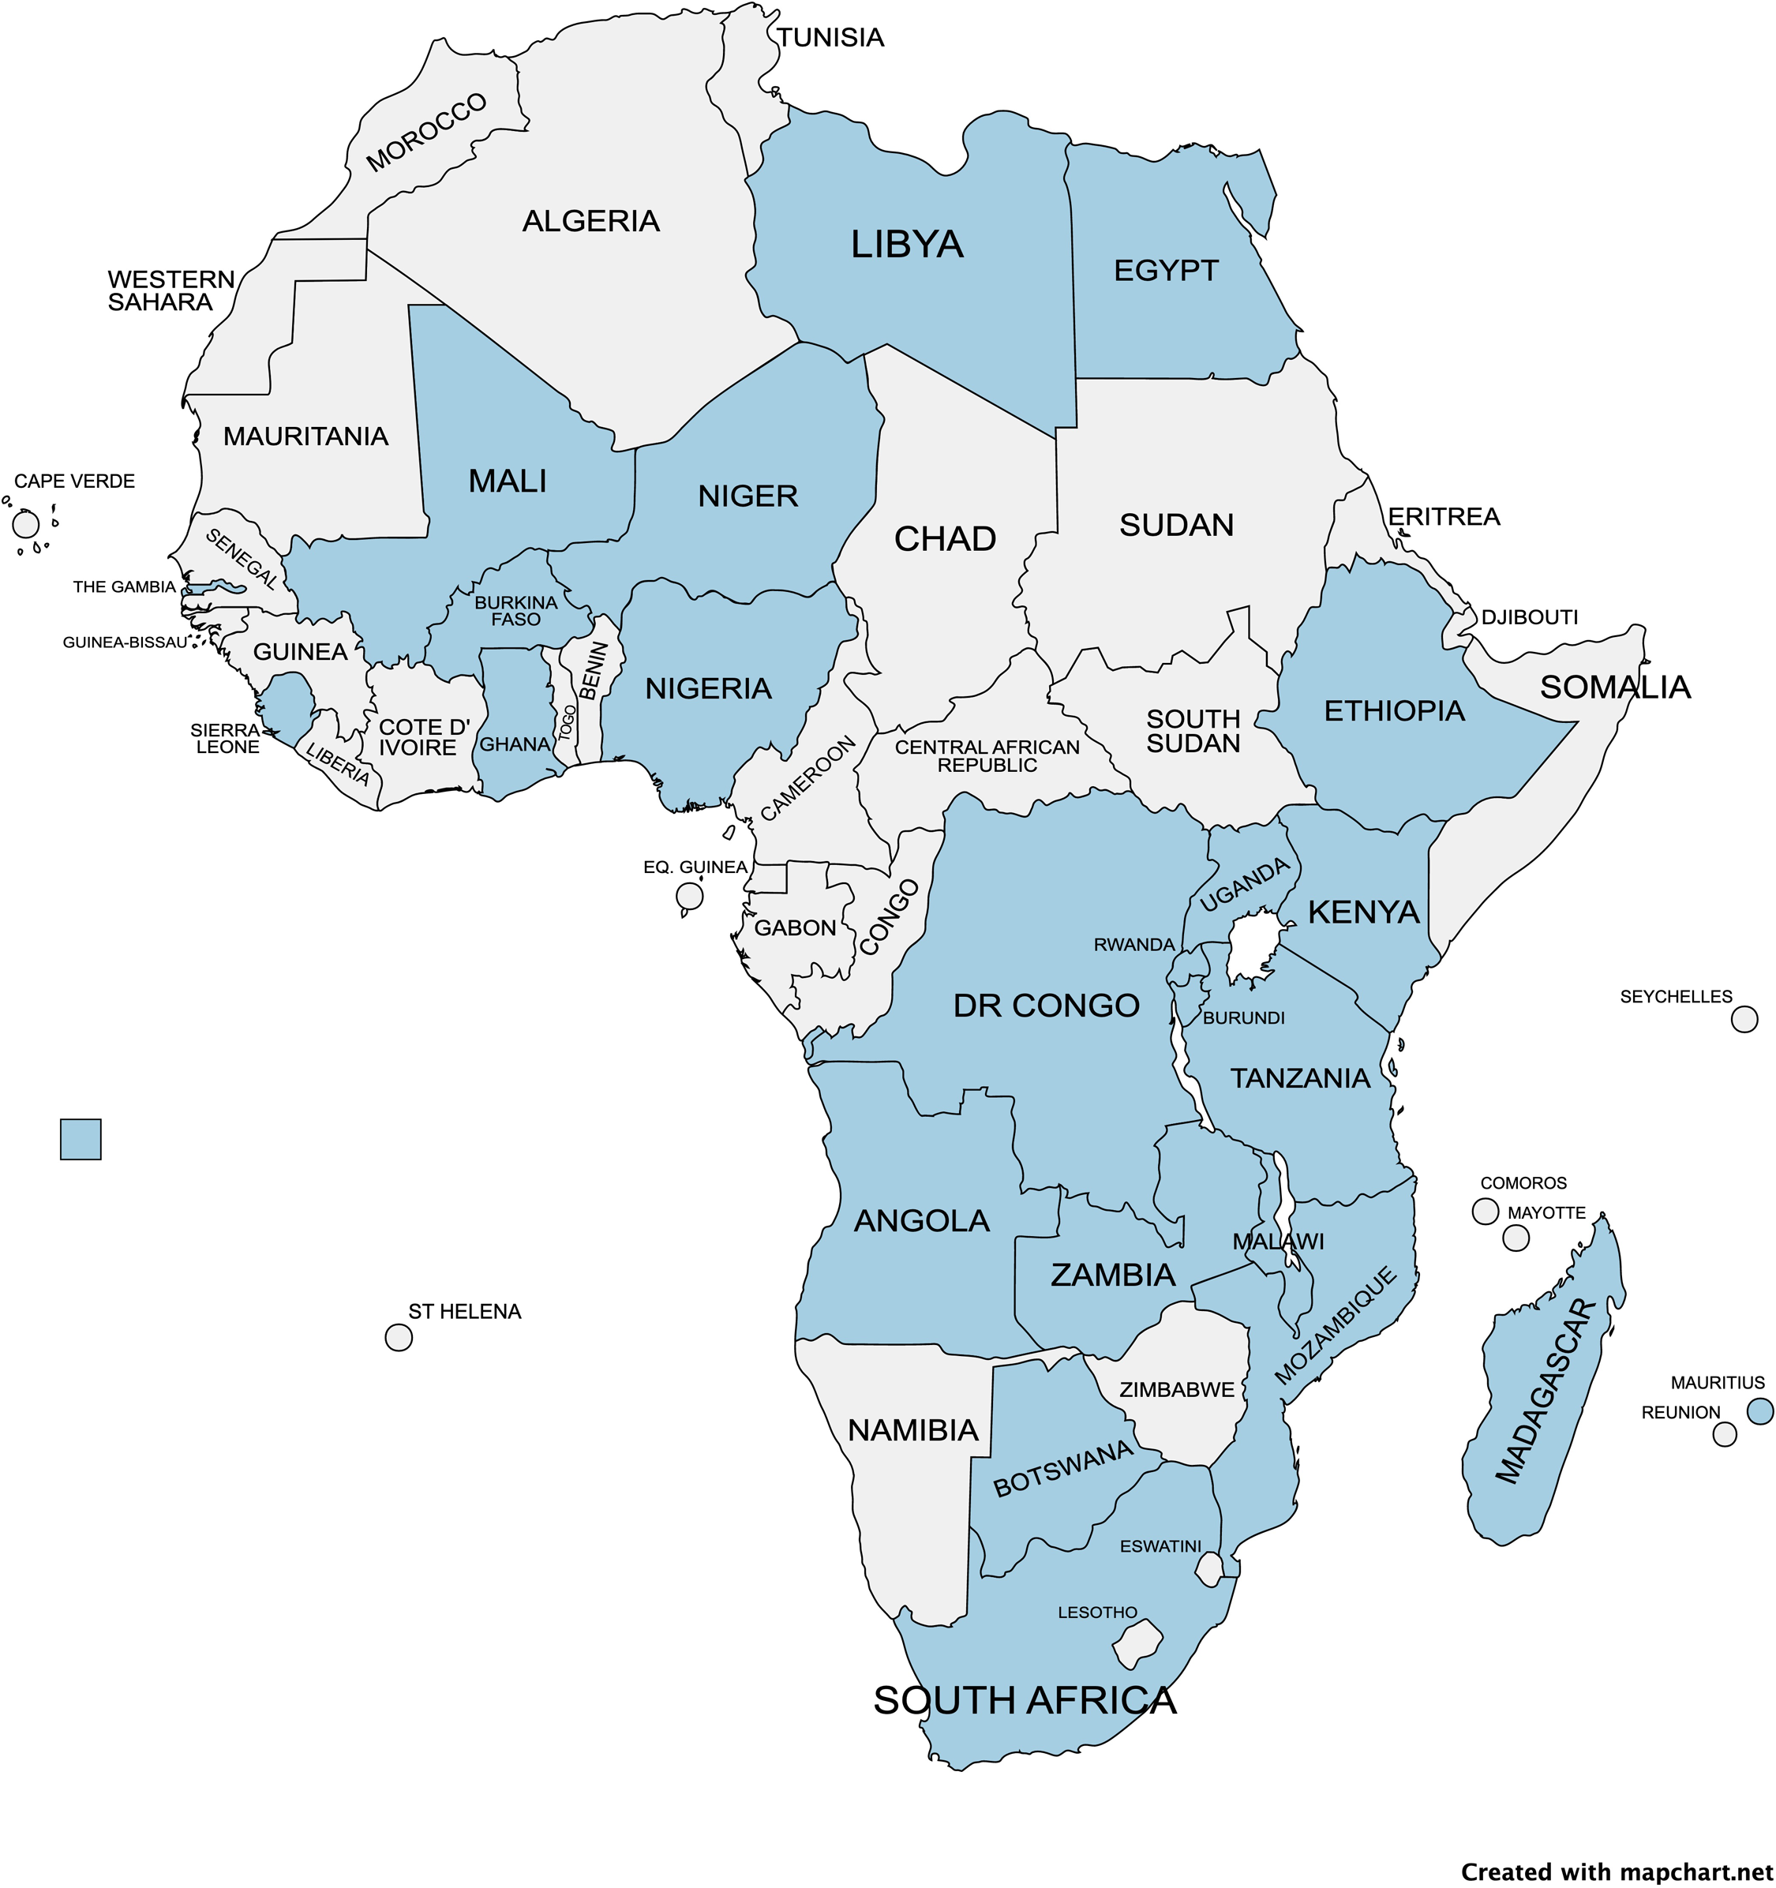
Range of interventions
Direct interventions
Risk assessment and screening
Checklists and protocols
Monitoring and surveillance
Availability of resources
Ability to perform technical skills
Indirect interventions
Community and maternal education
Contraception and family planning
Minimum training standards; referral patterns and delays
Advocacy to key stakeholders; simulation and team training
24-hour access to safe emergency caesarean delivery
Plos Global Health 2022. Taylor;2(8)

Slide 26

Health System Preparedness
Infrastructure
Health workforce
Skills and capacity
Equipment
Medicines
Technology
Geospatial mapping

Slide 27

Quality
Structure: All of the factors that affect the context in which care is delivered (physical facility, equipment, and human resources, and organizational characteristics)
Process: The sum of all actions that make up healthcare (diagnosis, treatment, preventive care, and patient education)
Outcomes: All the effects of healthcare on patients or populations (changes to health status, behavior, knowledge, satisfaction, survival and quality of life)

Slide 28

Failure to rescue
The idea that not every complication of medical care is preventable.
Health care systems should be able to rapidly identify and treat complications when they occur.
Failure-to-rescue is failure or delay in recognising and responding to a hospitalized patient experiencing complications from a disease process or medical intervention.
Measure of patient safety and quality of care

Slide 29
Surgical Safety (Human Behavior) Interventions
Staff education and training (capacity building)
Risk scoring systems
Rapid response systems (checklists)
Patient monitoring systems
Organisation of care bundles (Policies)
Clinical decision support (Guidelines)
Collaboration and support
Patient and family engagement

Slide 30

How to improve capacity to rescue
Consider innovative strategies to improve rescue
Community engagement
Policy engagement
Quality improvement
Capacity building

Slide 31

Innovations
Technology
New Diagnostic tools
Equipment
Infrastructure
Devices
Software
Communication platforms

Slide 32

Interventions targeted at communities
Health promotion
Health education
Screening
Teaching and training
Advocacy

Slide 33



Slide 34

Bridging the gap between Services and Systems
Services
Systems

Slide 35

Summary
PPH is common globally, but maternal mortality is highest in LMICs
Access and delayed access contribute to adverse outcomes
Failure to rescue is a reflection of the system and how well resourced it is
Social determinants and political determinants have a direct impact on patient outcomes
There is a need to bridge the gap between service delivery and health systems

