Slide 1

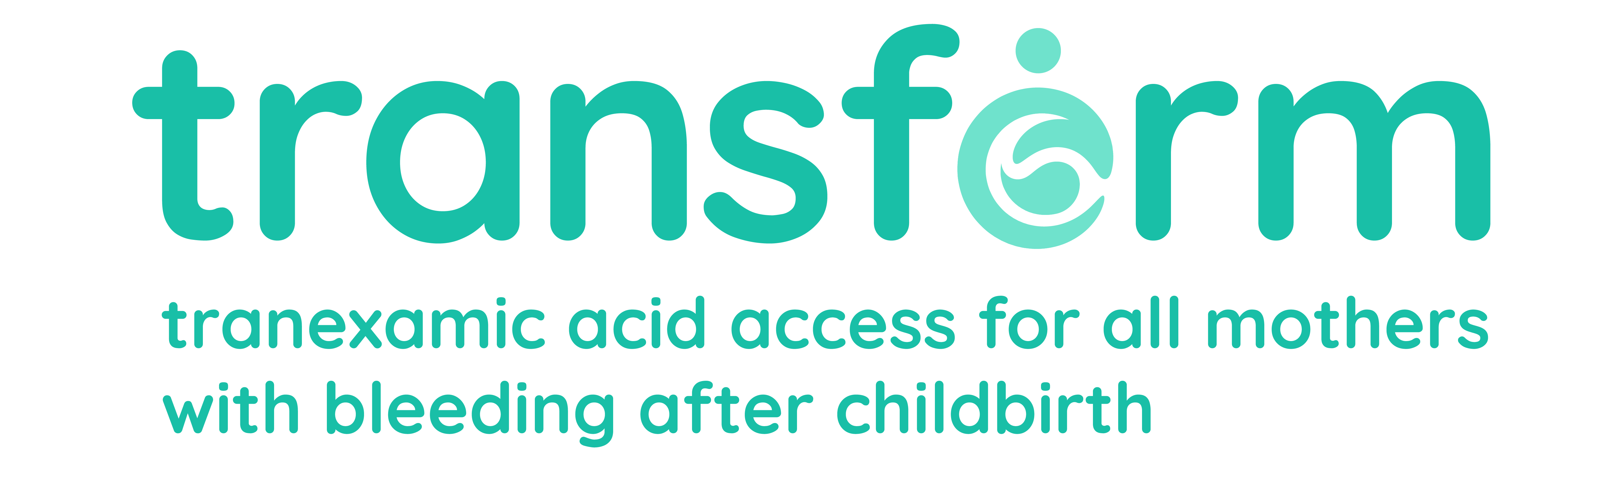

Intramuscular tranexamic acid for postpartum haemorrhage
Dr Amy Brenner
Assistant Professor
London School of Hygiene and Tropical Medicine, UK

Slide 2
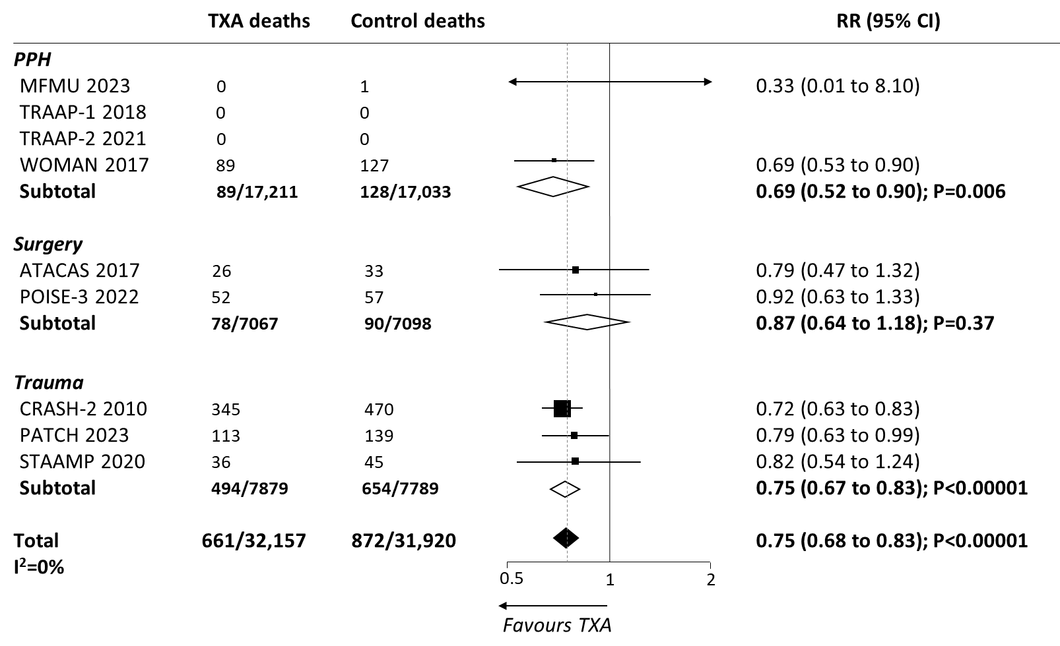
TXA is lifesaving
Randomised placebo-controlled trials of >500 participants

Slide 3
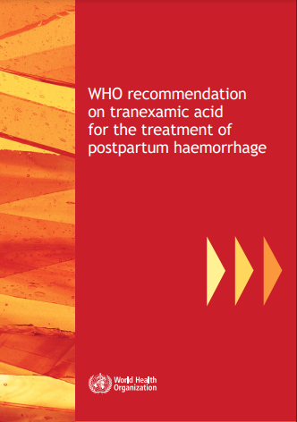
Need alternative routes of administration
TXA is most effective when given early
IV administration is major barrier to timely treatment
WHO initially called for research into alternative routes in 2017
WOMAN Trials Collaboration - programme of research:
PK-PD modelling, phase 1/2 trials in healthy volunteers, trauma victims and pregnant women to assess IV, IM and oral TXA

Slide 4
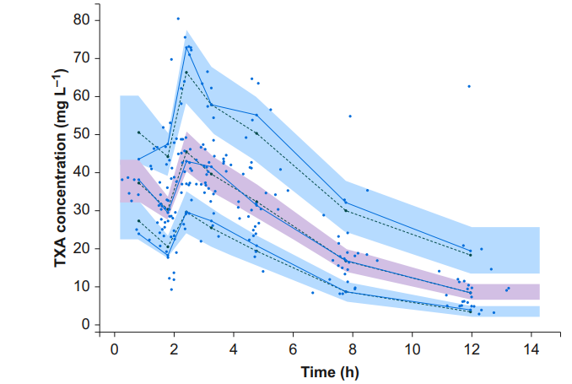
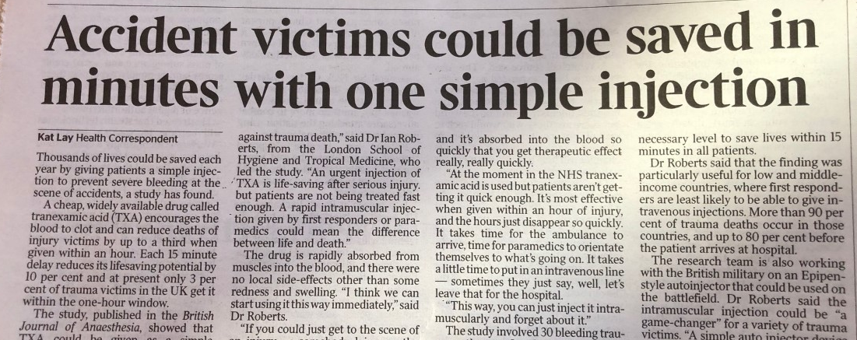

IM TXA for traumatic haemorrhage
PK study in 30 bleeding trauma victims
IM TXA rapidly absorbed and well tolerated

Slide 5
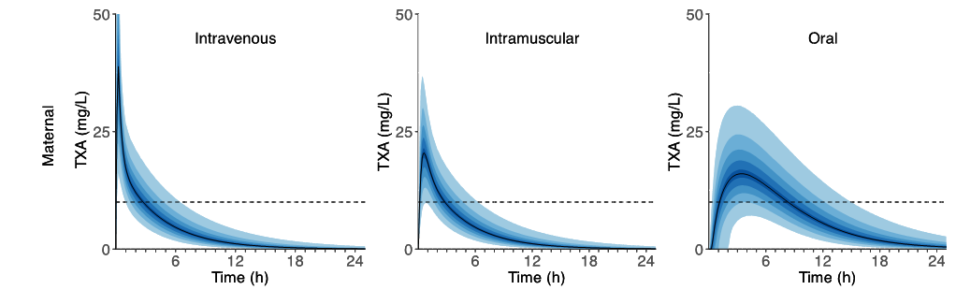

IM TXA for postpartum haemorrhage
Phase 2 trial in 120 women having caesarean section
IM TXA rapidly absorbed and well tolerated
Notes:
Explain time taken to reach therapeutic levels for IM vs oral route

Slide 6

Enough evidence to recommend the IM route?
Evidence not deemed sufficient, WHO called for more…
WHO PPH Roadmap priority research questions:
comparative effectiveness & safety of alternative routes
effectiveness and safety of TXA for PPH prevention
Important IM TXA innovations:
- autoinjector
- concentrated formulation

Slide 7


The I’M WOMAN trial
Aim: to assess the effects of IM and IV TXA in women at increased risk of PPH
Design: Randomised, placebo-controlled, three-arm trial
Setting: Hospitals in Africa and Asia
Population: ~30,000 women giving birth with 1+ risk factor for PPH
Intervention: Intramuscular TXA (1g)
Comparator/control: Intravenous TXA (1g), placebo
Outcome: Clinically diagnosed PPH
Timeline: Recruitment to start imminently, results expected in 2026

Slide 8
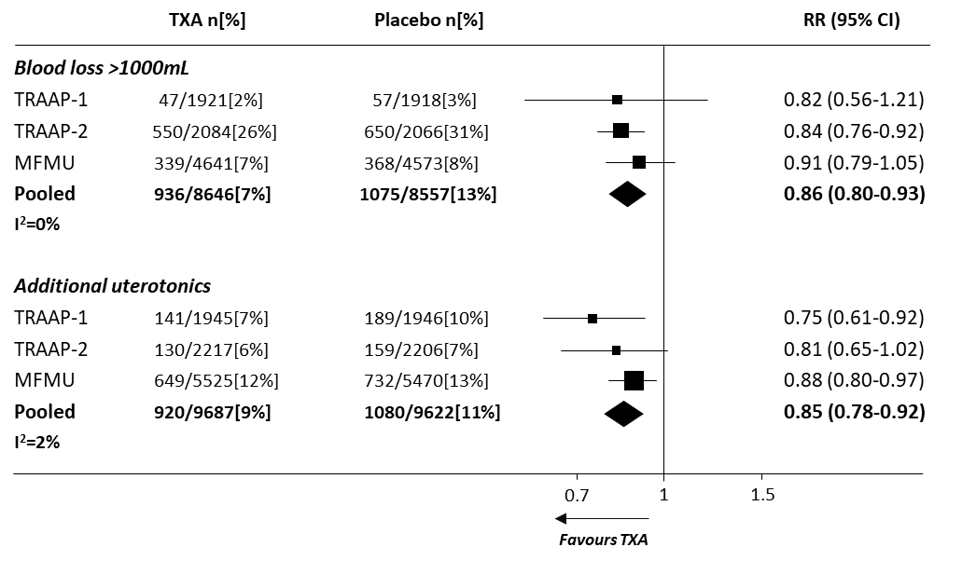
TXA for the prevention of PPH – benefits?
Prospectively registered, randomized placebo-controlled, well concealed trials of >500 patients.
Notes:
Benefits look promising but…

Slide 9
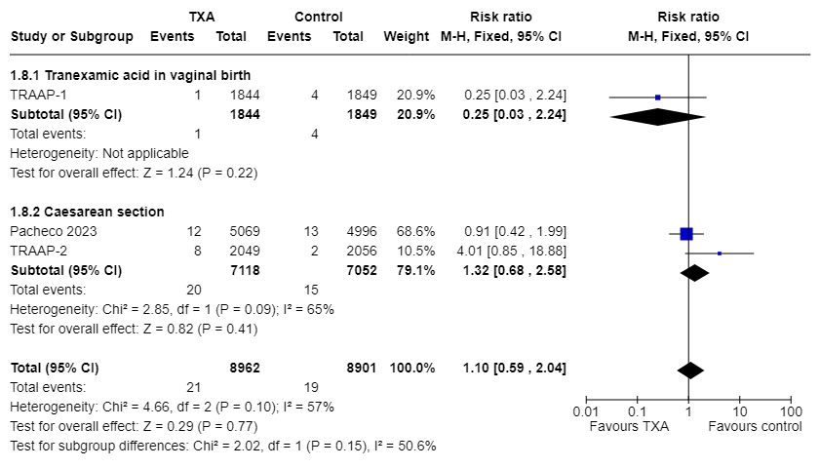
TXA for the prevention of PPH – harms?
TXA
Thrombosis
n N
Control
Thrombosis
n N
TXA
Thrombosis
n N
Prospectively registered, randomised placebo-controlled trials of >500 participants
Notes:
Pregnant women have increased risk of VTE, also a greater risk of venous thromboembolism (VTE) after cesarean delivery (CD). Need more evidence before recommending use in lower risk population

Slide 10
Balance of benefits and potential risks of
TXA for PPH prevention
Benefit increases with risk
I’M WOMAN trial
Net benefit if risk of PPH death is above threshold
Harm constant?

Slide 11
PPH interventions (lack of) evidence base
Interventions | WHO recommended? | WHO assessed quality of evidence
PPH prevention
Tranexamic acid | TBC | -
Controlled cord traction (VB with SBA) | Yes | High
Oxytocin | Yes | Moderate
Other uterotonics | Yes | Moderate
Uterine massage | No | Low
PPH treatment
Tranexamic acid | Yes | Moderate
Oxytocin | Yes | Moderate
Other uterotonics | Yes | Low
Uterine massage | Yes | Low
Fluid resuscitation (crystalloids) | Yes | Low
Bimanual uterine compression | Yes | Very low
External aortic compression | Yes | Very low
Balloon tamponade | Yes | Very low
Uterine artery embolization | Yes | Very low
Do we need more high-quality evidence?
Do women deserve better evidence?
Based on WHO PPH guidelines

Slide 12
Summary
High quality evidence that TXA is lifesaving, but the IV route is a major access barrier.
The I’M WOMAN trial will provide evidence on:
the effects of IV and IM TXA
the balance of benefits and potential harms of TXA for PPH prevention
Many PPH interventions are recommended based on low or very low-quality evidence
Based on existing evidence, you can:
Advocate for access to IV TXA for PPH treatment
Demand that TXA is available in the labour ward of all hospitals
Ensure training materials and guidelines are up-to-date
Strive for better evidence in maternal healthcare

Slide 13

Thank you for listening!
Any questions?
Amy.Brenner@lshtm.ac.uk
@WOMANtrial
Notes:
Zainab & son Mohamed aged 6, convinced TXA saved her life after having a PPH in WOMAN trial

