Slide 1



CARBOPROST VS OXYTOCIN AS FIRST LINE TREATMENT OF PRIMARY PPH
A PHASE IV DOUBLE BLIND DOUBLE DUMMY RCT
Shireen Meher
Deputy Chief Investigator, Birmingham Women’s and Children’s NHS Foundation Trust
Prof Andrew Weeks
Chief Investigator, University of Liverpool / Liverpool Women’s Hospital

Slide 2

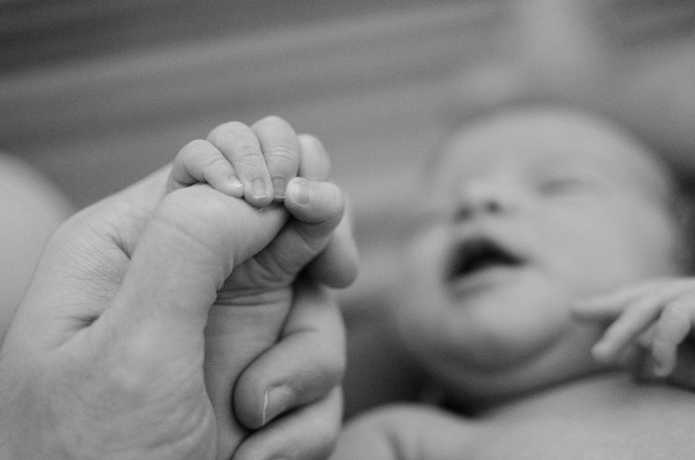

Objectives
Primary Objective
  To compare IM carboprost 250mcg with IV oxytocin (*5 or 10IU) for the initial treatment for women with clinically diagnosed PPH.
Secondary Objectives
  Cost-effectiveness
  Embedded qualitative study: views of participants and their carers about the treatments and the consent process.
* 5 IU following caesarean section, 10 IU following vaginal delivery
Notes:
As we’ve said the Primary Objective of COPE is to compare intramuscular carboprost with intravenous oxytocin for the initial treatment for women with clinically diagnosed PPH.
The secondary objectives of the study are
To assess the relative cost-effectiveness of the use of carboprost and oxytocin
To explore the views of participants and their carers about their experiences of the two treatments and the consent process

Slide 3
Methods
Study design
  Double blind double dummy placebo controlled RCT (phase IV study)
  Randomised in a 1:1 ratio, stratified by caesarean section or vaginal birth
Participants
  Women requiring medical treatment for primary PPH and >16 yrs age
  Exclusions: active cardiac / pulmonary disease, known contraindications/hypersensitivity to oxytocin or carboprost, stillbirth, declined participation antenatally
Outcome:
  Primary: blood transfusion up to 48 hours later (or hospital discharge if < 48 hours, includes cell salvage)
  Secondary: morbidity / mortality, core outcome set, health economics, qualitative outcomes

Slide 4
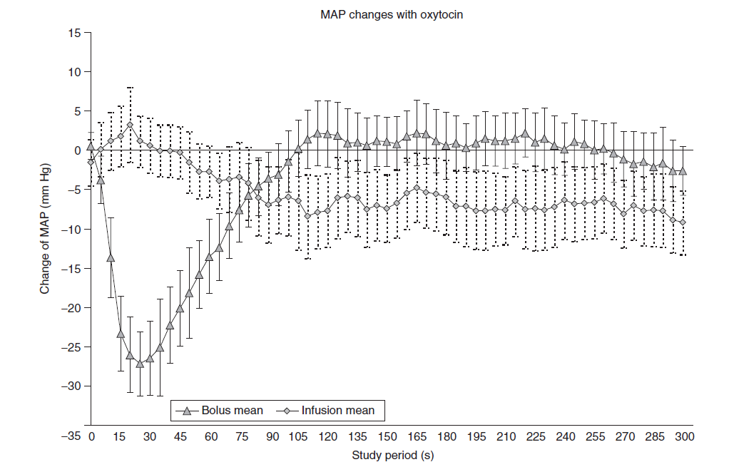
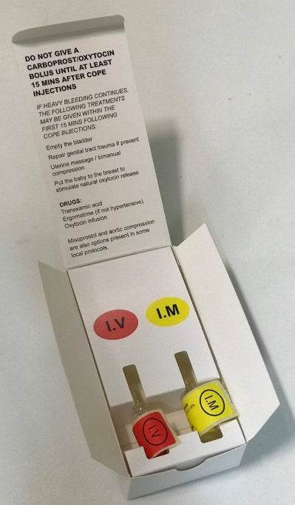
Intervention
  CARBOPROST
  250 micrograms by deep IM injection
  +
  PLACEBO
  (0.9% sodium chloride) by slow IV injection
  *OXYTOCIN
  (5 IU following caesarean section/ 10 IU following vaginal delivery) by slow IV injection
  +
  PLACEBO
  (0.9% sodium chloride) by deep IM injection
All intravenous injections to be given over at least 2 mins.
Dilution of intravenous injection in 10 mls saline to facilitate slow injection is advised
Oxytocin 5iu: bolus vs 5 min infusion Thomas et al. Br J Anaesth 2007
Notes:
Every COPE box will have 1 active drug and 1 placebo.
Either 250mcg of Carboprost given by deep IM injection and a placebo (0.9% sodium chloride) to be given IV
OR
10IU of oxytocin to be given IV and a placebo (0.9% sodium chloride) to be given IM

Slide 5
Key Features of COPE
Inclusive, pragmatic study
  Definition of PPH = any women who requires postnatal oxytocin therapy
  All women included – twins, retained placenta, caesarean section, placenta praevia
New consent procedures in an emergency
  Antenatal information
  Recruit without consent at time of postpartum haemorrhage
  Postnatal consent for follow-up
Notes:
To be eligible for COPE the woman must be over the age of 16 and need treatment for primary PPH.
Women are excluded from COPE if they’re known to have declined antenatally, are known to have a sensitivity to oxytocin or carboprost, have known active cardiac or pulmonary disease, known to have been previously treated as part of COPE, have already been treated for PPH, not including PPH prophylaxis, and women who have had a stillbirth.
Eligibility must be fully confirmed by a qualified DOCTOR authorised to do so on the Delegation Log. This must be explicitly recorded in the assessment of eligibility CRF prior to randomisation/no later than 12 hrs after randomisation.

Slide 6
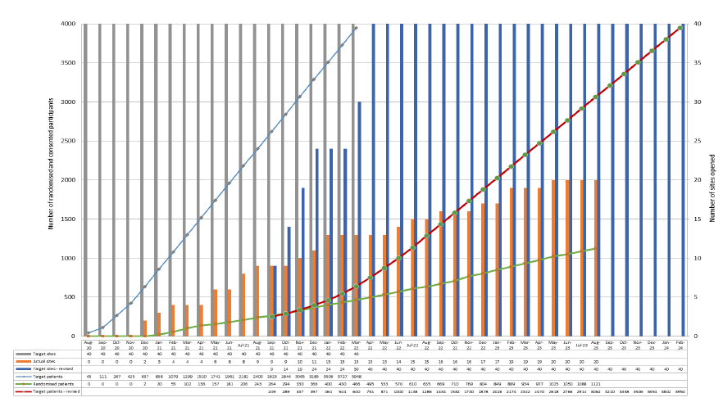
Progress so far…..
Recruiting for 32 months
Target: 3948 women, 40 sites
1121 women recruited
20 sites open
Recruitment will continue at least until July 2024
Pilot and qualitative work completed
Notes:
And this is the labelling of the drugs inside. Clearly labelled which is to be given IV and which is to be given IM. If upon inspection you notice that there is an issue with the kit, it should be quarantined & pharmacy notified.
If neither ampoule has been administered, the next sequential kit may be selected.
If one ampoule has been administered and there’s a problem with the second one a further COPE kit should not be selected. Care should continue as if both ampoules have been administered with use of emergency unblinding envelopes, if needed. We’re not sure where the unblinding envelopes will be just yet but we will know by the time we open
Anyone who usually administers medication can give these drugs, they don’t have to have had any extra training.
These should be given simultaneously if possible.
The next slide is just a short video about some potential recruitment scenarios.

Slide 7
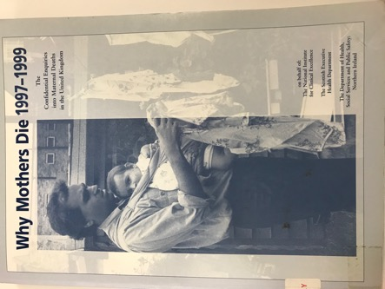
1. Contentious issues: dosage of oxytocin
Guidelines vary on recommended dose
Concerns about safety
  Maternal hypotension
  Case of maternal death with higher dose
COPE: 10iu SLOW IV bolus (5iu at Caesarean)
  Most powerful with rapid action, no harm in RCTs
  In line with WHO and NICE guidelines
  5 IU – not widely used except for Caesarean
  IM route – slower onset of action
  IV infusion – slow to prepare
Weeks AD. View from over the drapes: oxytocin at caesarean section and the COPE study. Anaesthesia News Nov 2020
A maternal death in a woman who had a high spinal block, adherent placenta and PPH received 10 IU iv bolus - CEMD 1997-9
Notes:
And this is the labelling of the drugs inside. Clearly labelled which is to be given IV and which is to be given IM. If upon inspection you notice that there is an issue with the kit, it should be quarantined & pharmacy notified.
If neither ampoule has been administered, the next sequential kit may be selected.
If one ampoule has been administered and there’s a problem with the second one a further COPE kit should not be selected. Care should continue as if both ampoules have been administered with use of emergency unblinding envelopes, if needed. We’re not sure where the unblinding envelopes will be just yet but we will know by the time we open
Anyone who usually administers medication can give these drugs, they don’t have to have had any extra training.
These should be given simultaneously if possible.
The next slide is just a short video about some potential recruitment scenarios.

Slide 8
2. Concern about side effects
Adverse Reaction | Events [Participants (%)] N=503 (pooled data)
Vomiting | 67 (13.3%)
Hot flushes | 35 (7.0%)
Hypotension | 18 (3.6%)
Diarrhoea | 17 (3.4%)
Headache | 8 (1.6%)
Pyrexia; temperature of greater than 38°C | 2 (0.4%)
Total | 147 (22.3%]
Notes:
And this is the labelling of the drugs inside. Clearly labelled which is to be given IV and which is to be given IM. If upon inspection you notice that there is an issue with the kit, it should be quarantined & pharmacy notified.
If neither ampoule has been administered, the next sequential kit may be selected.
If one ampoule has been administered and there’s a problem with the second one a further COPE kit should not be selected. Care should continue as if both ampoules have been administered with use of emergency unblinding envelopes, if needed. We’re not sure where the unblinding envelopes will be just yet but we will know by the time we open
Anyone who usually administers medication can give these drugs, they don’t have to have had any extra training.
These should be given simultaneously if possible.
The next slide is just a short video about some potential recruitment scenarios.

Slide 9
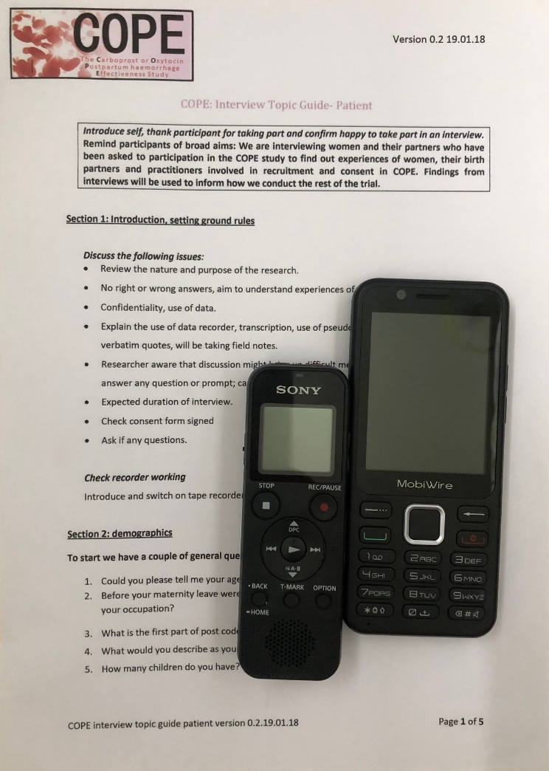

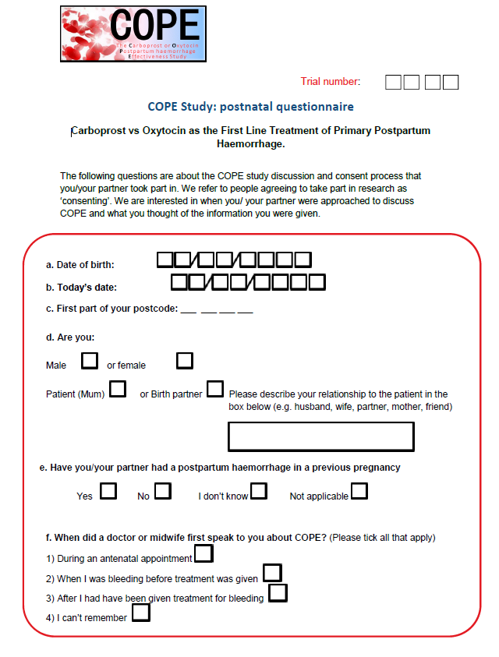
3. Consent: research without prior consent (RWPC)
The Embedded Qualitative Study
Women and birth partners
12 Consent discussion recordings
286 Questionnaires: 190 women (51%) 96 birth partners
22 interviews
Staff
27 staff- focus group
9 interviews
Notes:
And this is the labelling of the drugs inside. Clearly labelled which is to be given IV and which is to be given IM. If upon inspection you notice that there is an issue with the kit, it should be quarantined & pharmacy notified.
If neither ampoule has been administered, the next sequential kit may be selected.
If one ampoule has been administered and there’s a problem with the second one a further COPE kit should not be selected. Care should continue as if both ampoules have been administered with use of emergency unblinding envelopes, if needed. We’re not sure where the unblinding envelopes will be just yet but we will know by the time we open
Anyone who usually administers medication can give these drugs, they don’t have to have had any extra training.
These should be given simultaneously if possible.
The next slide is just a short video about some potential recruitment scenarios.

Slide 10
3. Consent: women’s views of RWPC
“You can be completely low risk and end up, you know, requiring litres of blood. I think nobody is going to retain that information at the time if they are haemorrhaging or having somebody place metal forceps in their vagina”.
P18 Mother
8%
Notes:
And this is the labelling of the drugs inside. Clearly labelled which is to be given IV and which is to be given IM. If upon inspection you notice that there is an issue with the kit, it should be quarantined & pharmacy notified.
If neither ampoule has been administered, the next sequential kit may be selected.
If one ampoule has been administered and there’s a problem with the second one a further COPE kit should not be selected. Care should continue as if both ampoules have been administered with use of emergency unblinding envelopes, if needed. We’re not sure where the unblinding envelopes will be just yet but we will know by the time we open
Anyone who usually administers medication can give these drugs, they don’t have to have had any extra training.
These should be given simultaneously if possible.
The next slide is just a short video about some potential recruitment scenarios.

Slide 11
3. Consent: timing of consent
Not antenatal: it may cause ‘unnecessary panic’
Not intrapartum verbal: “…I couldn’t relay anything that they said in there (Mother P6)
Not too soon after birth: “It took a few days to come back to normal… and start thinking properly” (Mother, P1)
When partner present: “I think he liked it as well…“ (Mother P4)
Increase visibility: “I would personally liked to have known before, even if nothing went wrong” (Mother, P2)
Notes:
And this is the labelling of the drugs inside. Clearly labelled which is to be given IV and which is to be given IM. If upon inspection you notice that there is an issue with the kit, it should be quarantined & pharmacy notified.
If neither ampoule has been administered, the next sequential kit may be selected.
If one ampoule has been administered and there’s a problem with the second one a further COPE kit should not be selected. Care should continue as if both ampoules have been administered with use of emergency unblinding envelopes, if needed. We’re not sure where the unblinding envelopes will be just yet but we will know by the time we open
Anyone who usually administers medication can give these drugs, they don’t have to have had any extra training.
These should be given simultaneously if possible.
The next slide is just a short video about some potential recruitment scenarios.

Slide 12
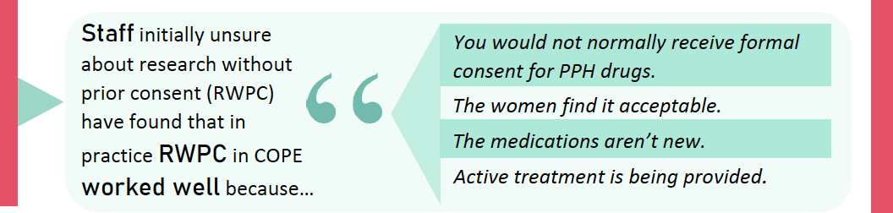
3. Consent: staff views of RWPC
“I think the fact that the women are okay with it, puts to bed any worries that I had about how it would be perceived…”
Notes:
And this is the labelling of the drugs inside. Clearly labelled which is to be given IV and which is to be given IM. If upon inspection you notice that there is an issue with the kit, it should be quarantined & pharmacy notified.
If neither ampoule has been administered, the next sequential kit may be selected.
If one ampoule has been administered and there’s a problem with the second one a further COPE kit should not be selected. Care should continue as if both ampoules have been administered with use of emergency unblinding envelopes, if needed. We’re not sure where the unblinding envelopes will be just yet but we will know by the time we open
Anyone who usually administers medication can give these drugs, they don’t have to have had any extra training.
These should be given simultaneously if possible.
The next slide is just a short video about some potential recruitment scenarios.

Slide 13

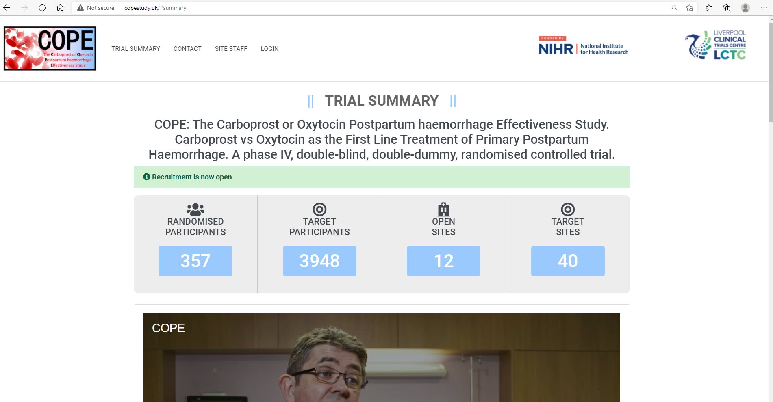
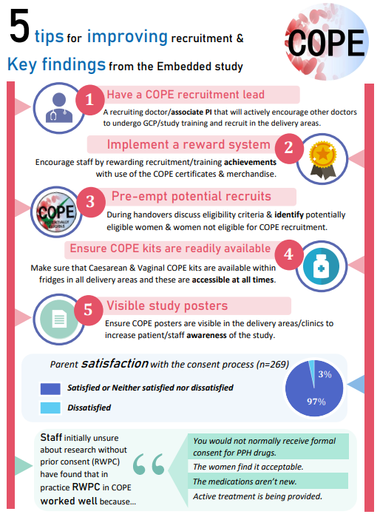
Improving recruitment and supporting sites
Remove antenatal recruitment pathway
Move from paper to online data collection
Supporting sites: weekly online How to Cope Drop in Sessions / Newsletter / Tip and tricks to recruit: COPE eligibility stickers / fridges with trial drugs close to delivery area /Online training
https://copestudy.uk
Username: training
Password: copeTRAINING56
How To COPE…
Weekly Teams drop-in
Wed 4-5pm
Notes:
And this is the labelling of the drugs inside. Clearly labelled which is to be given IV and which is to be given IM. If upon inspection you notice that there is an issue with the kit, it should be quarantined & pharmacy notified.
If neither ampoule has been administered, the next sequential kit may be selected.
If one ampoule has been administered and there’s a problem with the second one a further COPE kit should not be selected. Care should continue as if both ampoules have been administered with use of emergency unblinding envelopes, if needed. We’re not sure where the unblinding envelopes will be just yet but we will know by the time we open
Anyone who usually administers medication can give these drugs, they don’t have to have had any extra training.
These should be given simultaneously if possible.
The next slide is just a short video about some potential recruitment scenarios.

Slide 14
Thank you
Any questions?
Website: www.copestudy.uk
For further information contact ctrccope@liverpool.ac.uk

Slide 15
Study procedures
Emergency treatment +/- unblinding
Additional interventions (if required)
Randomise: obtain IMP box from fridge
Oxytocin
10 iv
Pregnant women
High / low risk
vaginal birth / CS
PPH
Carboprost
250 mcg IM
antenatal consent
15m
4 wk
Recruit without prior consent
Get consent to use data later, within 24 hrs
Outcomes

