Slide 1
PBC Toolkit Training for Core Implementation Teams
MOMENTUM Integrated Health Resilience
Introduction to Provider Behavior,
Provider Behavior Change (PBC), and the PBC Ecosystem
Adapted and expanded from Breakthrough ACTION’s
Provider Behavior Change Toolkit
April 2024

Slide 2
Objectives
Participants should:
Understand the purpose and content of the Provider Behavior Change Toolkit
Know how to use the Provider Behavior Change Toolkit
Have a vision for provider behavior change (PBC) efforts
Identify areas for adaptation in fragile settings and be able to apply to the toolkit
Prepare for the development of an action plan for applying the Toolkit, including indicators for measurement

Slide 3
What is Provider Behavior?
What providers do and do not do in their professional capacity
Includes behaviors before, during, or after an interaction with a client in the health facility

Slide 4
What is Provider Behavior Change?
PBC includes initiatives aimed at influencing provider behavior with the goal of:
Improving service delivery and adherence to guidelines
Improving the client experience and boosting trust in and demand for services
Increasing provider job satisfaction
Increasing the adoption or maintenance of desired behaviors among clients
Improving health outcomes

Slide 5
Why Provider Behavior Change?
Health providers play a critical role in the health system, as they have close and frequent interactions with their clients.
The quality of these interactions helps define patients’ experiences of care and their perceptions of the quality of care they received.
Patient experiences and perceptions have implications for continued use of healthcare services, the likelihood that clients will adopt or maintain healthy behaviors, and the likelihood of achieving desired health outcomes.

Slide 6
Provider Behavior Change Approaches
PBC sees providers as both a channel and an audience in their own right
Providers as the focus of the intervention
Providers can influence other providers and health staff (as well as clients)

Slide 7
Provider Behavior Change Approaches (continued)
PBC can employ a broad range of approaches:
Educational: Training, continuing medical education
Cues: Job aids, SMS reminders, point-of-service materials
Managerial: Supervision, mentorship, changes in facility processes, staffing adjustments
Group problem solving: Quality improvement
Addressing biases, social norms, and workplace norms: peer-to-peer, value clarification
Financial: Performance-based financing

Slide 8
Discussion
What are some behaviors you have noticed during visits to clinics? How did they affect you? Your family? Your friends?
As a public health/medical practitioner, how do you see provider behavior affecting quality of services and client-provider interaction?

Slide 9
What Affects Provider Behavior Change?
Many factors at multiple levels in the health system influence the way service providers act while delivering services
Provider behavior is the result of a complex set of factors
A provider’s ability or motivation to perform their roles effectively may be hindered by barriers at the individual, interpersonal, organizational, and institutional levels
Note: Most graphics used here are from the BA toolkit
Notes:
Provider ecosystem map:
Places provider at the center. Graphically represents the provider’s ecosystem
Many influencing factors at different levels. Relationships and interactions between factors
Facilitates holistic thinking and planning. Variety of approaches and strategies needed across system

Slide 10
Provider Behavior Ecosystem Map
A thinking tool to help SBC and service delivery practitioners, researchers, and donors working in voluntary family planning/reproductive health and other health areas do the following:
Understand and consider diverse factors that influence facility-based provider behavior
Understand how factors relate to and interact with one another across a system
Think more holistically about provider behavior change
Design, implement, and evaluate more supportive, effective provider behavior change initiatives

Slide 11
Use and Application
Formative research
Project design and implementation
Monitoring and evaluation
Advocacy and agenda-setting

Slide 12
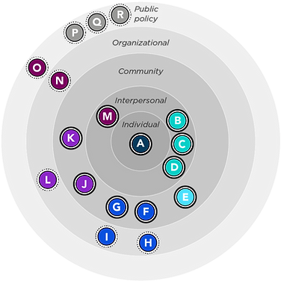
Individual Work
Video
Explore Provider Behavior Ecosystem Map
Familiarize yourself with the key actors and entities by clicking on link below:
https://breakthroughactionandresearch.org/provider-behavior-ecosystem-map/
Notes:
https://www.youtube.com/watch?v=zL5b66-xLtE
https://breakthroughactionandresearch.org/provider-behavior-ecosystem-map/

