Slide 1



A Practical Introduction to Classic LQAS
An Interactive Discussion about the Whys, Whens, and Hows of Applying Lot Quality Assurance Sampling
Joseph J. Valadez, Liverpool School of Tropical Medicine
MOMENTUM Monitoring Evaluation Innovation and Learning Working Group Webinar | February 22, 2024

Slide 2
Learning Objectives this Session
In-depth look at what LQAS is used for and not used for
Addressing questions such as:
    When to use it
    Who uses it
    Why use it
    How to use it

Slide 3
I Have a Problem
I am managing a malaria control programme.
The population should be protected by an LLIN
People with fevers should be tested for malaria and told their result within 24 hours of the onset of symptoms
Positive cases should be treated with an appropriate anti-malarial
I am working in some but not all of the districts.
This programme is implemented through the District health management teams
What is the utility of LQAS in this programme?

Slide 4
Information is Needed about the Program Activities. But at What Level Should I Obtain it?
National Level
District
District
Sub-District
Sub-District
Sub-District
Sub-District
Sub-District
Sub-District
Sub-District
Sub-District
Local managers need M&E data that show what is happening in the areas where they work

Slide 5
Surveys Monitoring Performance: Identifying Pockets of Risk
Immunization Coverage Target = 70%
Outcome Indicator = 68.4% children (95% CI + 0.07)
Coverage with Measles Vaccination
Catchment Area X
80%
90%
85%
80%
D
I
S
T
R
I
C
T
S
These sub-districts are your priorities to improve.
Called Supervision areas
55%
85%
95%
55%
90%
30%
30%
95%
70%
45%
45%
65%

Slide 6
Why LQAS?
The question implied by these examples is:
  How to assess performance in multiple locations delivering services
  And tell me the status of my program as a whole?
  And do it recurrently?
Use the data for 2 purpose:
    management of local production
    senior management decision making & reporting
Lot Quality Acceptance Sampling (LQAS) was developed to address these 2 purposes

Slide 7
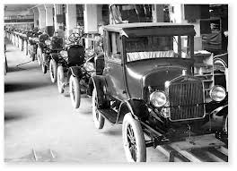
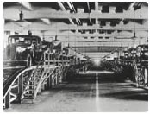
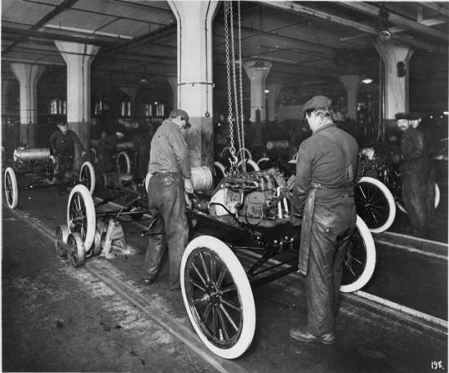
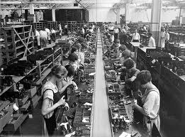

What Is LQAS?
A classification method:
used locally – in “supervision areas”
  To identify priority areas: not reaching an established performance target for coverage with a medication or vaccination, or voluntary counselling and testing for HIV (e.g., District, sub-district, catchment area for an activity, refugee camp, NGO or grantee catchment)
  Useful for local management decision making
Data when aggregated measure average coverage at more central level
(e.g., Region or province or nation)
  Suitable for reporting and policy purposes
LQAS uses small samples
Notes:
This slide shows 3 uses of LQAS. Third use (Technical Quality Assessment) is not relevant to this paper.
BY THIS COMMENT I THINK WE MEANS THAT THIS SLIDES DEALS WITH COVERAGE ESTIMATES AND NOT QUALITY.

Slide 8
We need Decentralised Measurement Tools
LQAS (Lot Quality Assurance Sampling)
Please see:
LQAS Empowering Community Health
https://www.lstmed.ac.uk/research/departments/international-public-health/monitoring-and-evaluation-technical-assistance-1
Chapter 1 of the training video
https://www.bit.ly/LQAS-In-Africa
Or
https://www.bit.ly/LQAS-in-South-Asia
and

Slide 9
Reached target
A
B
C
Below the target or
below average
D
E
F
G

Slide 10
Maintain the program at the
current level
Reached target
Identify Supervisors and Health
Workers that can help other Health Workers improve their performance
Below the target or
below average
Identify the reasons for program problems
Develop targeted solutions

Slide 11
Lot Quality Assurance Sampling
Works by dividing the survey area into 4 or more “Supervision Areas” (SA) based on how services are delivered
Train local health staff to randomly sample 19 respondents in each SA (a typical sample size)
These are then aggregated as a stratified random sample
(so here n = 5 x 19 = 95)
A
B
C
D
E
No meaningful Design Effect

Slide 12
How do I Choose an LQAS Sample Size and Decision Rule?

Slide 13
Three Basic Steps to Choose a Decision Rule
Set the target or the level of coverage your program is to accomplish and you want classified correctly if it has reached it (e.g., 80% coverage)
Set a lower threshold defining areas of egregiously low coverage you cannot afford to misclassify as acceptable. (e.g., 50% coverage)
    Typically, the coverage target (p-Upper) is about 30 percentage points larger than the lower threshold (p-Lower) for a sample of 19.
Define an acceptable classification error for each of these thresholds (e.g., <0.10, <0.10)
These decisions affect the sample size.
Note: p-Upper and p-Lower can be set at any level relevant to the intervention of interest.
LQAS is very sensitive for detecting the worse of the worse, and the best of the best

Slide 14
LQAS Sample Size & Decision Rule Table

Slide 15

The LQAS Table Is Based on 60 pages of Statistical Tables available in my book (1991)
Available through:
Harvard University Press
https://www.hup.harvard.edu/books/9780674049956
Amazon
Barnes & Noble
Waterstone

Slide 16
Summary of Steps to Collect the Data
Define the SA and the CA
Define the client populations of interest, key indicators, targets
Use PPS to identify the interview locations (normally villages)
Use Segmentation Sampling to select the starting Household
At the HH identify an eligible the interviewee using SRS if necessary
Use the LQAS Table to classify each SA
Aggregate the data to measure the prevalence

Slide 17
How Large a Sample Do You Need? What Resources Do You Have to Collect the Data?

Slide 18

Data Collection in Challenging Locations
Nepal c. 2008
Measurement is challenging
Select the most efficient sample

Slide 19

Keep the sample small as is required
South Sudan in the rainy season 2020 National LQAS

Slide 20
LQAS is a Classification Method
  Areas are classified as performing “acceptably” or “unacceptably” according to a performance target
  Classification is linked to a program response
    Invest resources in areas with unacceptable coverage to identify underlying reasons for the problems
    Identify effective practices in areas with acceptable coverage to maintain them
  Classification based on a sample from the population
    Subject to risks of misclassification errors
  Data across several SA can be aggregated as a stratified random sample to calculate coverage for the entire catchment area.

Slide 21
Common Pitfalls to Avoid
What a Sample of 19 Cannot Tell Us
Too imprecise to calculate exact coverage in a Supervision Area due to the typically small denominator (e.g., 8/19, 95%CI +0.225)
      Very precise to calculate coverage for the entire catchment area.
Not sensitive to detect differences in Supervision Areas that have small differences between them
      Don’t define a middle band of coverage (sometimes called the middle level of coverage depicted by the color yellow)
Not training data collectors for the full 4-5 days; thinking that LQAS doesn’t need in-depth training
Not checking the reliability of the data collection.

Slide 22
Advantages of LQAS for Local Program Management
Train local managers to collect the LQAS sample in areas for which they are responsible and know.
Can be used at a local level with modest amounts of supervision due to the sample size– (sustainability)
Identifies where the successes and challenges are located
Produces information that can be rapidly interpreted by local managers
Paper/pencil analyses rather than requiring computer analyses
Data can then be used for national reporting (95% confidence intervals) as well as for local management
A sampling theory that can be scrutinized (statistically a most accurate method)
Notes:
With the binomial model --

Slide 23
Children <5 years Slept Under
LLN Last Night
Target = 65%, Decision Rule = 10
 | Anseba, Eritrea
Area | Yes |  | No | Total
1 | 9 | * | 10 | 19
2 | 13 |  | 6 | 19
3 | 18 |  | 1 | 19
4 | 3 | * | 16 | 19
5 | 11 |  | 8 | 19
6 | 12 |  | 7 | 19
7 | 18 |  | 1 | 19
8 | 12 |  | 7 | 19
Total | 96 |  | 56 | 152
CRUDE Coverage |  |  |  | 0.632
These are the problem supervision areas. The Decision Rule is 10 infants who slept under an ITN in the night preceding survey.

Slide 24
District 1
District 2
District 3
District 4
District 6
District 5
*

Slide 25
Table 1: Anseba Zoba and Its 8 Sub-Zoba: Multiple ITN Indicators Sub-Zoba 1 2 3 4 5 6 7 8 |  |  |  |  |  |  |  |  | Zoba Coverage
>1 Bed net in HH (0-11) | 17 | 19 | 19 | 13 Prob | 18 | 18 | 18 | 17 | 91.4%
Slept under net (0-11) | 15 | 19 | 18 | 8 Prob | 18 | 17 | 17 | 12 Prob | 82.1%
Dipped in Last 6 mo (0-11) | 9 Prob | 18 | 13 | 3 Prob | 18 | 12 | 12 | 11 | 64.4%
Net with no visible tears or holes | 13 | 14 | 5 Prob | 7 Prob | 16 | 12 | 12 | 10 | 59.7%
While pregnant slept under ITN (0-11) | 12 | 18 | 16 | 8 Prob | 15 | 14 | 15 | 9 Prob | 71.3%

Slide 27
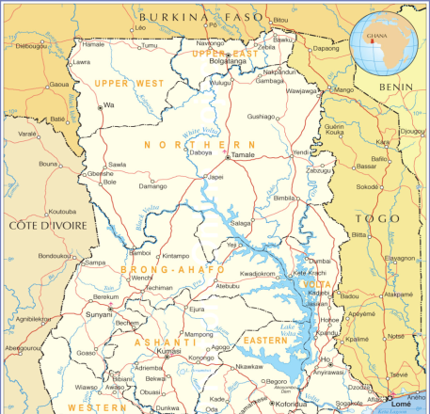
Ghana (2012): Three Regions Assessed
Northern Region is identified as the priority region for vaccination…

Slide 28
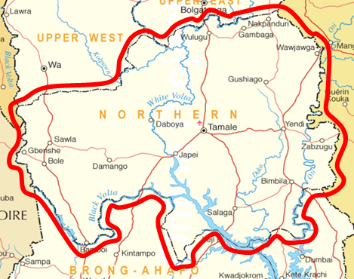

10 Districts in Northern Region: Ghana 2012
…Central Gonja District is identified as the district in need of most support…

Slide 29
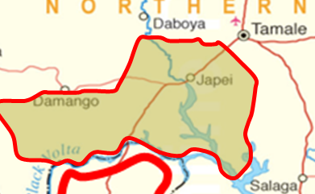
5 Supervision Areas in Central Gonja District: Ghana 2012
… and Kusawgu Sub-District is identified as the priority within Central Gonja.

Slide 30
LQAS Can be Used over Time to Track Change

Slide 31
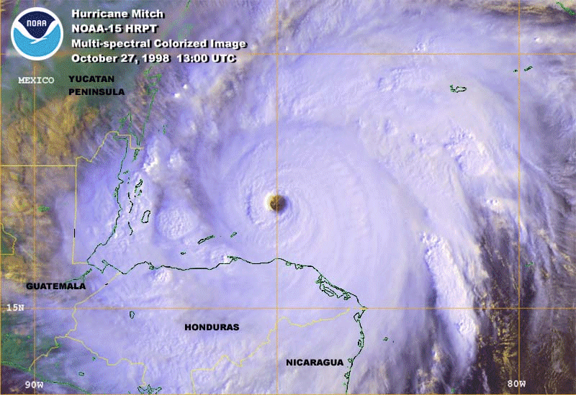

Slide 36


Based on 20+years in Nicaragua
A programme organisational model established to aid Nicaragua recover from Hurricane Mitch (1999-2003) with support of 16 local and international NGOs organised in a coordinated network.
The systems established then continue even today through the difficult Ortega Regime.
See Michael Quinn Patton’s Book. Review: https://bit.ly/MQPatton-Review-Saving-Societies-from-Within

Slide 37
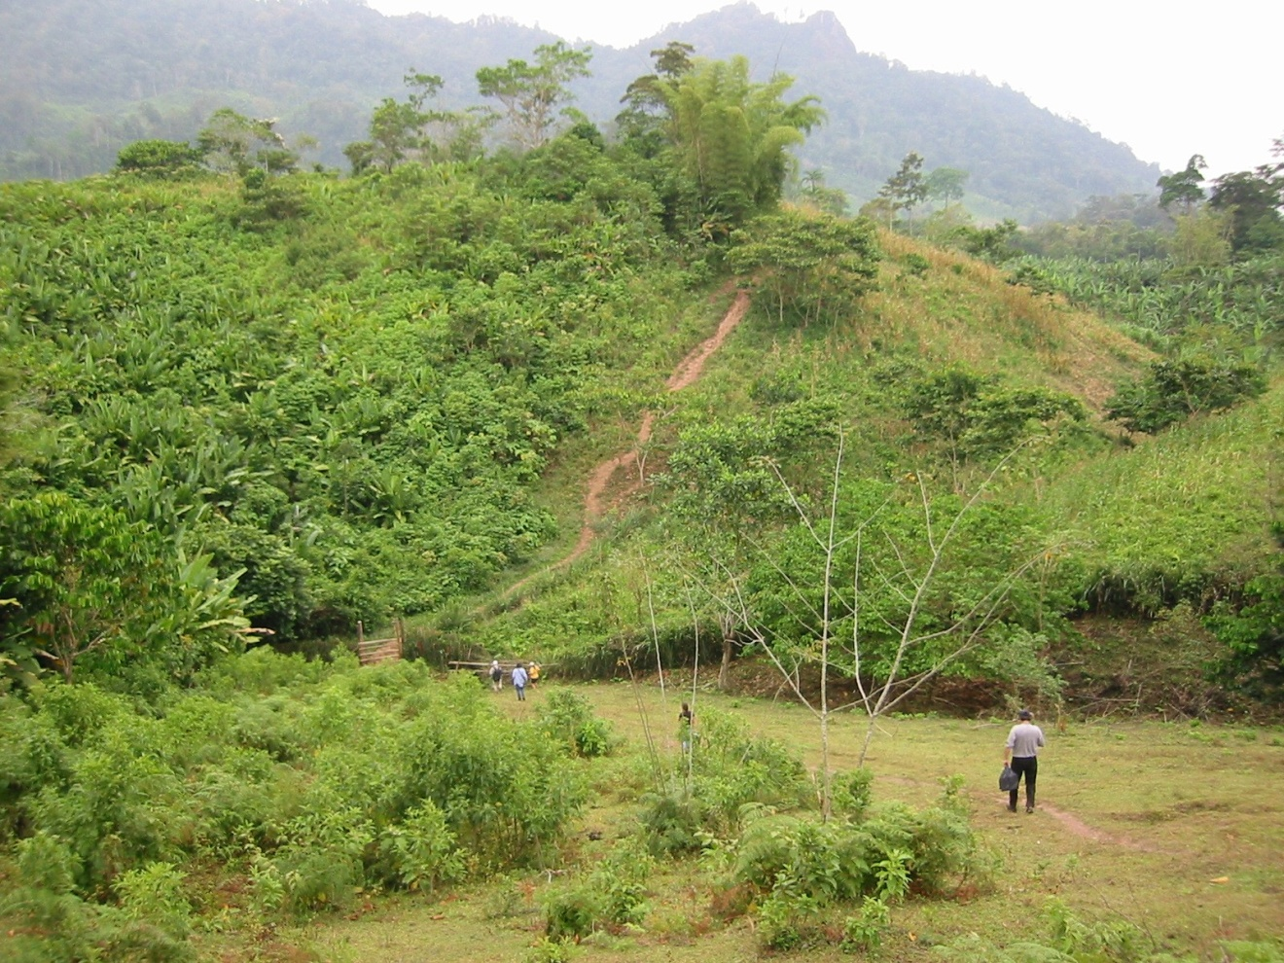
Use LQAS Tools and Links
LQAS Toolkit & training manuals
  www.bit.ly/LQAS-Toolkit
Sample Size Calculator
  www.bit.ly/LQAS_Sample_Size_Calculator
Large Country LQAS to integrate LQAS and cluster sampling
  https://openknowledge.worldbank.org/entities/publication/937b8feb-4926-5faa-a306-cc095c580099
  www.bit.ly/LC-LQAS-Sample-Size-Calculator
GAM LQAS https://academic.oup.com/ije/article/36/4/858/669356

Slide 38
Discussion

Slide 39
THANK YOU
For questions on LQAS, please contact Joseph Valadez (joseph.valadez@lstmed.ac.uk).
For questions on the MOMENTUM Monitoring Evaluation Innovation and Learning Working Group, please contact Soumya Alva (salva-jsi@prb.org) or Megan Ivankovich (mivankovich@prb.org).
MOMENTUM Knowledge Accelerator is funded by the U.S. Agency for International Development (USAID) as part of the MOMENTUM suite of awards and implemented by Population Reference Bureau (PRB) with partners JSI Research and Training Institute, Inc. and Ariadne Labs under USAID cooperative agreement ##7200AA20CA00003. For more about MOMENTUM, visit www.usaidmomentum.org. The contents of this PowerPoint presentation are the sole responsibility of PRB and do not necessarily reflect the views of USAID or the United States Government.
@USAID_MOMENTUM
@USAIDMOMENTUM
USAID MOMENTUM
USAID MOMENTUM

