Slide 1
Anaemia and PPH
Dr Ian Roberts
London School of Hygiene & Tropical Medicine

Slide 2
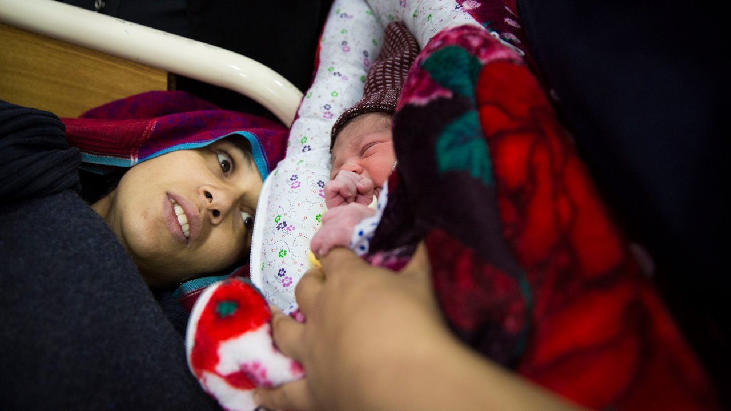

Notes:
Sobia – received TXA after suffering a PPH

Slide 3
Study design
Cohort analysis of data from randomised trial (>10,000 women)
Exposure is maternal haemoglobin measured before birth
Outcome is postpartum haemorrhage
All known confounders controlled in multivariable model

Slide 4
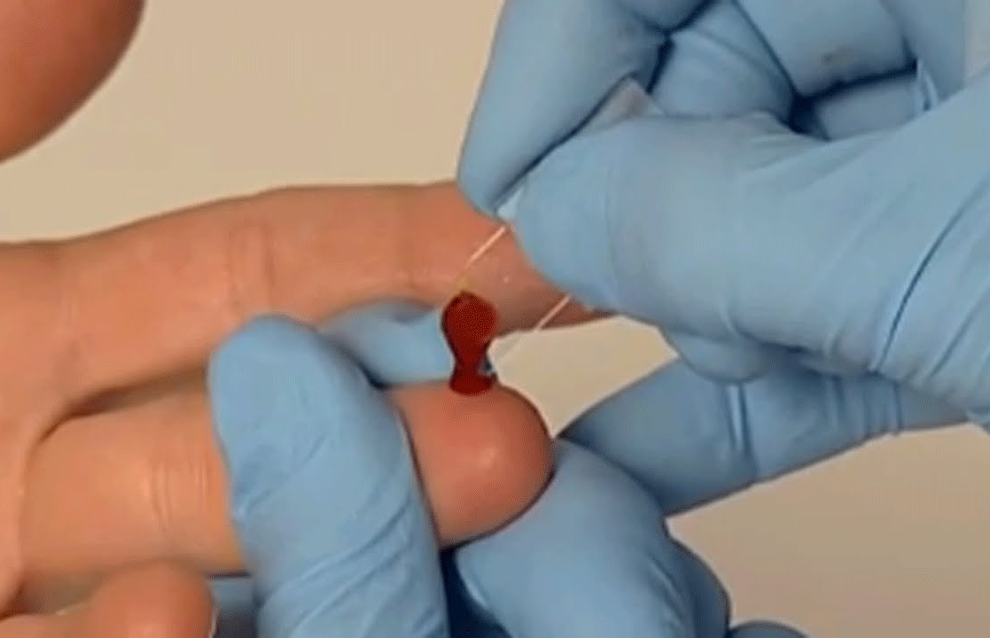
Prebirth haemoglobin
Measured using a HemoCue 201+
Measured while woman is in labour (part of the assessment for trial entry)

Slide 5
Pre-birth haemoglobin and PPH risk
(N=10,561)

Slide 7
Anaemia ‘overlooked’ as a cause of PPH

Slide 8
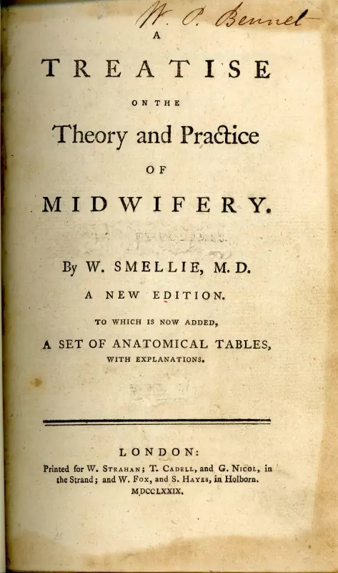
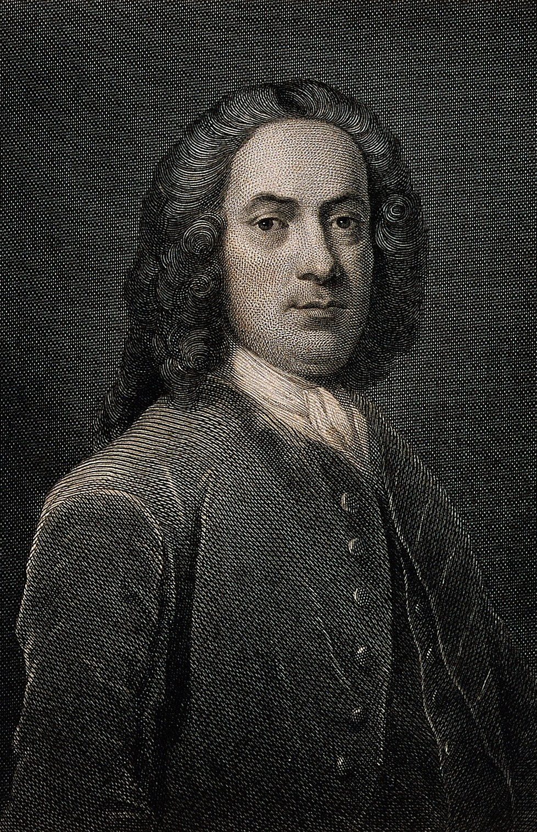

Slide 9
`The dangerous efflux is occasioned by everything that hinders the emptied uterus from contracting . . .’.
` . . . in these cases such things must be used as will assist the contractile power of the uterus, and hinder the blood from flowing so fast.. . .
William Smellie 1752

Slide 10
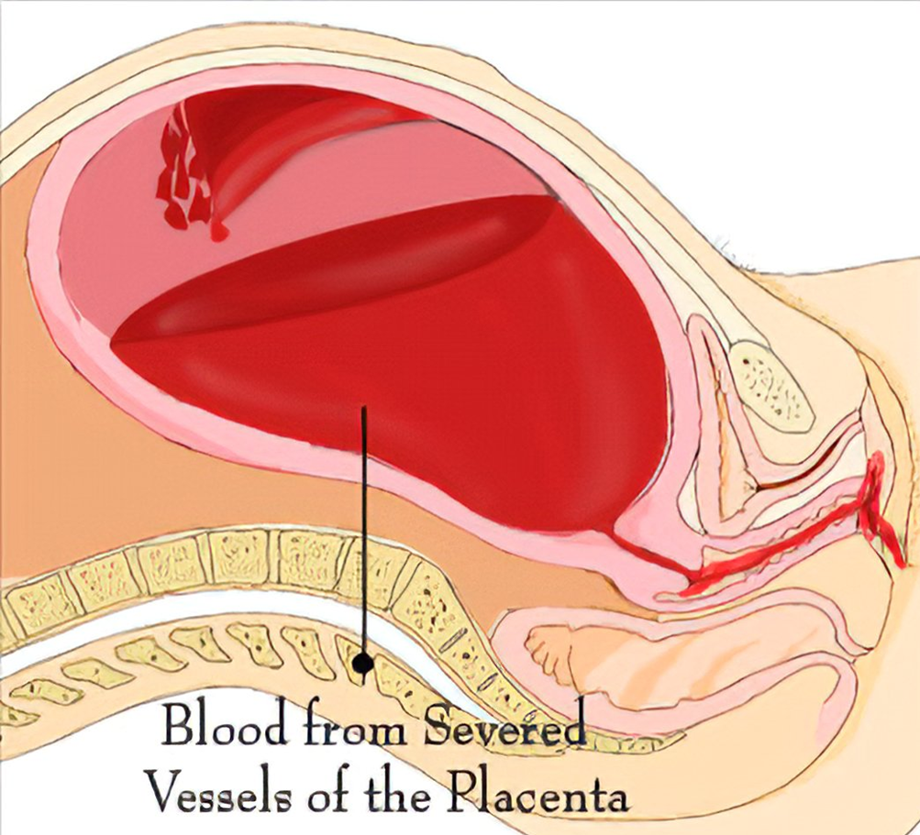
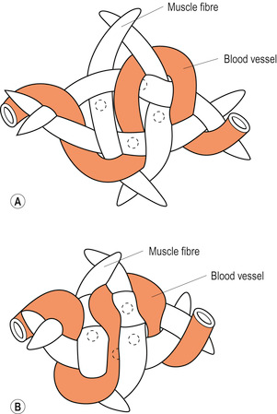
Living ligatures theory?

Slide 11
Anaemia and bleeding: mechanisms
Increased heart rate and cardiac output increases blood loss from bleeding vessels.
2. Reduced blood viscosity leads to increased flow.
3. Anaemia prevents platelet margination and increases bleeding time.
4. RBC direct contribution to haemostasias (thrombin formation and fibrin generation)
5. Anaemic blood clots are more susceptible to fibrinolysis.

Slide 12
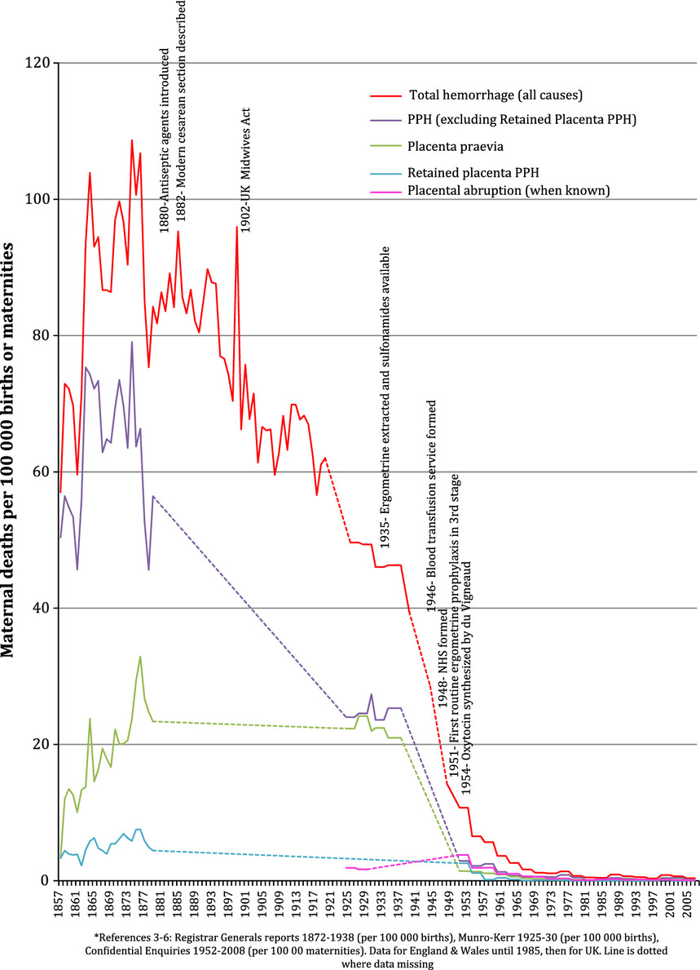
Lessons from 150 years of UK maternal hemorrhage deaths
In conclusion the majority of maternal hemorrhage mortality reductions in the UK occurred prior to the availability of effective oxytocics, antibiotics, and blood transfusion. Improving access to and standards of maternal care is key to addressing global maternal mortality today.
Robert Ker and Andrew Weeks AOGS 2015
Notes:
Maternal mortality rates by cause of hemorrhage in England and Wales/UK, 1847–2008*.
IF THIS IMAGE HAS BEEN PROVIDED BY OR IS OWNED BY A THIRD PARTY, AS INDICATED IN THE CAPTION LINE, THEN FURTHER PERMISSION MAY BE NEEDED BEFORE ANY FURTHER USE. PLEASE CONTACT WILEY'S PERMISSIONS DEPARTMENT ON PERMISSIONS@WILEY.COM OR USE THE RIGHTSLINK SERVICE BY CLICKING ON THE 'REQUEST PERMISSIONS' LINK ACCOMPANYING THIS ARTICLE. WILEY OR AUTHOR OWNED IMAGES MAY BE USED FOR NON-COMMERCIAL PURPOSES, SUBJECT TO PROPER CITATION OF THE ARTICLE, AUTHOR, AND PUBLISHER.

Slide 13
Tranexamic acid Placebo RR (95%CI)
Uterine atony PPH death 77/6428 (1.2%) 103/6333 (1.6%) 0.74 (0.55 – 0.99)

Slide 14
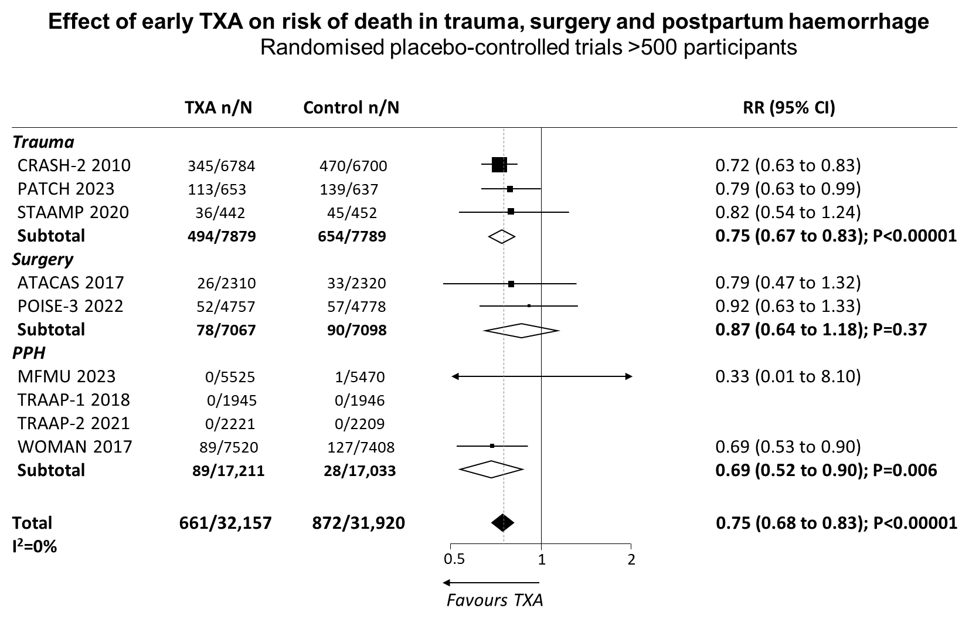
TXA is lifesaving

Slide 15
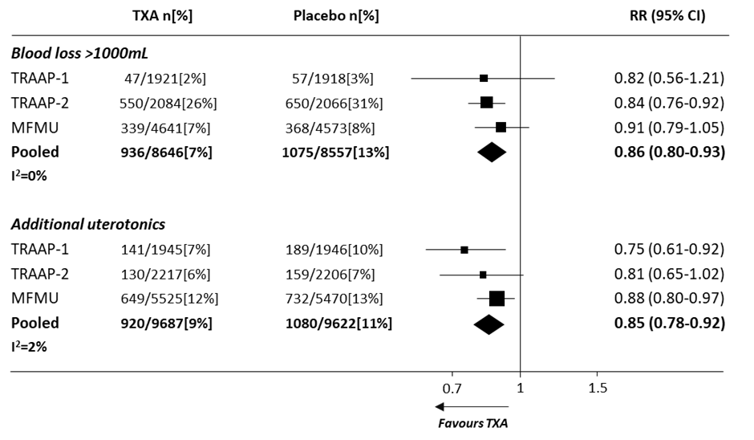
Meta-analyses of the effect of TXA on risk of postpartum blood loss >1000mL and receipt of additional uterotonics. Data from large (>500 patients), prospectively registered, placebo-controlled, randomised, well concealed trials. Prepared by Dr Katharine Ker from LSHTM.

Slide 16
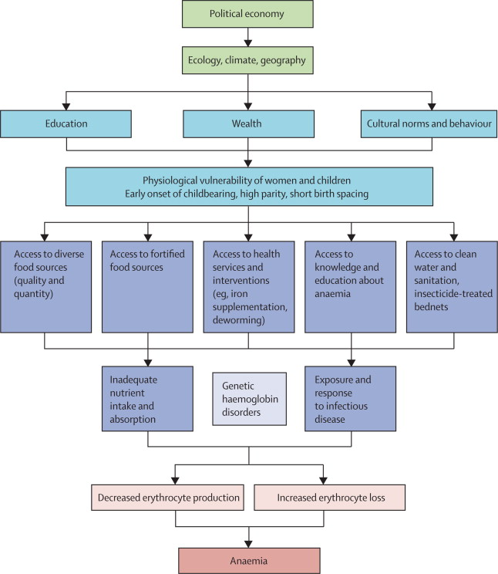
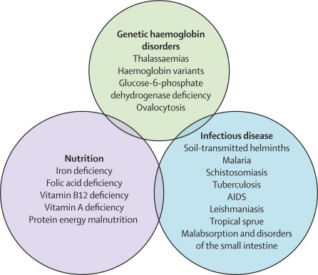
Balarajan et al. Anaemia in low-income and middle-income countries. Lancet. 2011 17;378:2123-35.

Slide 17
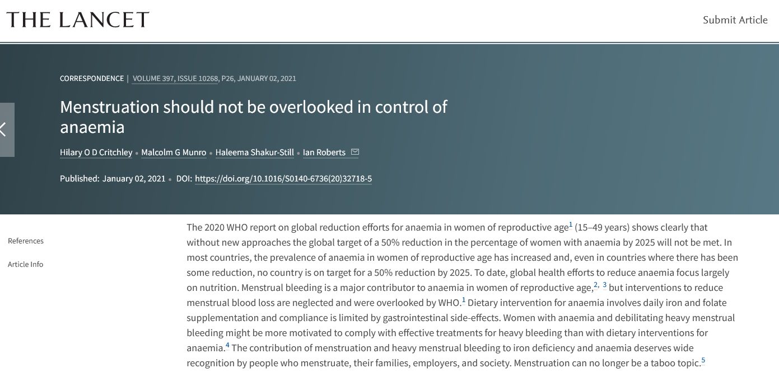

Slide 18
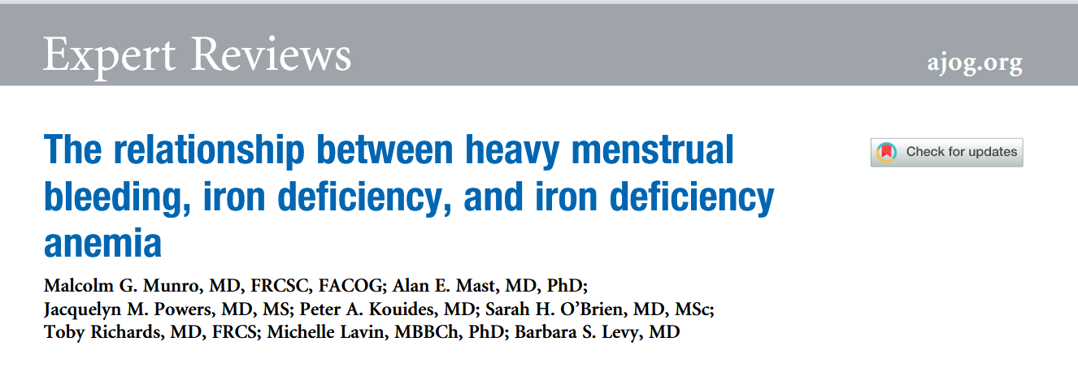
Munro MG, Mast AE, Powers JM, Kouides PA, O'Brien SH, Richards T, Lavin M, Levy BS. The relationship between heavy menstrual bleeding, iron deficiency, and iron deficiency anemia. Am J Obstet Gynecol. 2023 Jul;229(1):1-9.

Slide 19
Treatment of anaemia in women of reproductive age
Infant
Low birth weight
Higher mortality rate
Poor neurodevelopment
Diet
Child
Reduced mental capacity
Higher mortality rate
Poor growth, infection
Iron Deficiency
Pregnancy
Preterm birth
Antepartum bleeding
Postpartum bleeding
HMB
Adult
Cognitive impairment
Reduced growth
Reduced productivity

Slide 20
