Slide 1
WHO PPH Roadmap Sustainably scaling the trajectory towards zero rating PPH
By Dr Kihara Anne Beatrice
President Elect- FIGO
CoP PPH 13th- 14th September 2023

Slide 2
Outline
Background
Is enough being done towards elimination of PPH
Changing culture and models with pregnancy and childbirth morbidity /mortality
Quality of maternity care: external adn internal environment
Sustainability
Scalability
Social accountability
Impact evaluation

Slide 3
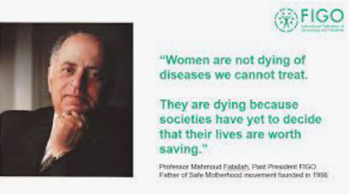
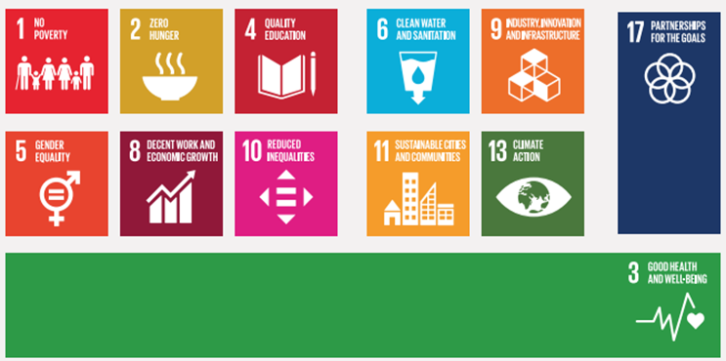
Women’s Health

Slide 4
PPH Quotes from FIGO
PPH is one of the leading causes of maternal mortality and morbidity globally. It disproportionately impacts women in low- and middle-income countries, especially those that are vulnerable and marginalised including those affected by broader social determinants, malnutrition, climate change and harmful knowledge systems. The WHO roadmap is a vital part of the solutions that we must scale up and expand to put a stop to these entirely preventable tragedies. We must save mothers. We must stop PPH.
---Dr Anne Kihara, FIGO President Elect,2023
High impact life-saving interventions are known to prevent PPH; however, these need to be implemented promptly if PPH management is to be successful. In low- and middle-income countries (LMICs), unresponsive health systems leading to inadequate and sub-optimal quality services often delay diagnosis and management of PPH.
--- Dr Jolly Beyeza, Vice-Chair, FIGO Childbirth and PPH Committee, 2023
Notes:
Ref: https://www.figo.org/news/new-who-postpartum-haemorrhage-roadmap-essential-tool-reduce-maternal-mortality-between-2023

Slide 5
WHO Roadmap for PPH
Research: Innovation, implementation and cross-cutting (bundled care approach)
Consolidated Norms and standards
Implementation barriers
weak policy and leadership
weak procurement and supply chain
Poor HCP staffing , training and supervision
Inequities and poor access to quality care
inrecognized Womens rights and social status in society
Advocacy
global branding and global advocacy
Social accountability , targeted groups with Knowledge products
CALL TO ACTION

Slide 6
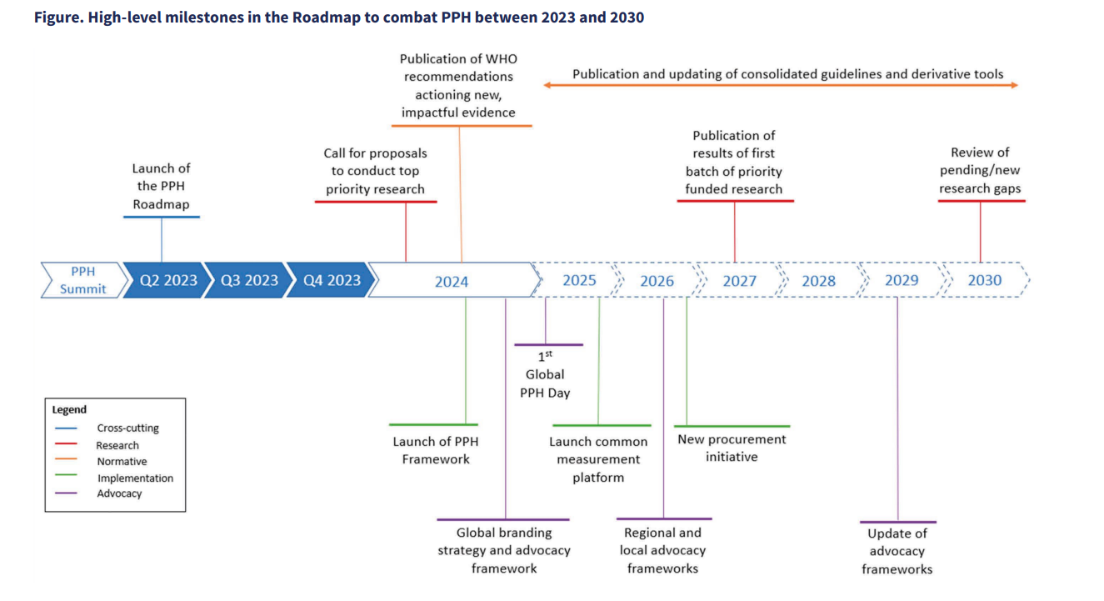

Slide 7
Background Changing culture with pregnancy and childbirth morbidity and mortality
Pregnancy is a human right and must perpetuate quality of humanity
Defining national and sub-national goals and targets, scorecards and benchmarking of performance management crucial in addressing priorities and gaps in maternal health
Gender mainstreaming and valuing every pregnancy towards healthy outcomes includes prevention and management of PPH
Improve the social determinants of the girl child prior to pregnancy and in between pregnancies (environment, social, and governance- ESG Score)
Optimizing the health of mothers during the pre-conceptual period and in the continuum of care throughout pregnancy, childbirth, and post-natal period
Notes:
Ref: Dempere, J.; Abdalla, S. The Impact of Women’s Empowerment on the Corporate Environmental, Social, and Governance (ESG) Disclosure. Sustainability 2023, 15, 8173. https://doi.org/10.3390/su15108173

Slide 8
Background: Changing culture with pregnancy and childbirth morbidity / mortality
Increase the potentiation of self–care diagnostics prior to and during pregnancy
Women need to decide early in pregnancy their desired service delivery modeland level of care (IBP, Emplan); Risk assessment and predictions for PPH with early referral mechanisms; tracking every pregnancy in the community, integrated services and linked to a health facility or referred to higher centers with sustained counseling and guidance
Counseling for fertility regulation before an unplanned, unwanted, or mistimed pregnancy occurs and post - abortion and post delivery contraception information and services
Avert teenage pregnancies at all costs and limit pregnancies to those one can nurture - Legislature and policy environment; eliminate harmful cultural practices, GBV( IPV), zero rate unmet need for family planning; zero rate preventable pregnancies
Gatekeepers must ALL be actively engaged in a pregnant women’s journey.

Slide 9
KAIZEN Principles in pregnancy and childbirth
Patient-Centered Care:understanding their needs, preferences and challengesand being responsive
Continuous Improvement: Kaizen emphasizes the importance of making incremental improvements over time
Identify and address root causes of quality barriers: involve identifying risk factors, improving staff training, or enhancing communication and teamwork among healthcare providers.
Streamline processes: involves analyzing the sequence of actions, eliminating redundancies, and implementing standardized tools or checklists to streamline processes.
Standardization: Kaizen promotes standardizing processes to eliminate variations and reduce errors. In childbirth, standardizing protocols and procedures can help ensure consistent, evidence-based care. By adhering to standardized practices, healthcare providers can enhance the quality and safety of care, minimize complications, and improve outcomes for mothers and newborns.
AVOID OBSTETRIC VIOLENCE

Slide 10
Is enough being done towards elimination of PPH
International committements: SDG, Global Strategy for EWEC, ICPD
Legislative and policy environment for Maternal health - DOESIT exist and the review cycle
PPH guidelines, SOP, job aids dissemination and their implementation
Regulation
PHC/UHC
Fiscal space DEDICATED towards MNH Programs
HRH and service delivery models: Obstetrician, medical officer , clinical officers, midwifery led care,CHP, PPP
HCP Capacity strengthening - tools, checklists, clinical simulations, obstetric drills, clinical audits / MPDSR
Performance management- MEAL
Social accountability
Notes:
Ref: Mukuru M, Gorry J, Kiwanuka SN, Gibson L, Musoke D, Ssengooba F. Designed to Fail? Revisiting Uganda's Maternal Health Policies to Understand Policy Design Issues Underpinning Missed Targets for Reduction of Maternal Mortality Ratio (MMR): 2000-2015. Int J Health Policy Manag. 2022 Oct 19;11(10):2124-2134. doi: 10.34172/ijhpm.2021.127. Epub 2021 Sep 7. PMID: 34664495; PMCID: PMC9808297.
Creanga AA, Dohlsten MA, Stierman EK, Moran AC, Mary M, Katwan E, Maliqi B. Maternal health policy environment and the relationship with service utilization in low- and middle-income countries. J Glob Health. 2023 May 10;13:04025. doi: 10.7189/jogh.13.04025. PMID: 36892948; PMCID: PMC9997690.
WHO recommendations: Optimizing health worker roles for maternal and newborn health through task shiftinghttps://optimizemnh.org/

Slide 11
Quality of maternity care: The interphase of the external and internal environment
Notes:
Ref: https://www.researchgate.net/publication/275665362_Quality_of_care_for_pregnant_women_and_newborns_-_The_WHO_vision/figures?lo=1&utm_source=google&utm_medium=organic
Martin mullerBussiness analysis Excellence Quality Framework - Five Interrelated Views on Quality https://business-analysis-excellence.com/quality-framework/
Martin Muller LinkedIn http://www.linkedin.com/pub/martin-muller/4/103/821
The National health Workforce Accounts database, World Health Organization, Geneva (https://apps.who.int/nhwaportal, https://www.who.int/activities/improving-health-workforce-data-and-evidence).
Ref: https://www.researchgate.net/publication/275665362_Quality_of_care_for_pregnant_women_and_newborns_-_The_WHO_vision/figures?lo=1&utm_source=google&utm_medium=organic
Martin mullerBussiness analysis Excellence Quality Framework - Five Interrelated Views on Quality https://business-analysis-excellence.com/quality-framework/
Martin Muller LinkedIn http://www.linkedin.com/pub/martin-muller/4/103/821
The National health Workforce Accounts database, World Health Organization, Geneva (https://apps.who.int/nhwaportal, https://www.who.int/activities/improving-health-workforce-data-and-evidence).

Slide 12
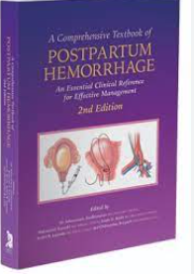
FIGO efforts in prevention and managment of PPH
Dedicated scientific committees to address prevention and managment of PPH , HMB , well - woman care
FIGO Guidelines, Position statements, research - knowledge translation by member societies to local guidelines for prevention and managment of PPH
Addressing anaemia with a life course approach and in the continuum of care preconception , prenatal , delivery and postpartum
Accelerating Measurable Progress and Leveraging Investments for Postpartum Haemorrhage Impact (AMPLI-PPHI) project, JHPIEGO -FIGO
Leadership Development Initiative( LDI) focus on policy and governance, gender, life saving interventions for PPH: HSC, TXA , IFAS, intravenous iron for correction of anaemia, Care bundles E- MOTIVE

Slide 13
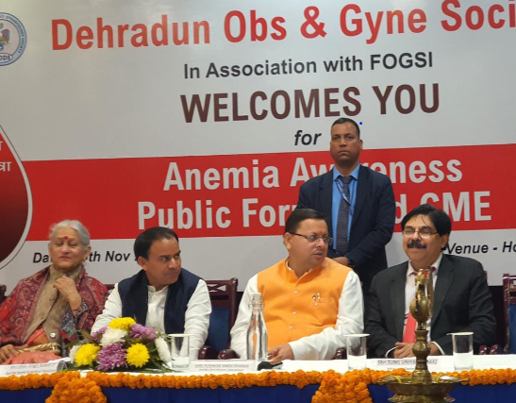
FIGO efforts in prevention and managment of PPH
TBA, BCLS/ ALSO/ BEmONC/ CEmONC/ EMONC/ PRONTO/ CHP; level of care in public and private, optimizing the HCW; referral system
Technical Innovations: fagmented, sequential or concurrent; health personnel competencies, HCP numbers to workload , skill mix, level of care
QOC and accreditation of facilities e.g. Manyatta Program in India; anaemia caravan by FOGSI
Technology in PPH prevention and management: medial products and devices; service delivery
Clinical audits / MPDSR; ICD 11
Participation in community of practice and with communities of Interest

Slide 14
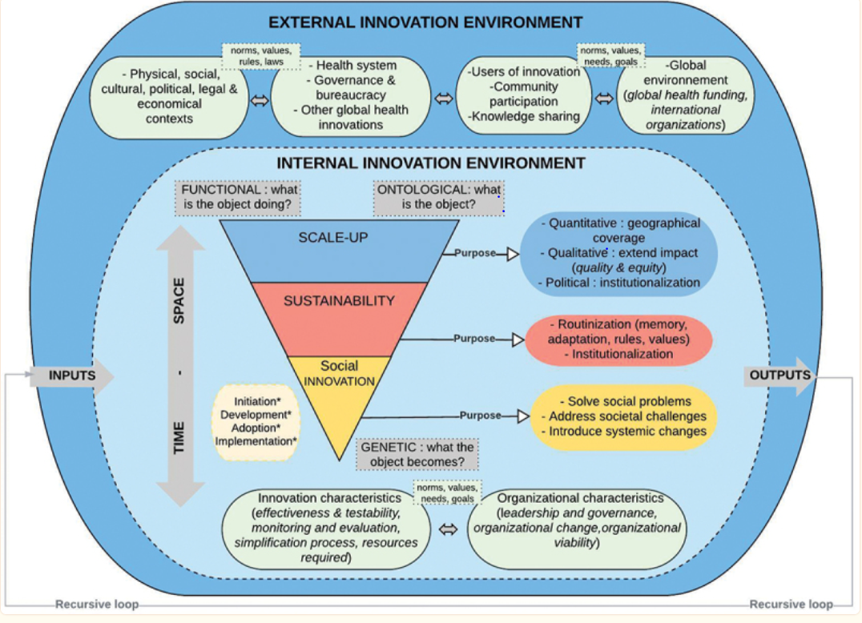
Notes:
Ref: Niang M, Alami H, Gagnon MP, Dupéré S. A conceptualisation of scale-up and sustainability of social innovations in global health: a narrative review and integrative framework for action. Glob Health Action. 2023 Dec 31;16(1):2230813. doi: 10.1080/16549716.2023.2230813. PMID: 37459240; PMCID: PMC10353334.
Ref: Niang M, Alami H, Gagnon MP, Dupéré S. A conceptualisation of scale-up and sustainability of social innovations in global health: a narrative review and integrative framework for action. Glob Health Action. 2023 Dec 31;16(1):2230813. doi: 10.1080/16549716.2023.2230813. PMID: 37459240; PMCID: PMC10353334.

Slide 17
Social accountability in prevention and managment of PPH
Social accountability tailored to the social and political context, strategic planning/ budgeting and multi-sectoral/multi-stakeholder involvement; focusing on the factors and processes affecting acceptability, adoption, effectiveness aand sustainable scalability .
Increasing the voice and agency of communities
Community engagement in health governance:INTERNAL and EXTERNAL ENVIRONMENT
The role that governance plays in the adoption and scale-up of health system innovations
Policy environment
Resilience of the health system
Stakeholders involved in service delivery
Fiscal space DEDICATED towards MNH Programs
Self -care in prevention and managment of PPH
Patient demands and experience with care
Engendering health
Multidisciplinary and Multisector approach
Number, targeted audience and quality of public forums/ dialogue, surveillance and response
Cascade at all levels from Self -advocacy, health Institutions to global frameworks makig it an institutionalized agenda

Slide 18
SOCIAL Impact not adequately articulated
IMPACT EVALUATION an effect on, change or benefit to the activity, attitude, awareness , behaviour, capacity, opportunity, performance policy, practice, process or understanding of an audience, beneficiary, community, constituency, organisation or individuals in any geographic location whether locally, regionally, nationally or internationally
Moves from the way things were or are
With introduction of the intervention / innovation review of the change
The value proposition attained with the change
Impact evaluation conducted addresses:
Advocacy
Allocation of funds
Analysis -to continue or scale
Accountability -risk managment
Notes:
Ref: Meighan Mary, Ayisha Diop, Wendy R. Sheldon, Aichatou Yenikoye, Beverly Winikoff
BMC Pregnancy Childbirth. 2019; 19: 379. Published online 2019 Oct 24. doi: 10.1186/s12884-019-2502-5
PMCID: PMC6814039
Cook JR, Saxena K, Taylor C, Jacobs JL. Cost-effectiveness and budget impact of heat-stable carbetocin compared to oxytocin and misoprostol for the prevention of postpartum hemorrhage (PPH) in women giving birth in India. BMC Health Serv Res. 2023 Mar 17;23(1):267. doi: 10.1186/s12913-023-09263-4. PMID: 36932411; PMCID: PMC10024421.
Kenneth Finlayson, Soo Downe, Joshua P. Vogel, Olufemi T. Oladapo
PLoS One. 2019; 14(5): e0215919. Published online 2019 May 8. doi: 10.1371/journal.pone.0215919
PMCID: PMC6505942

Slide 19
Thank you
The Obstetricians and midwives MUST stand in-front, behind and beside women and girls as:
Caregivers
Researchers
Advocates
Educators
Protectors
sustaining , scaling and saving lives from PPH

