Slide 1


MOMENTUM Safe Surgery in Family Planning and Obstetrics: Mozambique
A Holistic Program Approach to Prevention and Management of PPH
Arune Joao Estavela MIH, Ph.D,
Postpartum Hemorrhage Community of Practice Annual Meeting: September 13 and 14, 2023

Slide 2
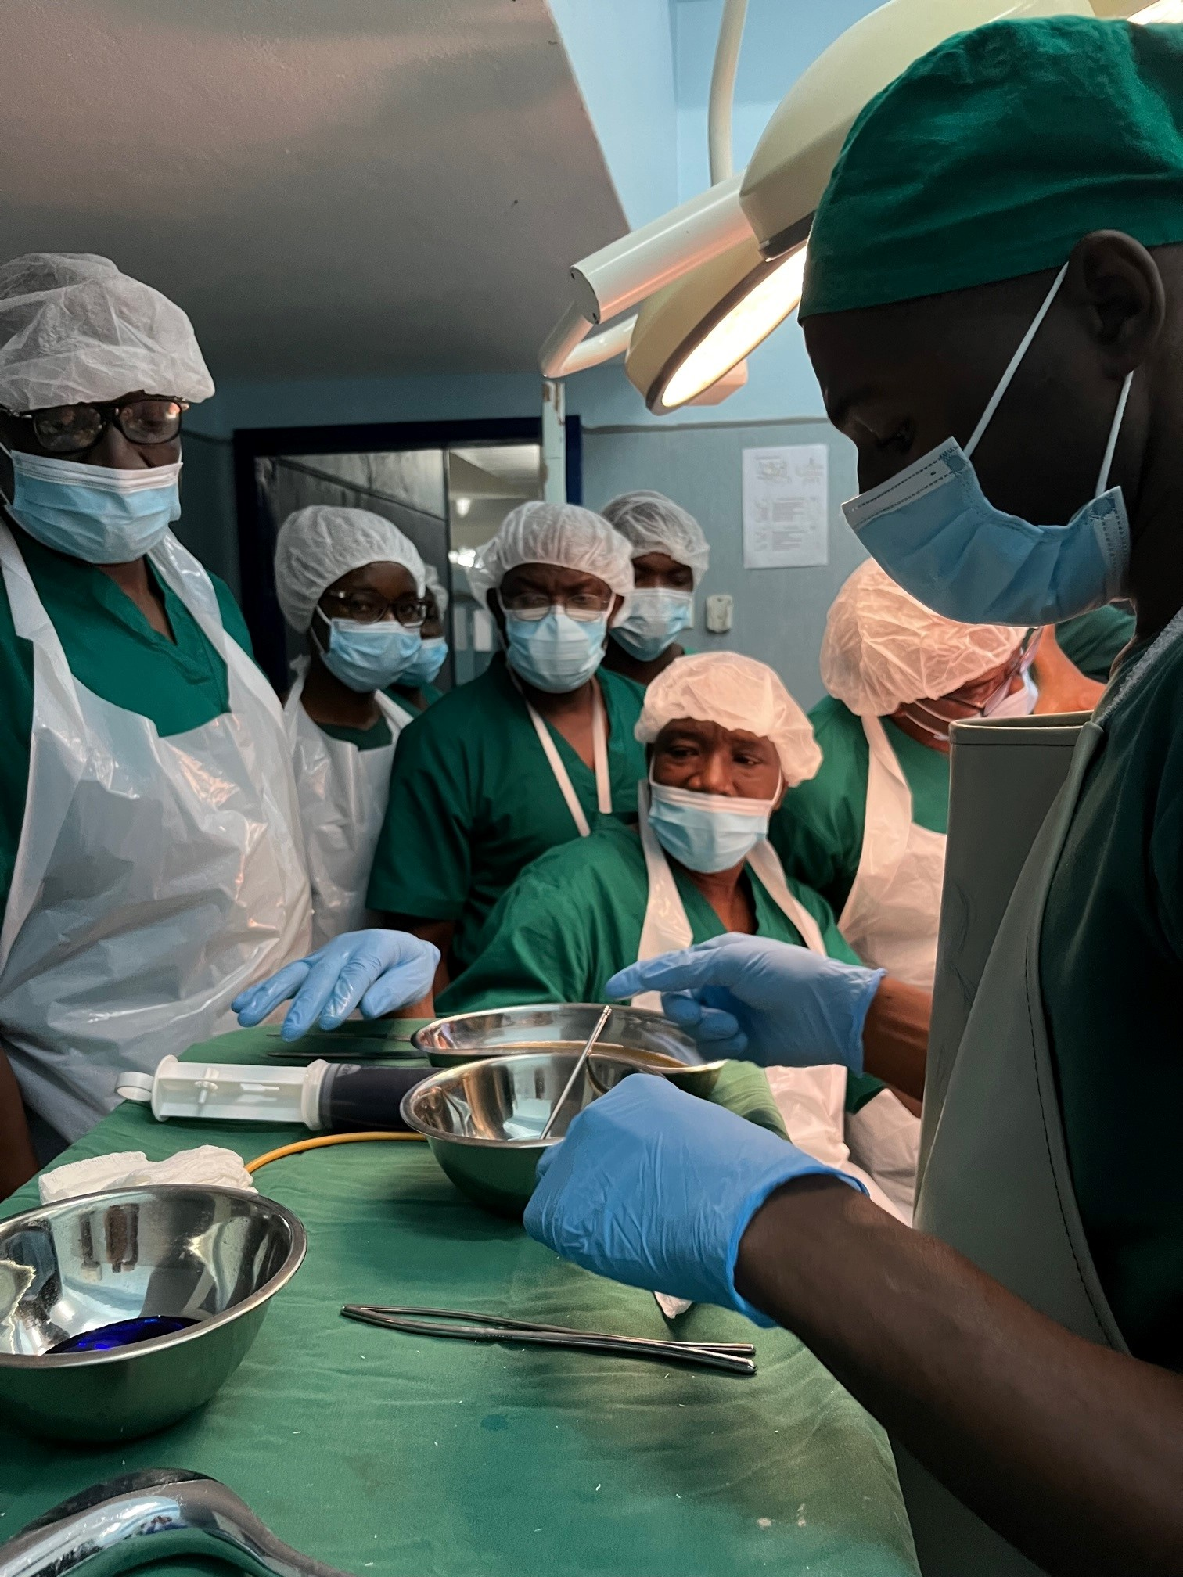

Project Overview
Award duration:
  September 25, 2020 – June 30, 2026
Focus technical areas:
  Surgical obstetric care:
  Cesarean delivery (CD) and
  peripartum hysterectomy
  Obstetric and iatrogenic fistula
  Voluntary, long-acting reversible
  contraception (LARCs) &
  permanent methods (PMs)
Training session on BEmONC. Credit: G. Nelba

Slide 3
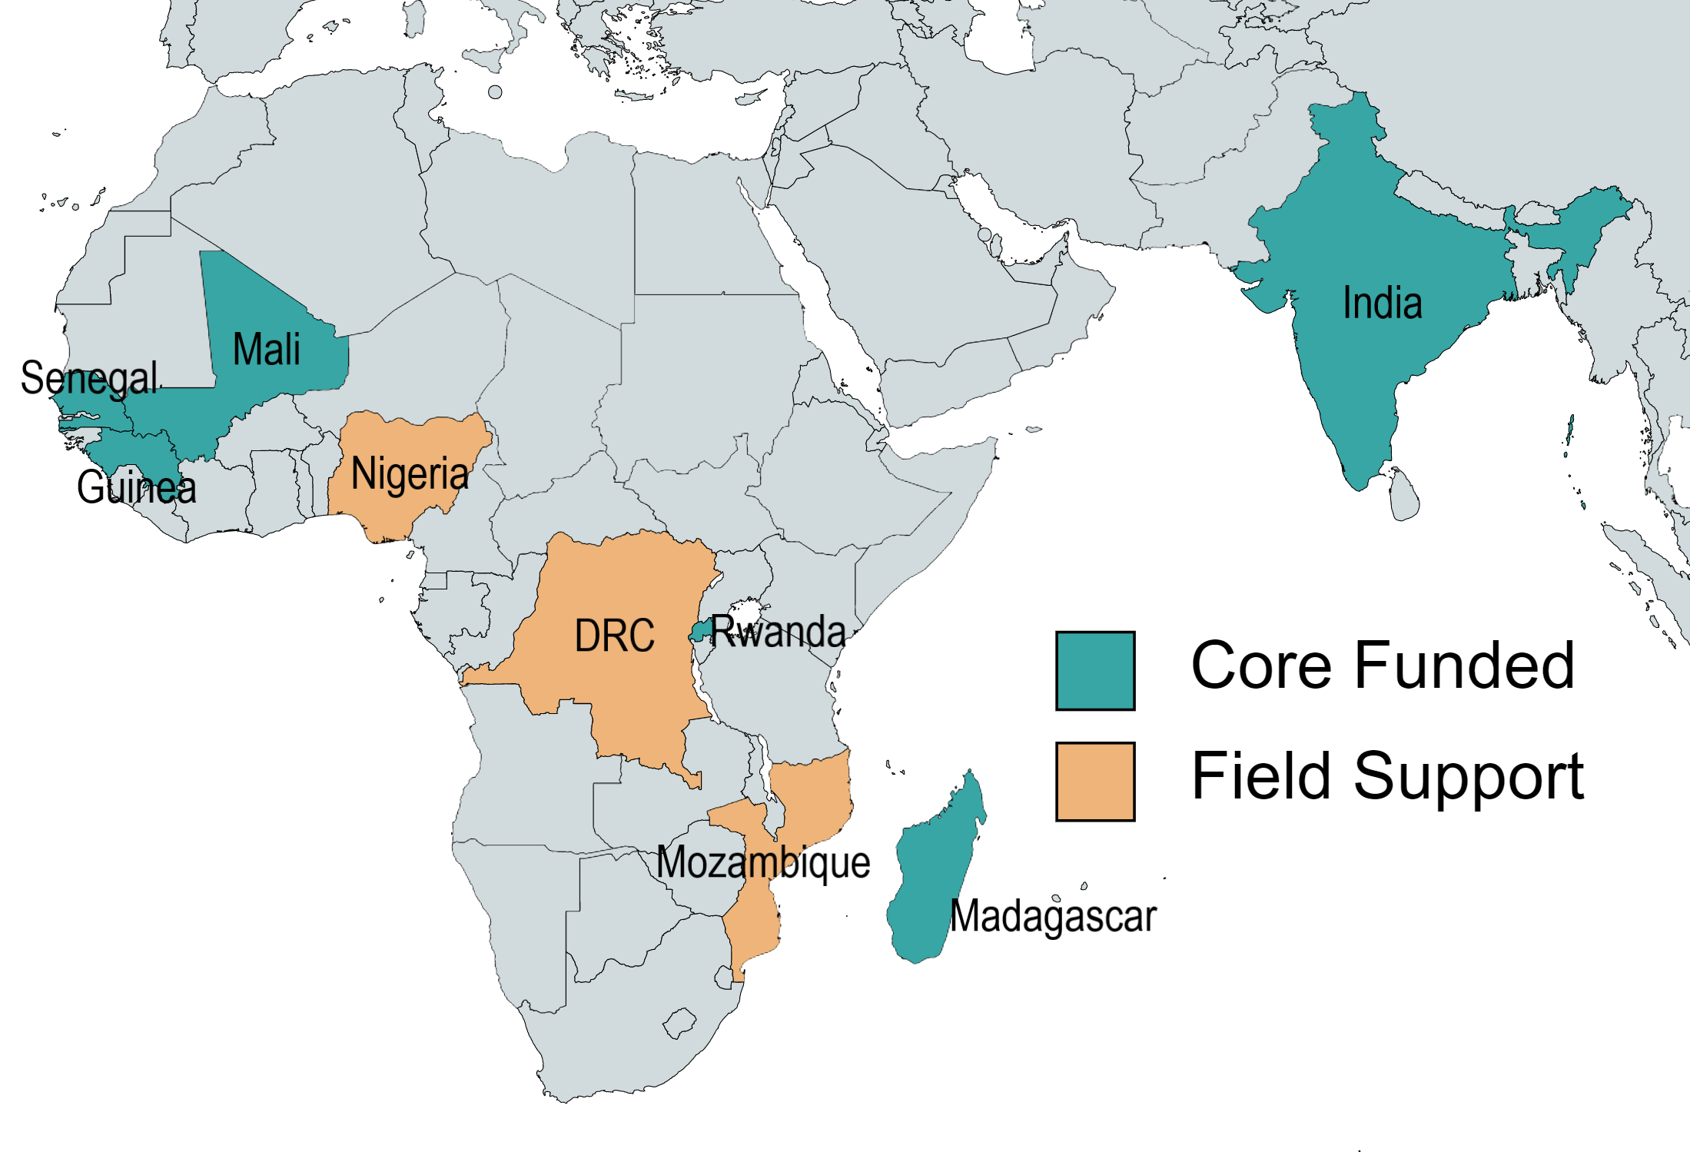
MOMENTUM Safe Surgery Geographic Scope
 | Funding Type | Fistula | Surgical Obstetrics* | LARCs/PMs | FGM/C | COVID
DRC | FS | X | X | X
Guinea | Core | X | X
India | Core |  | X | X
India | ARPA |  |  |  |  | X
Madagascar | Core |  | X
Mali | Core | X | X | X
Mozambique | FS, Core | X | X | X
Nigeria | FS | X | X |  | X
Rwanda | Core | X | X | X
Senegal | Core | X | X | X
*Cesarean delivery, peripartum hysterectomy

Slide 4
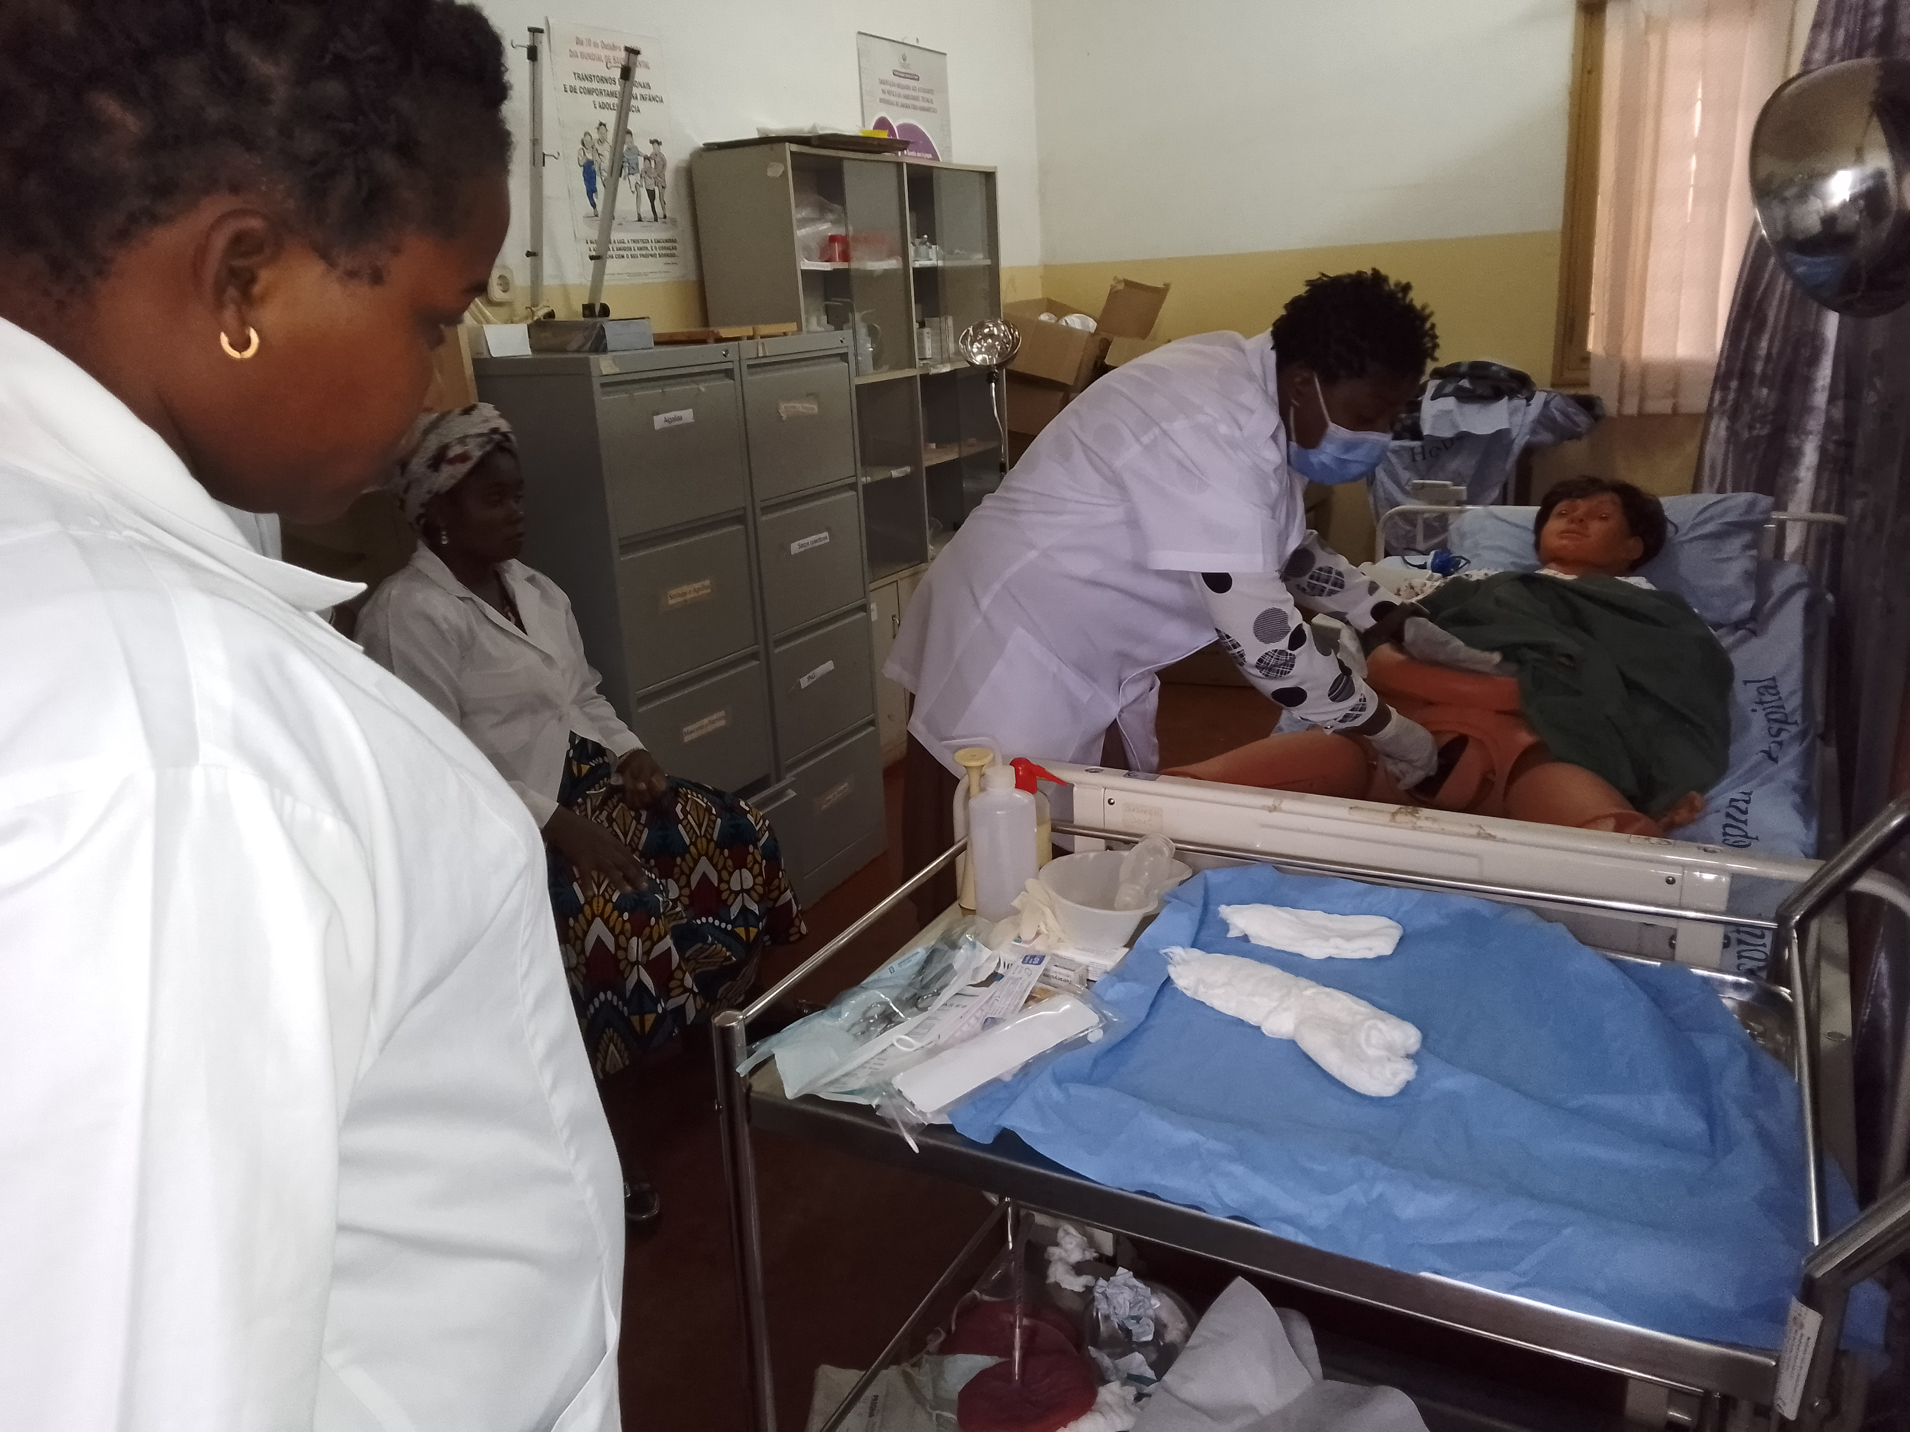
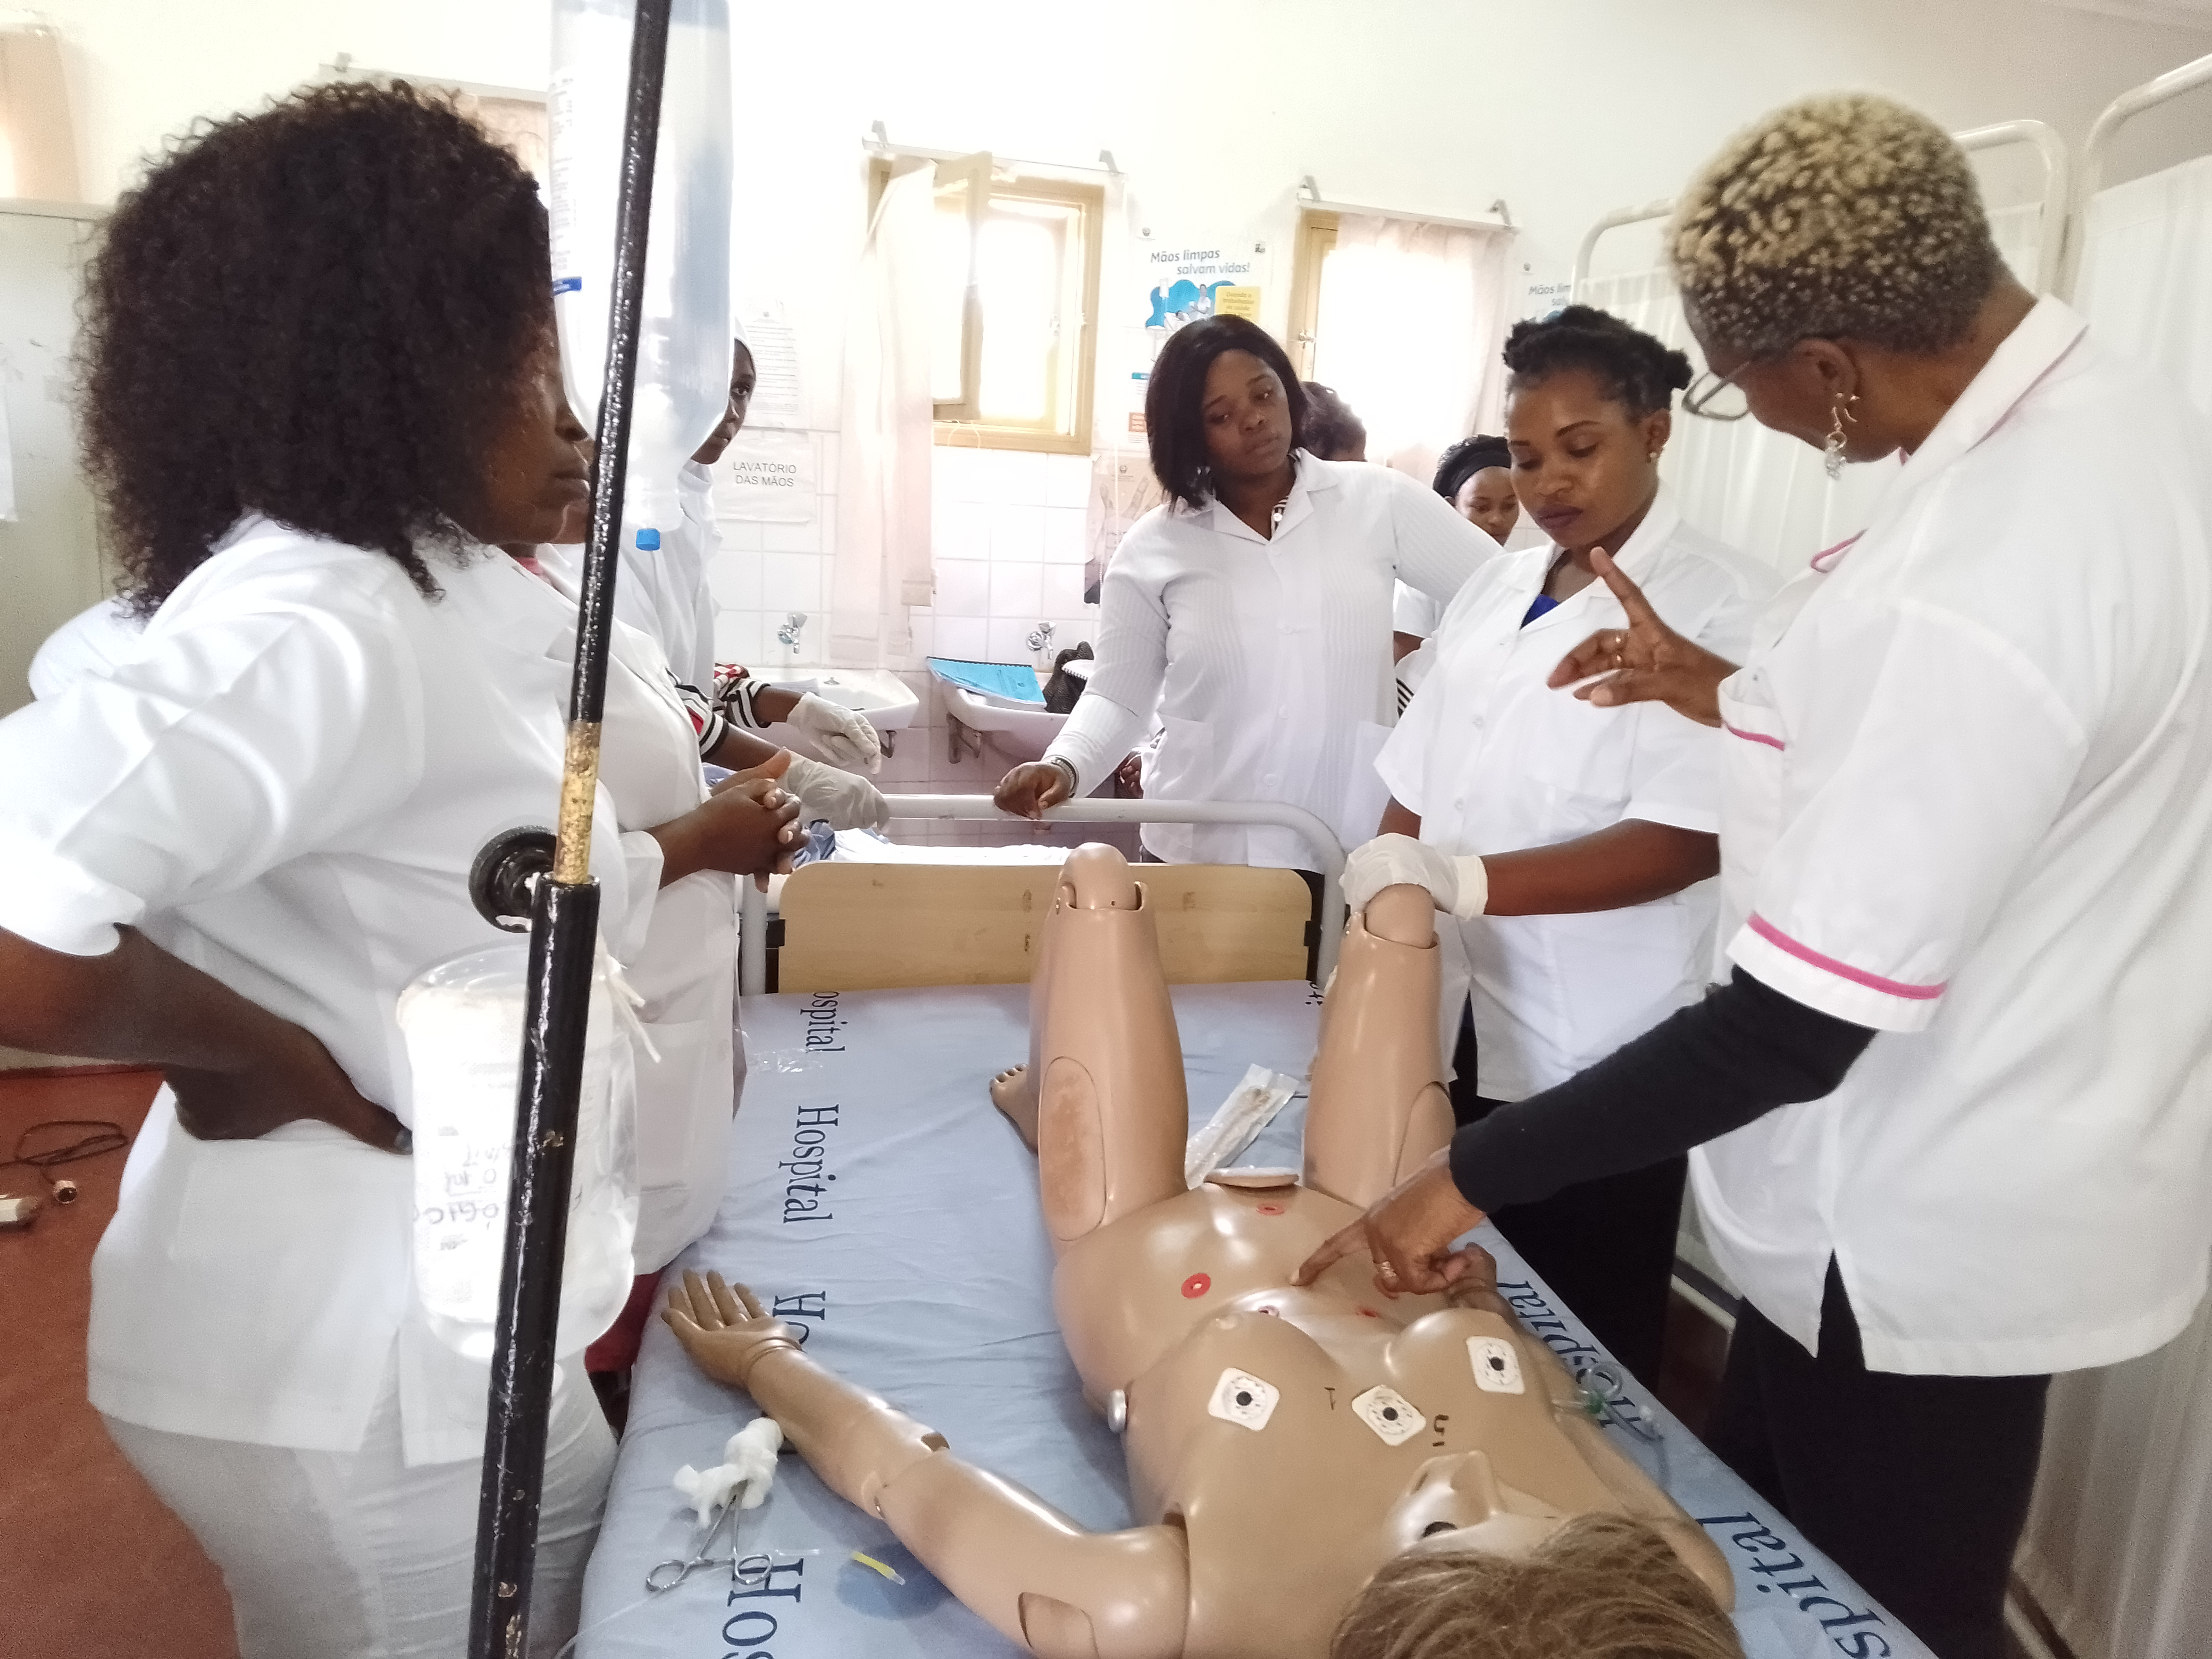
Support for labour management to prevent and manage PPH
  28 HCW trained as Master Trainers:
  Provision of quality labour management
  Routine use and updating of partogram
  Early diagnosis of obstetric emergencies
  Early referral for those who need advanced care ( Mobile phone)
  Training on Safe Cesarean delivery
Training session on BEmONC. Credit: G. Nelba

Slide 5
Training manual for Cesarian Delivery

Slide 6
Integrated safe Cesarean delivery training
  Integrated, modular training modular package developed by MOMENTUM Safe Surgery in conjunction with local experts and the Ministry of Health
    Includes modules on partogram use and monitoring, neonatal resuscitation, management of perineal lacerations , assisted vaginal delivery in addition to
    Cesarean delivery
      Indications and contraindictions
      Pre-operative care
      Surgical techniques to avoid signficant blood loss and potential for PPH
      Complications of Cesarean delivery – diagnosis and management
      Post- Cesarean delivery IUD placement
    Peripartum hysterectomy
      Indications ( including PPH)
      Pre-operative management for PPH
      Surgical technique

Slide 7
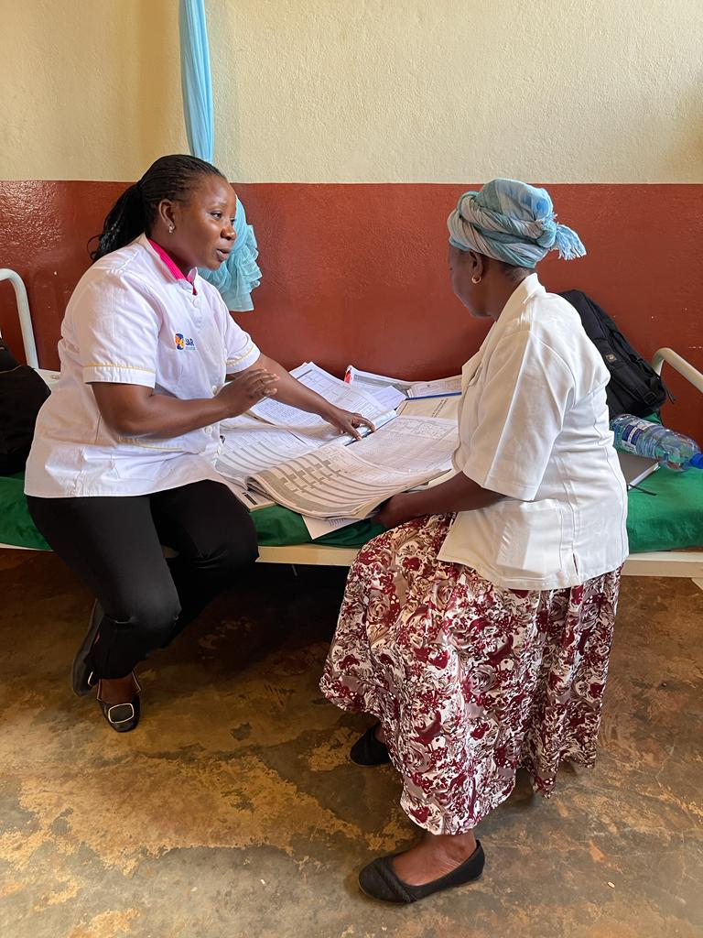
On site cascade training by master trainers for over 100 HCW on quality labour management
Key areas covered during the training
Good labour practices and techniques
Provision of guidance on how to use partogram and pratice sessions
Identification and management of obstetric complications including PPH
Availability of job aids and SoP of labour management
Availability and accessibility of delivery and labor emergency kits
Ensure correct stelirization of delivery kits
Quality of data reporting
Management of obstetric and newborn and referral system
Quarterly on-the-job training during antenatal care
Training session on BEmONC. Photo Credit: G. Nelba

Slide 8
Provision of quality labour and PPH management
  Practical sessions are led by MCH mentor every two weeks
  Clinical case discussions are held with respect to monitoring of labour from admision setting to labour ward and to delivery
  PPH clinical cases discussions for both successful and unsuccessful management are held
  Maternal and newborn mortality reviews :
    Identification of cause of death
    Discussions around system failures that may have contributed to the death
    Development of action plans
Training session on BEmONC. Credit: G. Nelba

Slide 9
Referral for Obstetric Complications
Reasons for Referrals | # cases* | Delivery Outcomes*
Antepartum hemorrhage; cervical laceration; retained placenta; placental abruption; uterine rupture; multiparity; and ectopic pregnancy | 21 | 24 Cesarean Deliveries 10 Normal Vaginal Deliveries 6 Newborn Deaths and 30 Newborns Alive * No maternal deaths
Obstructed labour | 12
Pre-eclampsia; eclampsia; women < 14 years old; short stature ; twins; previous CD | 7
*Some referrals do not have an associated outcome reported for delivery, because they may occur post-delivery or may not necessitate delivery at time of referral.

Slide 10
National Tools For PPH Management

Slide 11
OBRIGADO / THANK YOU
@USAID_MOMENTUM
MOMENTUM Safe Surgery in Family Planning and Obstetrics is funded by the U.S. Agency for International Development (USAID) as part of the MOMENTUM suite of awards and implemented by EngenderHealth with partners IntraHealth International, Johns Hopkins CCP, and London School of Hygiene & Tropical Medicine under USAID cooperative agreement #7200AA20CA00011. For more information about MOMENTUM, visit USAIDMomentum.org. The contents of this PowerPoint presentation are the sole responsibility of EngenderHealth and do not necessarily reflect the views of USAID or the United States Government.
@USAIDMOMENTUM
USAID MOMENTUM
USAID MOMENTUM

