Slide 1
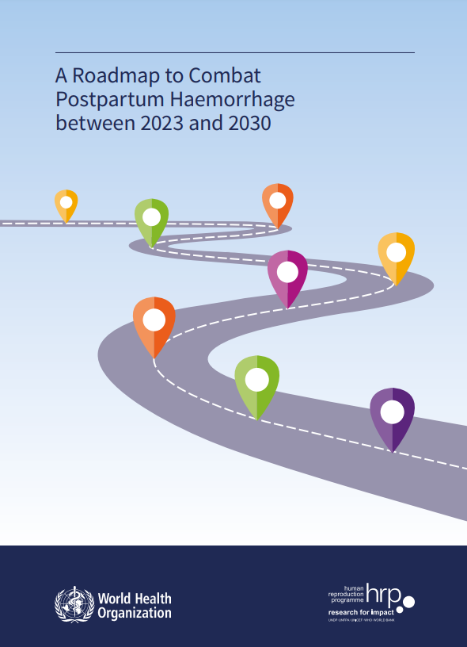
Welcome
To the Postpartum Hemorrhage Community of Practice

Slide 2
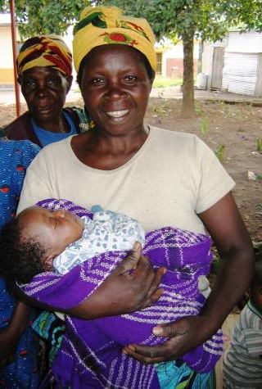
PPH Summit
If maternal anemia decreased by 25% 10% maternal deaths
If early diagnosis of PPH increased from 50% (now) to 90% 5 0% maternal deaths
If first response improved by 30% 12% maternal deaths
Impact of multiple interventions 80% deaths

Slide 3
USAID’s role (Maternal Health Team, Missions, IPs)
Support WHO to update, consolidate and digitalize WHO PPH Guidelines
Support our partners (MCGL, etc) to assist countries to update, disseminate and implement updated national guidelines for PPH
Address moderate and severe maternal anemia - working with nutrition team
Advocate, educate, and demonstrate better diagnosis of PPH immediately PP
Support efforts to reduce non-indicated use of augmentation and induction
Support commodities/supply chain work - with a focus on getting quality-assured, key life-saving medicines to the last mile
Focus on rolling out/scaling up the E-Motive bundle
Expand support for safe blood systems
Work with Missions to include a focus on PPH and activities listed her in their ENAP/EPMM Acceleration Plans

