Slide 1



Mental Health Matters in
Postpartum Hemorrhage
A/Prof Simone Honikman
Coauthors: Nina de Jong & Marisa Dawson
www.pmhp.za.org

Slide 2

Postpartum mental health conditions
Postpartum depression (PPD): 17.2%
(Wang, 2021)
  Southern Africa highest rate: 40.0%
Anxiety disorders, PTSD, Obsessive Compulsive Disorder: 18.0%
(Fawcett, 2019)
Post-traumatic stress disorder (PTSD): 4.7%
Post-traumatic stress 12.3%
(Heyne, 2022)
Postpartum psychosis: ~0.2%
(VanderKruik, 2017)
Notes:
Postpartum depression prevalence was found to be 17.22% in a global study published in Nature. The highest prevalence was found in Southern Africa: 39.96%).
https://www.nature.com/articles/s41398-021-01663-6
Anxiety in postpartum women (18.0%, HDI95% [13.1% to 24.3%]), however this is including PTSD!!!
https://www.psychiatrist.com/jcp/mental/women/anxiety-disorders-in-pregnant-and-postpartum-women/
Meta-analyses of 154 studies (N = 54,711) applied a random-effects model to four data sets, resulting in pooled prevalence rates of 4.7% for PTSD and 12.3% for PTSS in mothers.
https://www.sciencedirect.com/science/article/pii/S0272735822000423?via%3Dihub Heyne et al 2022
Our review found that post-partum psychosis incidence ranged between 0.89 and 2.6 in 1000 births across several countries, and one study reported prevalence to be 5 in 1000 births. These incidence estimates appear to be relatively consistent with the frequently cited prevalence of 1–2 in 1000 births for postpartum psychosis in the general population
https://www.ncbi.nlm.nih.gov/pmc/articles/PMC5534064/

Slide 3
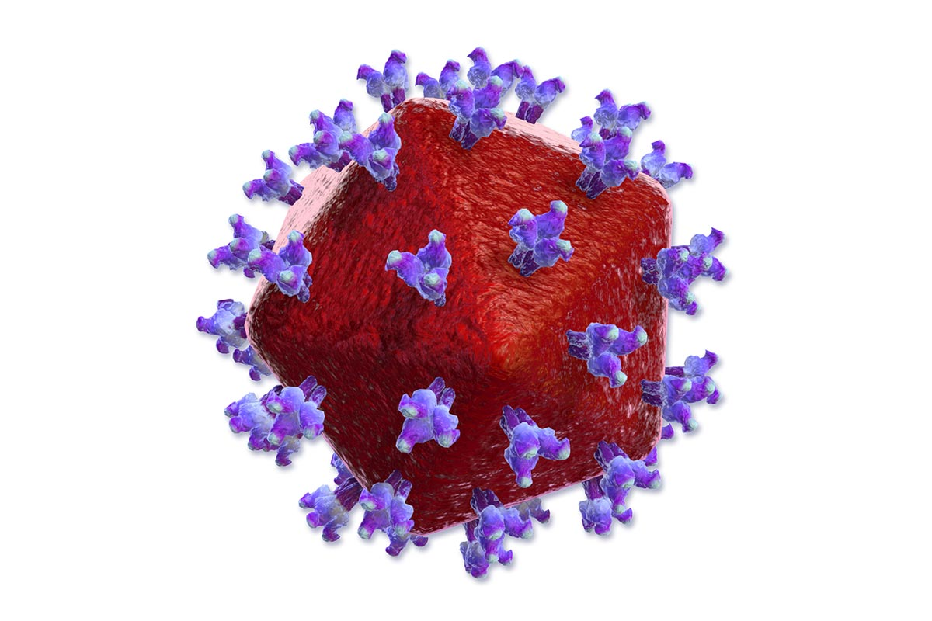




Maternal mental health problems and vicious cycles
Notes:
Highlight the critical importance of maternal mental health during the postpartum period
Introduce the topic of how intrapartum complications can impact postpartum mental health
Untreated mental health distress can lead to:
HIV infection
substance abuse
the impacts of poverty and other hardships
her experiencing violence from intimate partners
self-harm
loss of employment
decline in health due to decreased access to health services
Consequences for child:
negative impacts on foetal brain development
increased crying and irritability in the infant
disruption of the mother-infant bond
early cessation of breastfeeding
non-completion of immunisation regimes
higher rates of infectious illness and hospital admission
gastro-intestinal problems or diarrhoeal disease
poor nutrition
decreased motor skills
delayed growth or stunting
long-term behavioural and emotional problems
infant mortality

Slide 4
Risk factors for Postpartum depression
Antenatal/prenatal
  Pre-existing/ past history mental health issues (Dekel, 2017; Hutchens, 2020)
  Lack of social support (Hutchens, 2020)
  Life stress/ social determinants (Hutchens, 2020, Wang 2021)
  Anaemia (Kang, 2020)
Intrapartum
  Subjective negative perception of childbirth
      Disrespectful/ abusive care (Silveira, 2019)
    Obstetric complications
      Amount of blood loss (Waller, 2022)
      Healthcare worker perception vs subjective perception of patient (Dekel, 2017; Waller, 2022)
Notes:
Hutchens et al, 2020 (https://onlinelibrary.wiley.com/doi/full/10.1111/jmwh.13067): umbrella review of 21 studies on risk factors for PPD, most common risk factors identified were lack of social support and life stress. Prenatal depression identified as very strong risk factor with highest odds ratios across studies.
Kang et al, 2020 (https://www.sciencedirect.com/science/article/abs/pii/S0022395619309197?casa_token=56GyMT-IZGIAAAAA:QfUYwZbMg7LUaRZtOksOL04ax2QhIrnJHhyFfu4zAwN7ZjqB-9IxjNaYr77vWG7ENbNP6SH0hw): meta-analysis of 7 studies on association between anemia during pregnancy and PPD, mix of HIC and LMIC. OR of 1.53 found.
https://doi.org/10.1016/j.jad.2019.06.016
Waller et al, 2022 (https://link.springer.com/article/10.1007/s00737-022-01263-3#Sec1): prospective survey-based study (US, 1000 individuals) on factors of influence in patient-reported childhood trauma in the US. Traumatic birth experiences increase the risk of developing postpartum depression (OR 1.33). Amount of blood loss in vaginal and caesarean births associated with greater patient-reported childbirth trauma. Discrepancy between what physician reports as routine and what mother perceives as traumatic.
Dekel et al, 2017 (https://www.ncbi.nlm.nih.gov/pmc/articles/PMC5387093/pdf/fpsyg-08-00560.pdf): systematic review of 36 articles on risk factors for postpartum PTSD, mainly from high-income Western countries. Negative subjective experience of childbirth seen as most important risk factor for PTSD after childbirth, and is more important than the objective stressor severity.

Slide 5
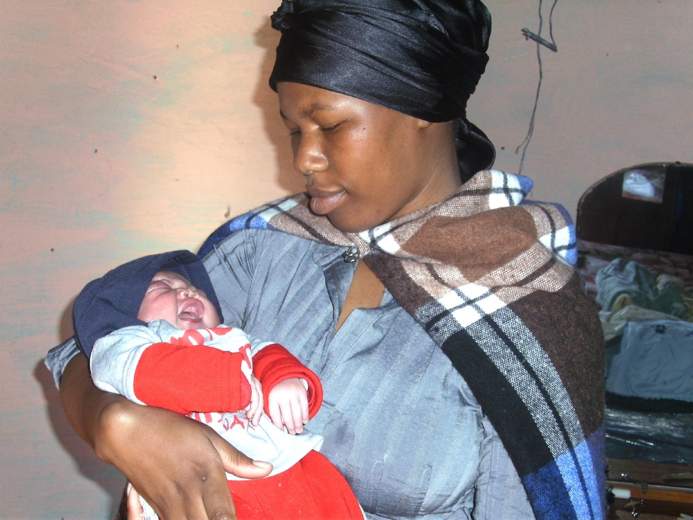
Obstetric and Neonatal-related outcomes
Obstetric
  Miscarriage
  Antepartum hemorrhage
  Caesarean section delivery
  Preterm birth RR 2.3
  Low Birth Weight RR 1.9
  Prolonged labour
  Delayed and decreased initiation of breastfeeding
  Jarde et al 2016 JAMA Psychiatry
  (Syst Rv and MA)
Health-seeking behaviour
  Antenatal care uptake ↓
  Uptake of health regimens ↓
  Neonatal infections, admissions, ICU ↑
  ↓ completion immunisations
Suicide
Photo: PMHP
Photo: PMHP

Slide 6

Role of postpartum hemorrhage (PPH) and mental health outcomes
Postpartum depression
  Systematic review, 9 studies from both HIC and LMIC: OR 1.28 (Schoretsanitis, 2023)
  Cross-sectional study, ~1 million women in South Korea: OR 1.55 (Youn, 2017)
  Longitudinal study, ~42 000 women in UK: adjusted HR 1.10 (Parry-Smith, 2021)
Postpartum Post Traumatic Stress Disorder
  Adjusted HR 1.17, not statistically significant (Parry-Smith, 2021)
  Systematic review, 5 studies all from HIC countries: no clear correlation found (Zaat, 2018)
Notes:
Schoretsanitis et al, 2023 (https://onlinelibrary.wiley.com/doi/10.1111/acps.13583): in a systematic review including 9 studies (940000 women, 6 HIC, 3 LMIC) an OR for developing PDD of 1.28 was found for women with PPH compared to without (although with high heterogeneity of 98.9%). Higher ORs were estimated for women with a history of depression/anxiety or antidepressant use and from low-middle income countries.
Youn et al, 2017 (https://www.sciencedirect.com/science/article/pii/S0022399917307730?via%3Dihub): cross-sectional study based on medical records of roughly 1 million women in South-Korea, linking birth complications to healthcare visits for depression following childbirth. OR of 1.55 for PPD following uterine arterine embolization (this outcome used in lieu of PPH), 0.1% vs 0.2%.
Parry-Smith et al, 2021 (https://www.sciencedirect.com/science/article/pii/S0022395621001667?via%3Dihub#sec3): longitudinal study in UK, roughly 42000 women included, based on data from electronic patient records, linking recorded PPH (based on ICD codes) and primary care visits due to adverse mental health outcomes. Women with a history of mental illness excluded. Significant increase in risk of developing postnatal depression after postpartum hemorrhage (4.75% vs 5.34%, adjusted hazard ratio: 1.10) (adjusted for age, BMI, ethnicity, SES, delivery mode and birthweight).
No statistically significant increase in risk of developing PTSD (0.17% vs 0.20%, adjusted hazard ratio: 1.17).
Zaat et al, 2018 (https://www.sciencedirect.com/science/article/pii/S0301211518301702?via%3Dihub): systematic review of studies on association between childbirth complications and postpartum PTSD, five studies included, all in high-income Western countries. Definition of PPH and PTSD varied between all studies. Not one study showed a clear correlation between PPH and postpartum PTSD. More research and specifically more uniform research is required.

Slide 7
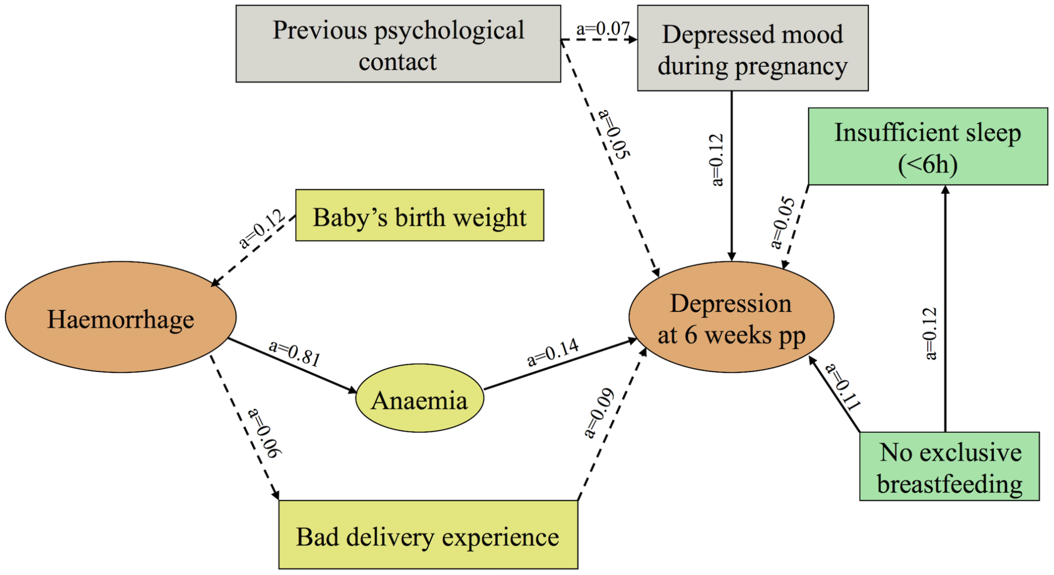
Role of anaemia
Depressive symptoms
  Meta-analysis: OR 1.53 for anemia during pregnancy (Kang, 2020)
  Cohort study, Sweden, ~500 women: OR 2.29 for postpartum anemia
  (Hb <11 g/dl or 6.8 mmol/L) (Eckerdal, 2016)
PTSD risk
  Prospective study, France, ~500 women: OR 2.7 – OR 4 for postpartum anaemia (Hb <9 g/dl or 5.6 mmol/L) (Sentilhes, 2017)
Figure: Eckerdal, 2016
Notes:
Kang et al, 2020 (https://www.sciencedirect.com/science/article/abs/pii/S0022395619309197?casa_token=56GyMT-IZGIAAAAA:QfUYwZbMg7LUaRZtOksOL04ax2QhIrnJHhyFfu4zAwN7ZjqB-9IxjNaYr77vWG7ENbNP6SH0hw): study already referenced in slide on risk-factors. Meta-analysis of 7 studies on association between anemia during pregnancy and PPD, mix of HIC and LMIC. OR of 1.53 found.
Eckerdal et al, 2016 (https://journals.plos.org/plosone/article?id=10.1371/journal.pone.0144274): cohort study in Sweden, roughly 500 women included (mostly healthy and highly educated) of which 196 experienced PPH, defined as >1000ml of blood loss. Edinburgh Postnatal Depression Scale self-administered at 6 weeks postpartum. Adjusted OR of 2.29 found for risk of significant depressive symptoms after postpartum anemia (Hb<110 g/L). No statistically significant association found for postpartum hemorrhage. Path analysis was performed in which PPH was suggested to indirectly influence risk of PPD through anemia and bad delivery experience (anemia p<0.05, bad delivery experience p between 0.05-0.20).
Sentilhes et al, 2017 (https://www.nature.com/articles/s41598-017-09314-x.pdf): prospective study in France, roughly 500 women filled in self-administered questionnaire one year after giving birth. Postpartum anemia (Hb <9 g/dl or 5.6mmol/L) independently associated with higher risk of PTSD at one year after giving birth, OR depending on questionnaire (4 for impact of event scale/IES, 2.7 for traumatic event scale/TES).

Slide 8
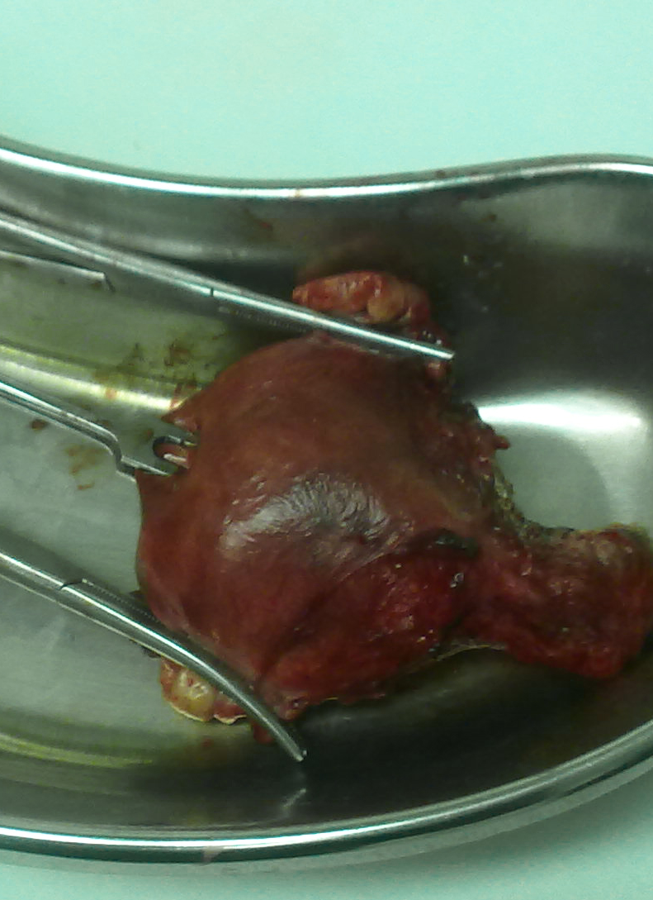
Role of peripartum
hysterectomy
Postpartum depression
  Cross-sectional study, South Korea, ~1 million women: OR 2.41 (Youn, 2017)
PTSD
  Retrospective study, France, ~35 women: 64% of patients (Michelet, 2015)
  Retrospective cohort study, US, ~400 women: Adjusted OR 15.48 (De la Cruz, 2016)
Notes:
Youn et al, 2017 (https://www.sciencedirect.com/science/article/pii/S0022399917307730?via%3Dihub): the same South-Korean cross-sectional study as mentioned previously for PPH. OR of 2.41 found for PPD following hysterectomy (0.1% vs 0.3%).
Michelet et al, 2015 (https://www.sciencedirect.com/science/article/pii/S1297958915003045): retrospective analysis of impact of emergency hysterectomy, France, 44 hysterectomies performed among 869 cases of PPH, of which 35 patients responded. Impact of event scale performed via telephone at median 26.5 months following hysterectomy. 64% of patients developed PTSD (IES>30). No controls so no odds ratio. High risk of selection bias.
De La Cruz et al, 2016 (https://link.springer.com/article/10.1007/s00404-016-4008-y): retrospective cohort study in the US, 409 women included of whom 74 underwent emergency hysterectomy (note: partly recruited from post-hysterectomy support group, so some bias in sampling). PSS PTSD score filled in online, average 4 years after hysterectomy or average 1.6 years after birth for non-exposed women. Adjusted odds ratio of 15.48 found for PTSD after emergency hysterectomy (adjusted for maternal age, social support, trauma history, history of mental illness, parity, delivery mode, time since delivery).
Link between peripartum hysterectomy and PTSD seems highly likely, more research required.

Slide 9
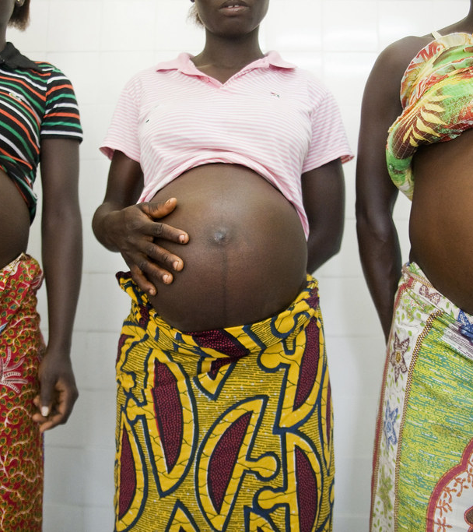
Experiences after PPH: South Africa
11 women in South Africa experiencing PPH- Severe Adverse Maternal Morbidity (SAMM)
Stellenbosch University Masters thesis
(J Bennett, 2019)
Included women with hysterectomy/stillbirth
Unstable relationships / no partner
Fear of death: sole carer for other children
Communication
Faith and spirituality
Self-blame
Notes:
Inclusion criteria required that participants experienced a severe obstetric haemorrhage as defined by WHO organs based SAMM criteria.
During the event, women not only feared for their own lives, but feared for the lives of and
futures of their babies, partners and other family members. The majority of the women
interviewed were single parents and the thought of life without them was overwhelming. Only 3 of the participants were in stable relationships.
Some of the participants expressed the impact of the lack of information passed onto them
from health care workers in the antenatal period, during the acute event and in the period
after. The lack of information led to a great sense of frustration for the women as they were
led into a state of confusion and started believing what they had been told by friends and
family members. Some only learnt about their diagnosis from the PI during the interview.
Surprisingly, some of the women who had a hysterectomy did not know this and furthermore
were shocked at the fact that they would no longer be able to carry a pregnancy.
Not being provided with adequate information regarding the location or status of their
newborn babies was a source of anxiety and frustration
Lwazi, who had an abruptio placentae with an IUD only learnt of the demise of her baby 2
days after delivery. She assumed that the baby was in NICU and when she was stronger, she
would go to visit
All but one of the women used religion and spirituality to transcend beyond the difficult
situation they found themselves in. The women felt that prayer was beneficial in helping them
cope with the acute event and most ascribe their survival to religious beliefs and prayer.
Following the acute event, when the women had an opportunity to ruminate over what had
happened, many questioned why this had happened to them. Some women viewed the event
as a form of punishment and blamed themselves for wrongdoing in the pregnancy or before.
Others blamed doctors or other health care workers as they felt that their situations were
avoidable and as a result of sub-standard care.
Anger: at themselves, their faith, their partners or health care professionals
Guilt was most commonly linked to self-blame. Women felt guilty for falling pregnant, not
terminating their pregnancies when advised to, over working, neglecting their health and
ignoring advice of medical practitioners. (Badly controlled diabetes, smoking during pregnancy)
One participant with particularly poor social circumstances felt isolated from
the world and described being “helpless” as she was abandoned by her partner and had no
visitors. What was particularly frustrating for her was being unable to move or speak while
she was being ventilated and worrying about her children surviving on their own at home.
Fifteen women participated with a mean age of 32.5 years. Most had a cesarean section, with uterine atony as the most common indication for EPH. Participants were all Caucasian and married; most had a 4-year college degree; and 66.7 percent lived in the United States, 20 percent in the United Kingdom, and 13.3 percent in Canada. Among the women, 53.3 percent had EPH with their first child. The most common indication for EPH was uterine atony (66.7%), followed by placenta accreta (13.3%); 66.7 percent had cesarean sections. The average maternal length of hospital stay was seven nights; 77.3 percent awoke after surgery on a ventilator and 86.7 percent were admitted to Intensive Care Unit (ICU).
Pain: Women's reports of exceptional pain were a consistent theme. Those with vaginal deliveries seem to report more pain during the hemorrhage, even if they received pain relief during delivery. ICU stays often involved severe pain, regardless of delivery type.
Fear: Many women reported fear during the hemorrhage, or more commonly, during the remaining hospital stay. While hemorrhaging, most participants relied on others' cues to assess the situation. Feelings of fear did not surface until baby was taken away, her partner was escorted out of the room, or personnel shouted for blood products.
Death & dying: Death and dying was a recurring theme. Most women were unaware of the situation's severity, and that death was a possibility. In fact, a number of participants felt calm and unafraid while hemorrhaging. A few women did feel they were dying. Talking about how they nearly died or could have died was often the most emotional part of the interview
Delayed emotional response: Most women described feeling numb after finding out about their hysterectomy, which delayed emotional reactions such as sadness, guilt or anger. If they did have an emotional reaction immediately, it was eclipsed by gratitude and relief at surviving. While in the hospital, attention focused on their physical recovery and newborn care. The emotional impact of their experience manifested much later, not often at the time of hospitalization. Because of the delayed emotional reaction, being psychologically assessed in the hospital was not a good indication of psychological health.
Need to know: Women desired information at all phases of their experience. After the hysterectomy, the need for information became acute. Women wanted to know what, how, and why everything happened. Practitioners who filled in these blanks helped them accept what had occurred and gave them closure.
During the hemorrhage, knowing the procedures that were being attempted, and what outcomes were possible was helpful. Because of the emergent nature of hemorrhage, signing consent for the hysterectomy was typically rushed, and most signed without a full understanding. A few questioned the necessity of the hysterectomy, which created regret and resentment.
Communication: Communication was a central theme that permeated the interviews, not only in what information to communicate, but when and how. While hemorrhaging, many women described feeling calm, even when vaguely aware of the severity of the situation. This experience may be related to hypovolemic shock, but it appeared to be affected by the level of calm projected by staff. Women expressed a particular need for compassion, respect, and sensitivity in the provision of care. In addition to facing their own mortality, they faced the loss of the perfect birth experience, and the loss of an organ tied to femininity and fertility. They had a need for practitioners to acknowledge feelings of grief, whether in the hospital or at follow-up.Women who received excellent care involving attentiveness, sensitivity, and compassion expressed profound appreciation. A few described health care practitioners becoming emotional themselves, which was supportive and meaningful.

Slide 10
Possible interventions
During Hemorrhage and Hysterectomy | During Hospital Recovery | During Follow-up
Project calm Communicate Manage pain Compassion Empowerment | Point person Communicate Seamless transfer Contact baby Breastfeeding Do not leave alone Refer emotional support Debrief Manage pain Compassion Acknowledge grief/loss | Additional follow-up and screening Refer emotional support Detailed debriefing Compassion Acknowledge grief/loss
Adapted from De la Cruz, 2013
Notes:
Phase I: Hemorrhage and Hysterectomy
Project calm atmosphere when possible
Communicate what is happening
Manage pain or explain why not possible
Be compassionate and respectful
Promote a sense of empowerment and control
Phase II: Hospital Recovery
Identify point person to facilitate communication
Ensure seamless transfer between nurses
Provide early contact with baby
Support breastfeeding if desired; set up with lactation consultant
Allow flexible visitation for mother’s and baby’s visitors; do not leave alone
Provide referrals for emotional support, even if no apparent need
Conduct debriefing of events
Manage pain or explain why not possible
Be compassionate and respectful; acknowledge feelings of grief/loss
Phase III: Follow-up
Provide minimum of one additional follow-up, and more as needed
Provide referrals for emotional support, even if no apparent need
Conduct more detailed debriefing of events
Be compassionate and respectful; acknowledge feelings of grief/loss

Slide 11
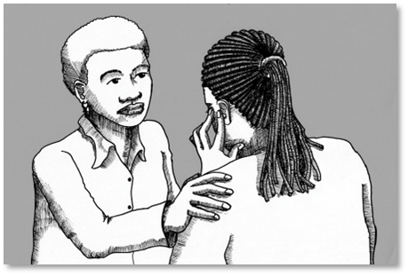
Take-home messages
Links between PPH and negative mental health outcomes
  Consider impacts of anaemia and hysterectomy
Targeted mental health interventions should be considered for at-risk women
Further research required
  Causal pathways
  Resource poor settings
Thank you
Simone.honikman@uct.ac.za
www.pmhp.za.org
Illustr: Graeme Arendse

